Slide 1
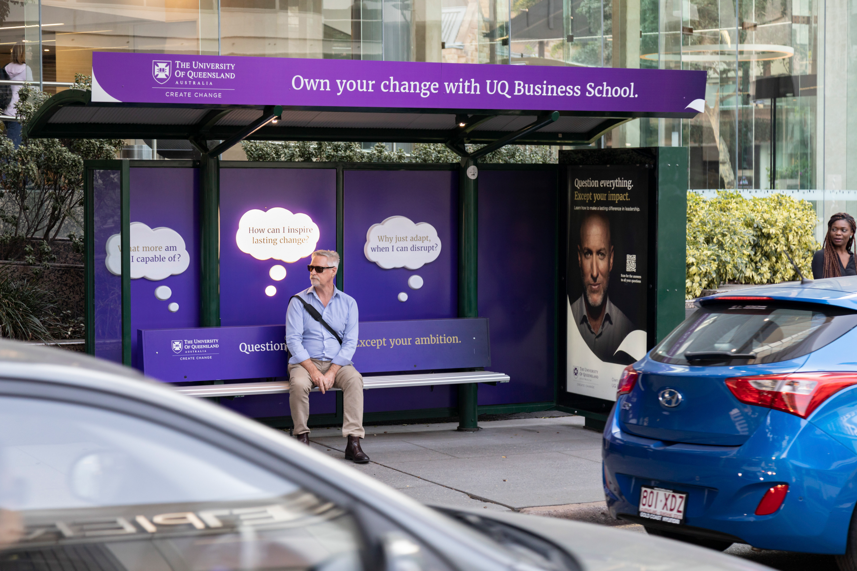
Anatomy of Out of Home: the best of 2019
November 2019

Slide 2
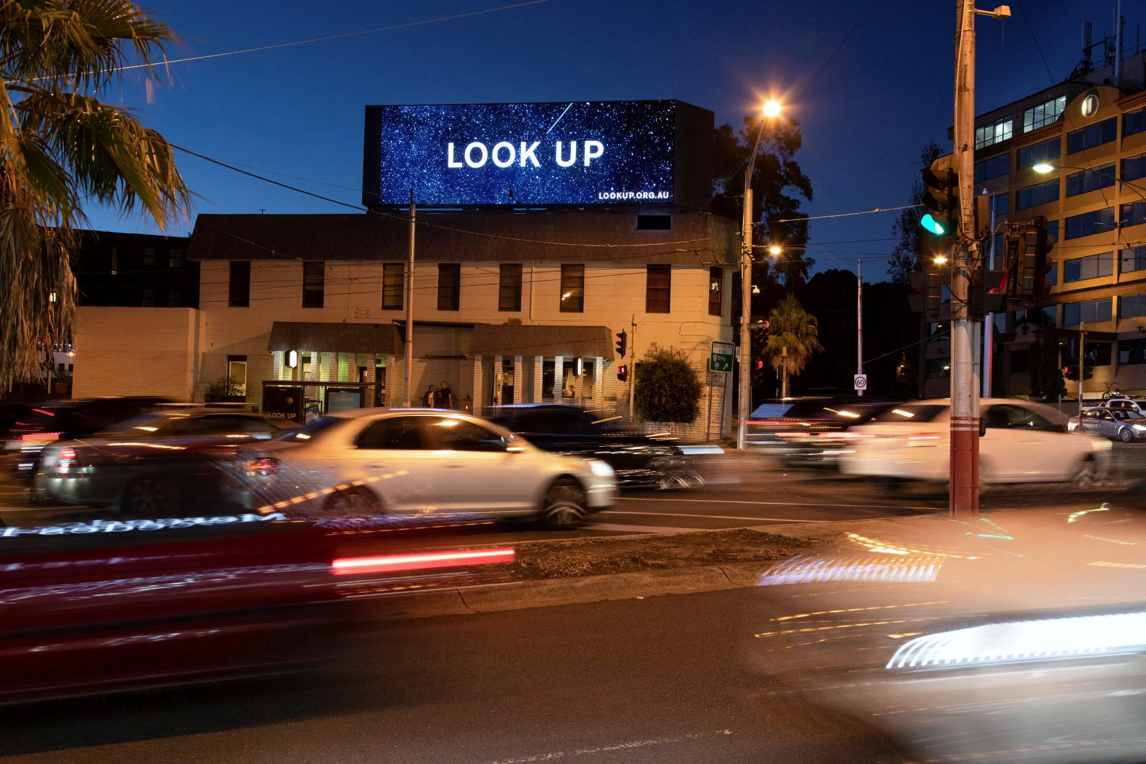
IN 2019 THE OUTDOOR INDUSTRY ASKED 12.8M* AUSTRALIANS TO
LOOK UP
* Total reach of the Jan/Feb campaign

Slide 3
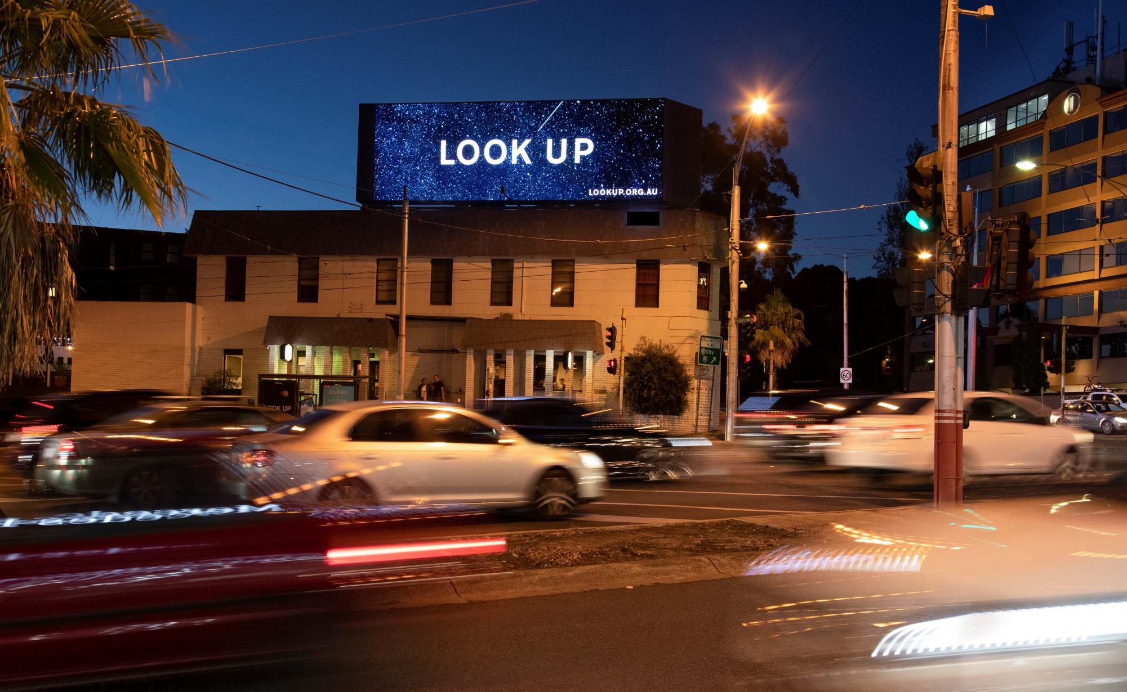
The LOOK UP campaign showcased
Outdoor’s brand building prowess
Drove recall
Started
conversations
Changed
behaviour
Inspired
curiosity
10x
1
3
33%
50%
out of
people surveyed remembered the campaign
of those who recalled the campaign said they talked about it to friends or family
of those who recalled the campaign said they were now making a conscious effort to Look Up
higher online paid searches for ‘Look Up’ than average, showing that the campaign piqued curiosity to find out more
Source: OMA Look Up post Jan/Feb campaign survey – July 2019 AOOH

Slide 4
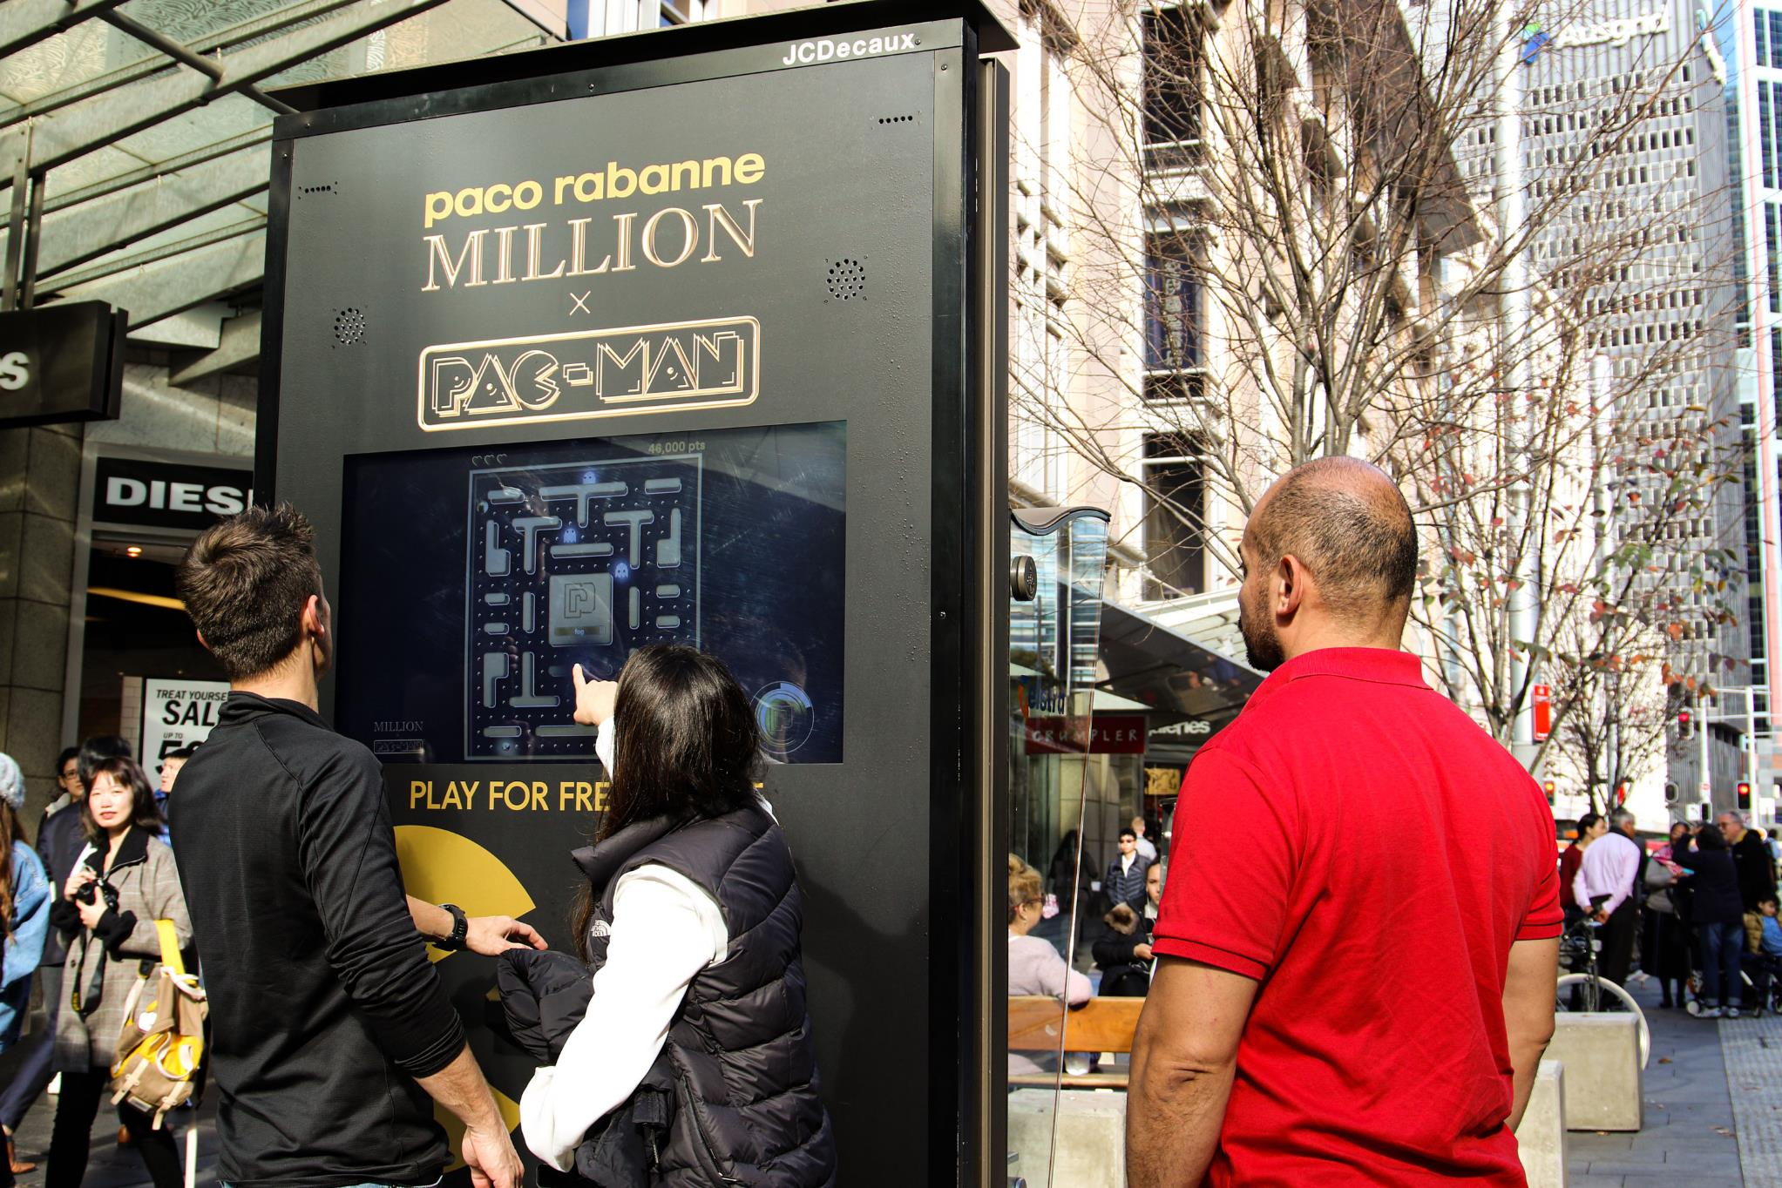
IN 2019 WE SAW THAT OUTDOOR IS EFFECTIVE IN REACHING GEN X, Y & Z

Slide 5
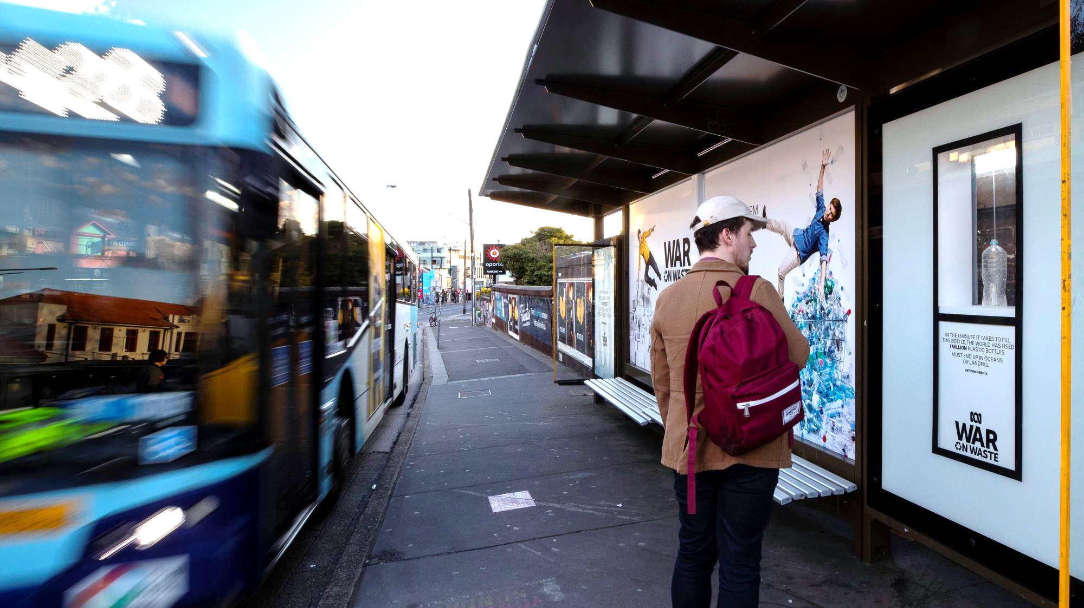
Gen X, Y & Z prefer Outdoor
Outdoor
is the
Outdoor
is the
Outdoor changes behaviour
Outdoor
campaigns are shared
1st
2nd
87%
1
4
out of
preference compared to all Online formats for Gen X and 2nd only to Mobile Reward Videos for Gen Z & Y
most preferred traditional media channel for Gen Z and equal with Television for Gen Y
uplift* in the activity of Looking Up when out & about by 18-44s vs 50% for all people
US adults have posted an image of an Outdoor campaign to Instagram
Source: Kantar Millward Brown. Click here to read
Source: Kantar Millward Brown. Click here to read
Source: *OMA Look Up post Jan/Feb campaign survey
Source: Nielsen research Click here to read

Slide 6
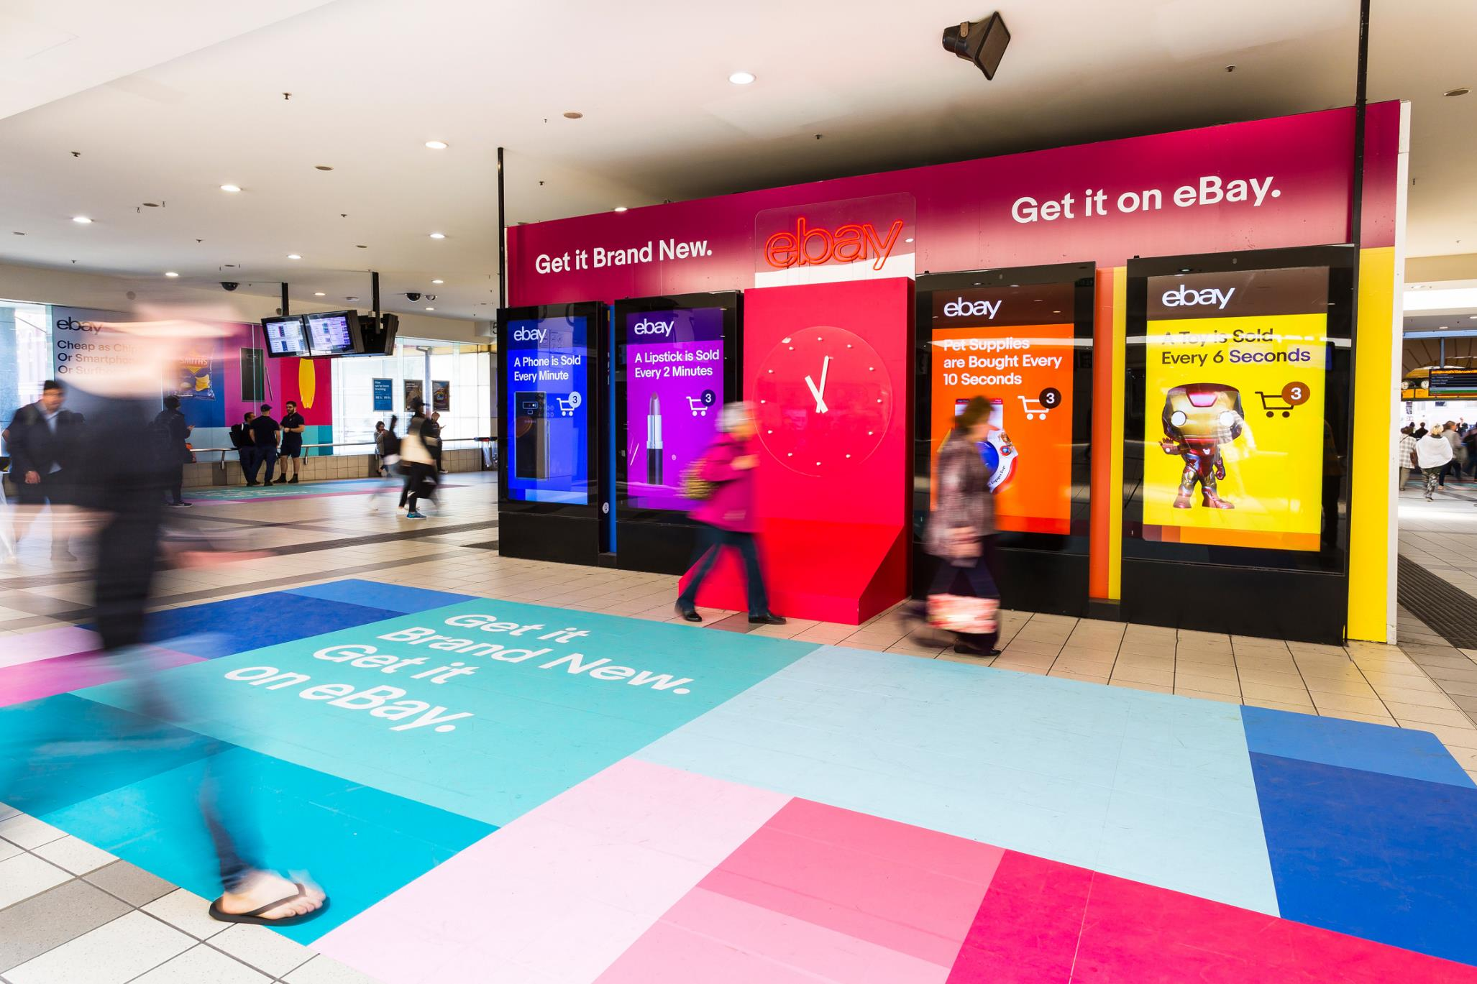
IN 2019 WE SAW THAT OUTDOOR + MOBILE = RESULTS

Slide 7
Outdoor + Mobile = Results
Outdoor
drives Mobile actions
Outdoor increases store visits
Outdoor primes Mobile campaigns
+127%
+38%
+48%
uplift in store visits when the audience is exposed to DOOH + Mobile
uplift in smartphone actions to the brand when Outdoor is seen
People are 48% more likely to click on a mobile ad if they have seen the same ad first on Outdoor
Source: IAB, “Mobile causes visitation lifts for video game marketer to be off the charts.” View full case study here. For more details and more mobile and OOH case studies click here
Source: : Outsmart OutPerform study, click here for more details and downloads
Sources: Ocean Outdoor research. Click here for more details

Slide 8
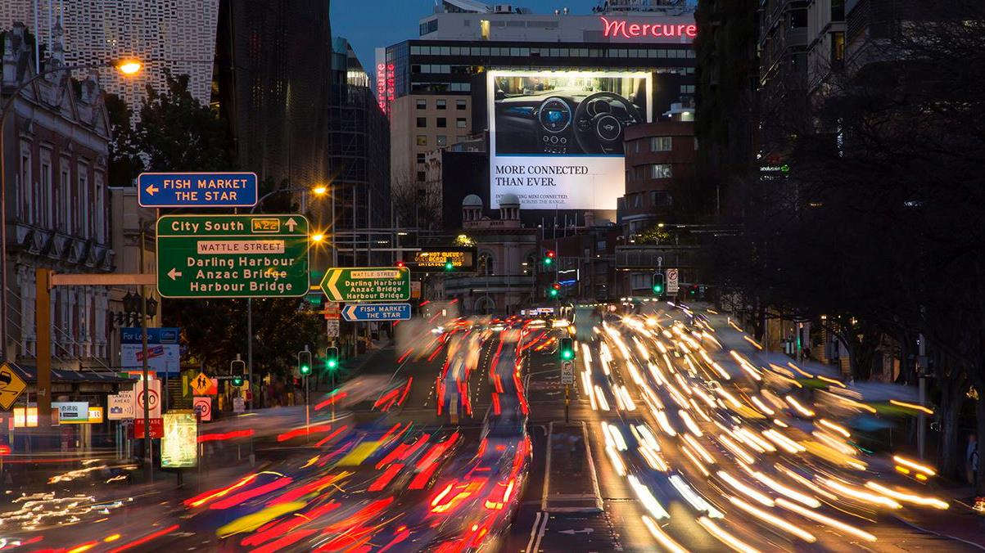
In 2019 OUTDOOR AUDIENCES GREW AGAIN

Slide 9
The MOVE 2019 update showed audience growth and increased reach
Outdoor audiences have grown by
Outdoor
audiences grew
Outdoor reach is increasing
217K
2.4%
29%
in 2019 vs population growth of 1.5%
since 2010 vs19% for the population
Change in audience for the same signs year on year since the launch of MOVE.
more people* are in Outdoor environments each day.
*on average
Source: MOVE October 2019 data release – October 2019 AOOH
Source: MOVE October 2019 data release – October 2019 AOOH

