Slide 1
Out of Home is part of award winning campaigns
April 2020

Slide 2
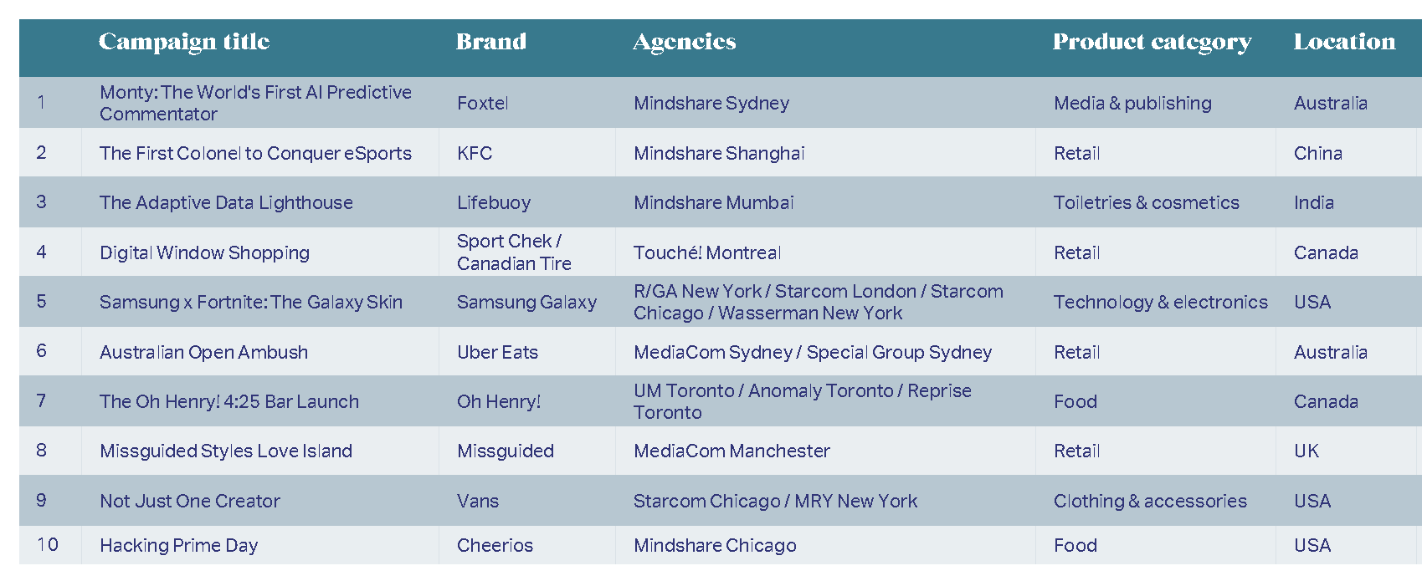
2019’s top ten award winning campaigns – according to WARC 100
9 in 10
Australians leave home each day
Click here for the methodology WARC uses to compile the ranking

Slide 3
More than half of the top campaigns used Out of Home
Out of Home was part of the plan for
55%
9 in 10
Australians leave home each day
of the top 100 media strategies for 2019, up from 46% in 2018. Second only to social media, in 65% of campaigns. Television was present in 18%, down from 55% the previous year.
Source: WARC Top 100 media rankings report. WARC subscribers can get more details here

Slide 4
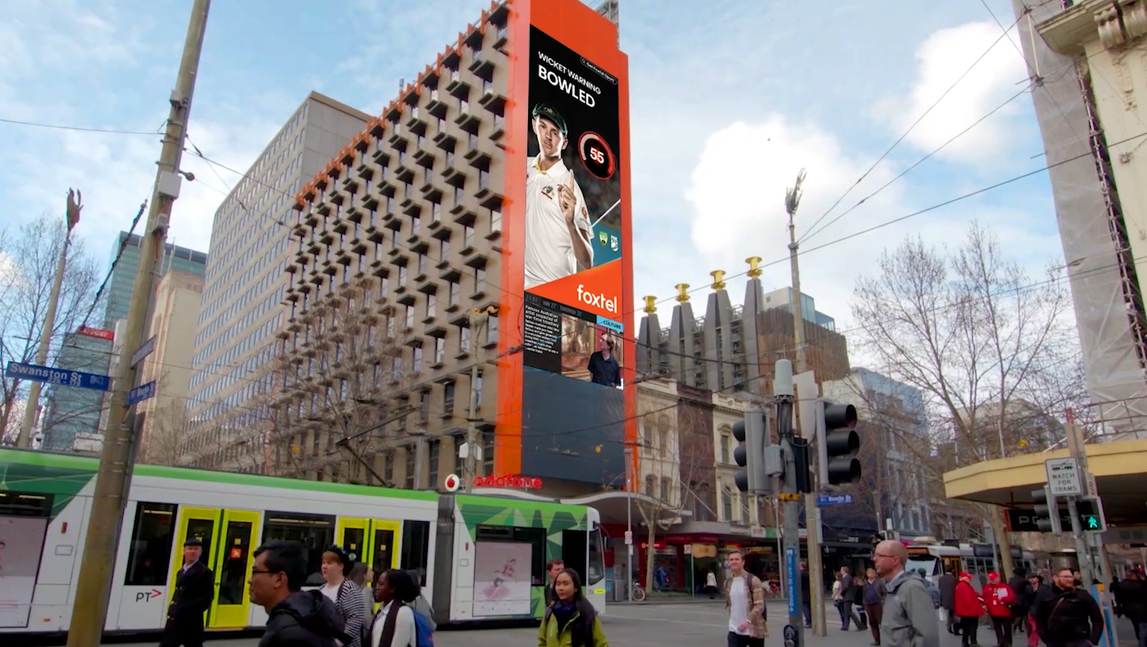
The #1 campaign was on Australian Out of Home
Fox Cricket’s AI Monty delivered an
18%
9 in 10
Australians leave home each day
increase in average weekly subscribers, while Fox Cricket became the #1 channel for share on Foxtel. Fox Cricket: Monty – The world's first AI predictive commentator was used to engage passive viewers and predict ‘lean in’ moments.
Source: WARC Top 100 rankings for 2020; WARC subscribers can click here and the Case Study for more info

Slide 5
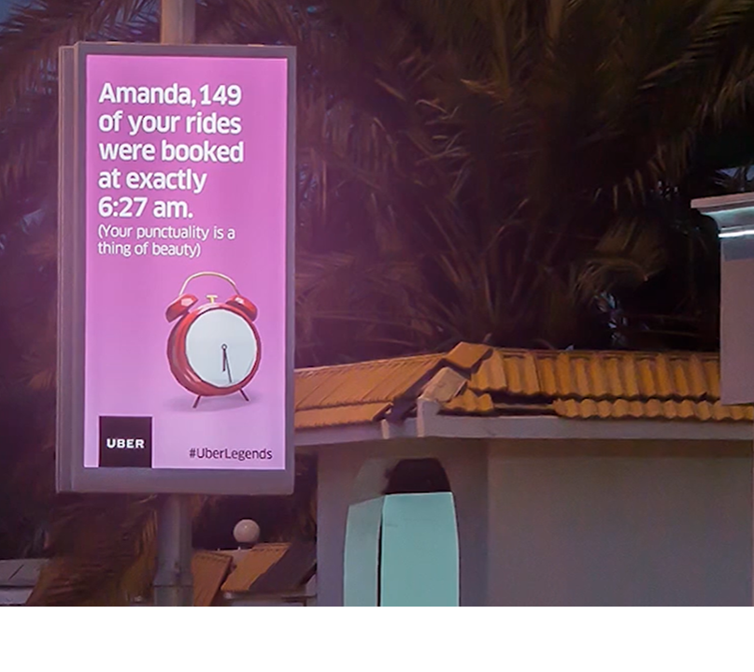
Out of Home and Online integration supercharged award winning campaigns
Uber social media followers increased
115%
9 in 10
Australians leave home each day
and engagement rose 192% as a result of the Uber Legends campaign incorporating Uber riders' data into entertaining branded content. Converting Uber riders into brand advocates.
Source: WARC Top 100 rankings for 2020; WARC subscribers can click here and the Case Study for more info

Slide 6
Anatomy of Out of Home

