Slide 1
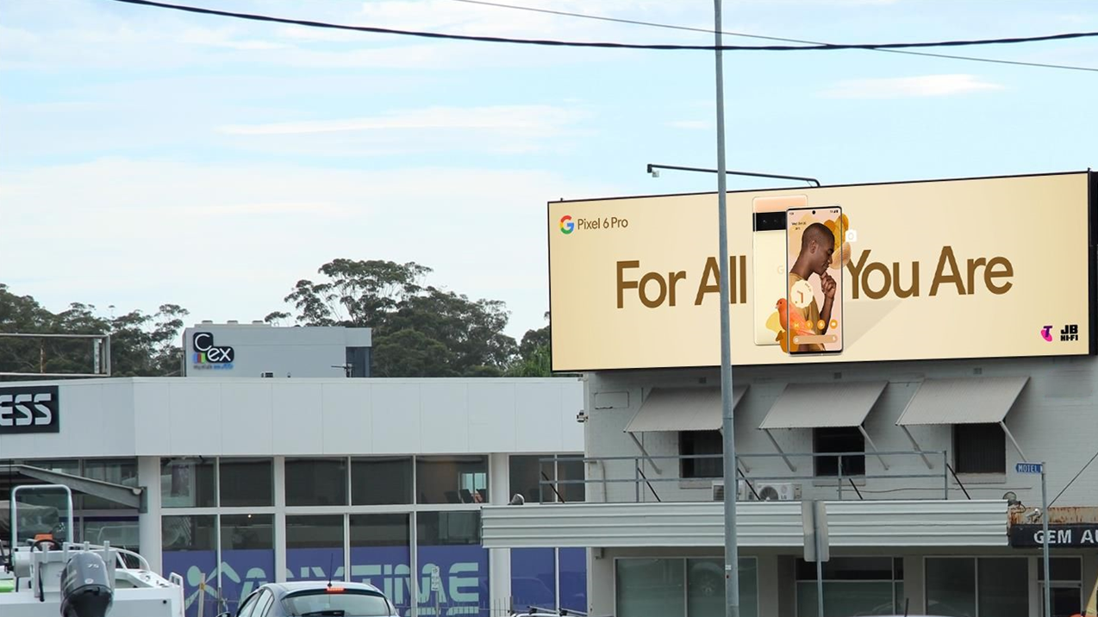
OOH works at every stage of the funnel
August 2022

Slide 2
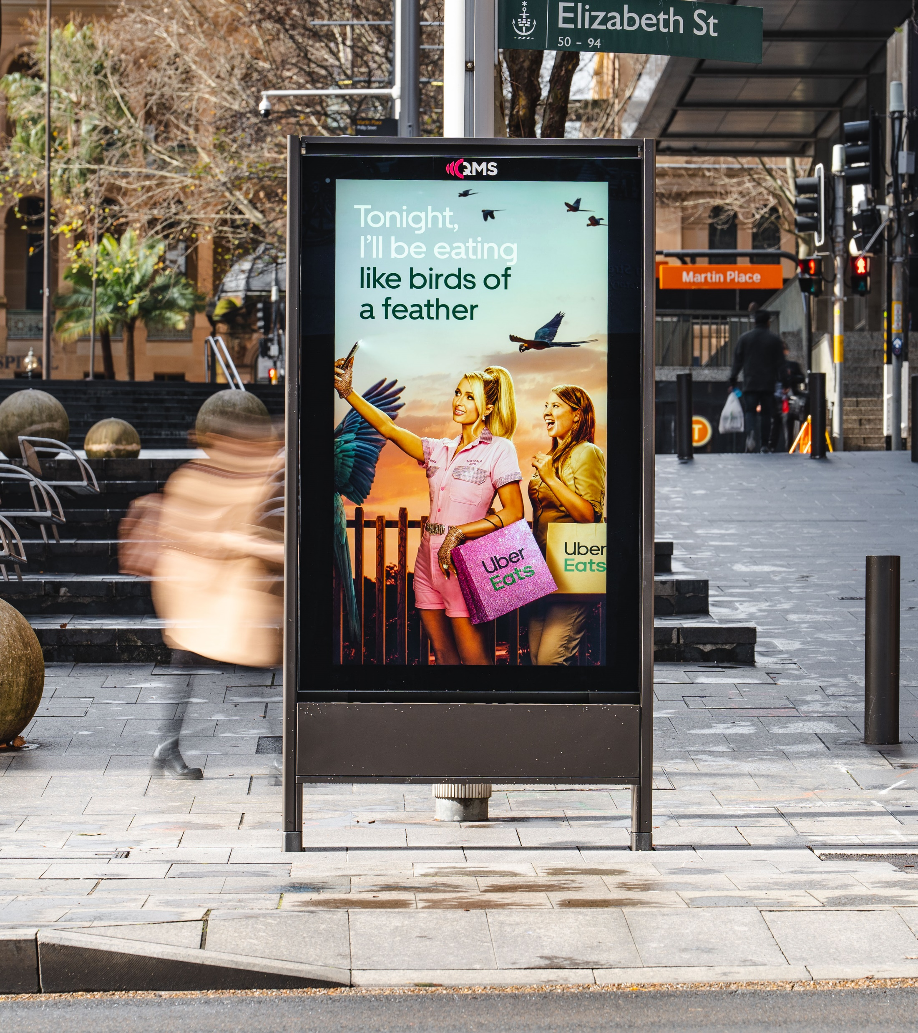
Where is Out of Home in the sales funnel?
According to a study by the Outdoor Advertising Association of America (OAAA) done in May this year, Out of Home (OOH) while remaining at the top of the funnel for High Impact is also moving down the funnel, driving action and spurring purchases.
In this month’s Anatomy of OOH, we dig into the study to see how OOH and Online work together to increase ROI.
Source: OAAA Comscore Online Activation Study, May 2022

Slide 3
OOH drives online search
41%
of people who see an OOH ad will use a search engine to gain more information about the product or service.
Source: OAAA Comscore Online Activation Study, May 2022

Slide 4
OOH helps activate online video viewing
30%
of people searched for a video after seeing an OOH ad.
Source: OAAA Comscore Online Activation Study, May 2022

Slide 5
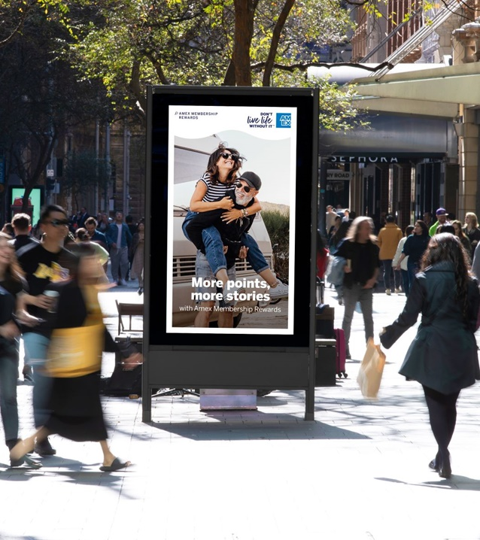
OOH drives website traffic
28%
of people visited a website after seeing an OOH ad.
Source: OAAA Comscore Online Activation Study, May 2022

Slide 6
OOH drives online sales
20%
of people exposed to an OOH ad make a purchase online.
Source: OAAA Comscore Online Activation Study, May 2022

Slide 7
More research and insights may be found at Anatomy of Out of Home

