Slide 1
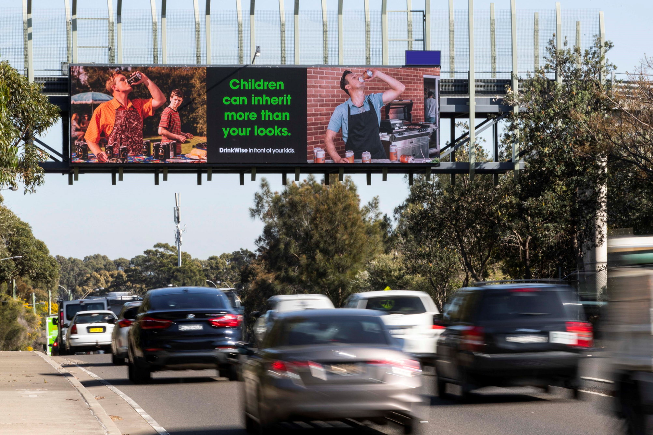
How to use Outdoor advertising to influence: A DrinkWise case study
February 2020

Slide 2
What does the campaign tell us?
The DrinkWise Out of Home campaign is a partnership between the Outdoor Media Association and DrinkWise to raise awareness for adults and parents for how they consume alcohol in front of their children. Commencing in July 2018, the campaign has just finished its fourth tranche in January 2020. The following data shows impact and effectiveness from 2019 to 2020 campaign surveys.

Slide 3
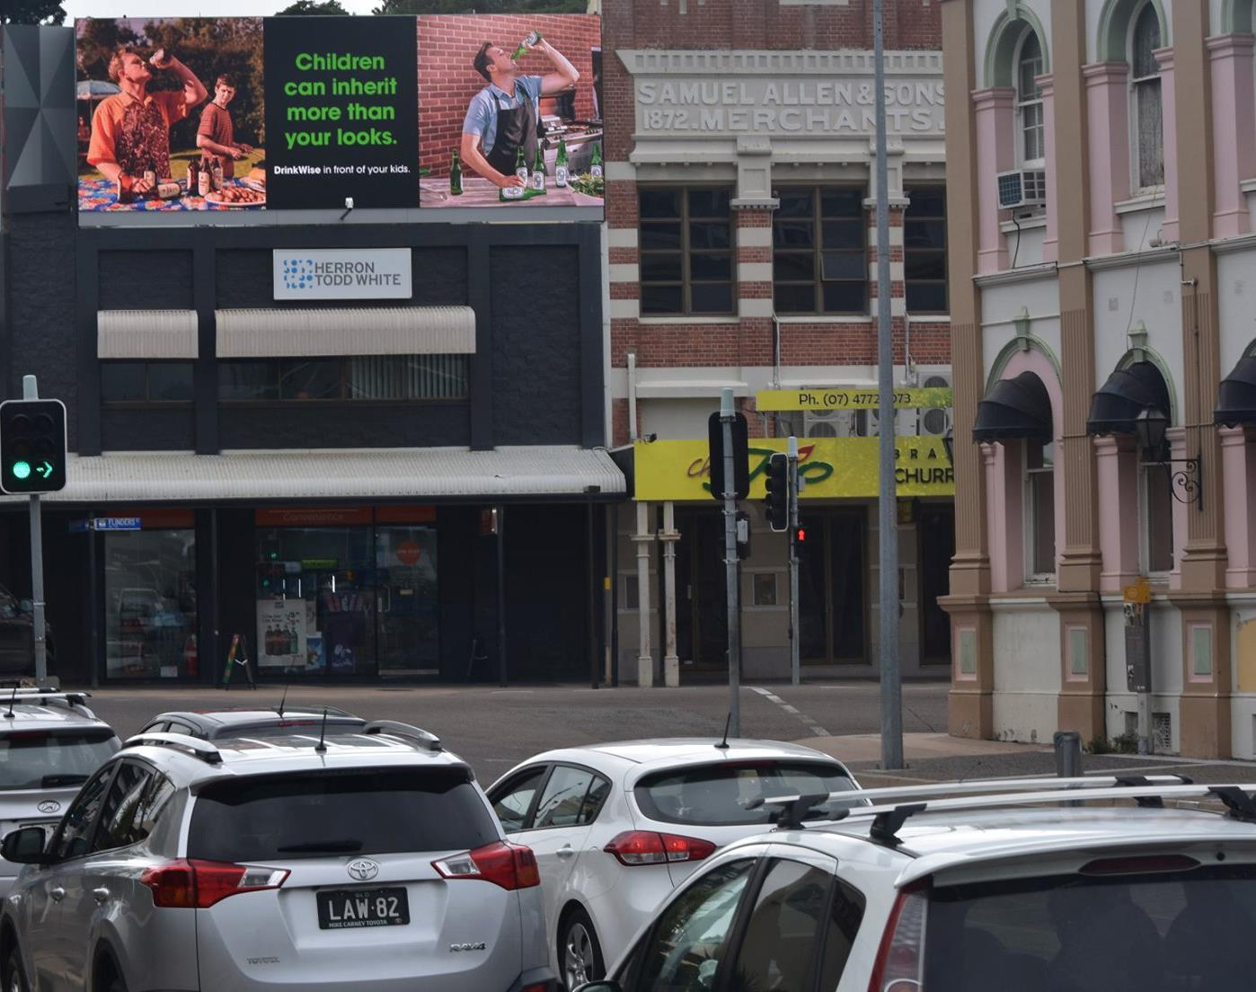
Out of Home drives recall
After the campaign ran in 2020
54%
of people surveyed remembered seeing a responsible drinking ad in the last month, up from 40% in 2019
Source: Dynata ad hoc surveys, June 2019 and January 2020.

Slide 4
Out of Home starts conversations
After the campaign ran in 2020
44%
of people who saw the campaign said they discussed it with other people, up from 33% in 2019
Source: Dynata ad hoc surveys, June 2019 and January 2020.

Slide 5
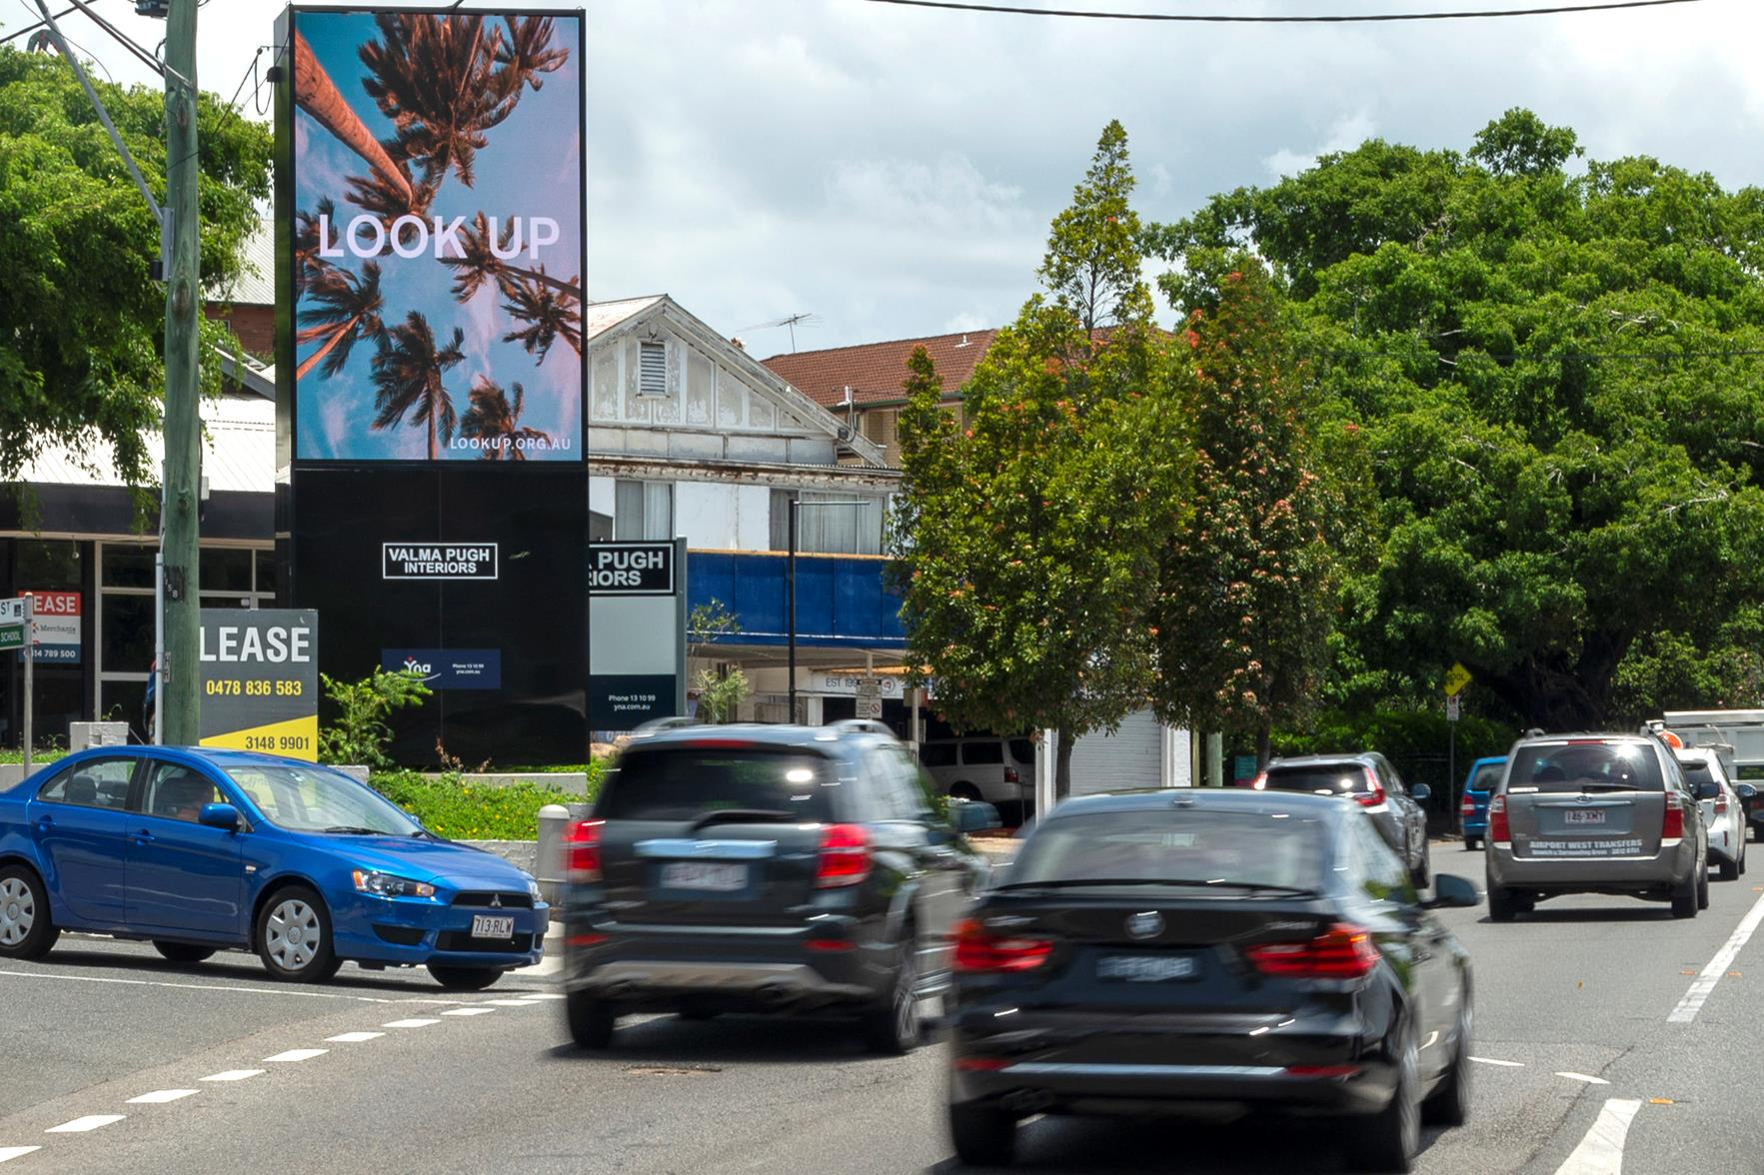
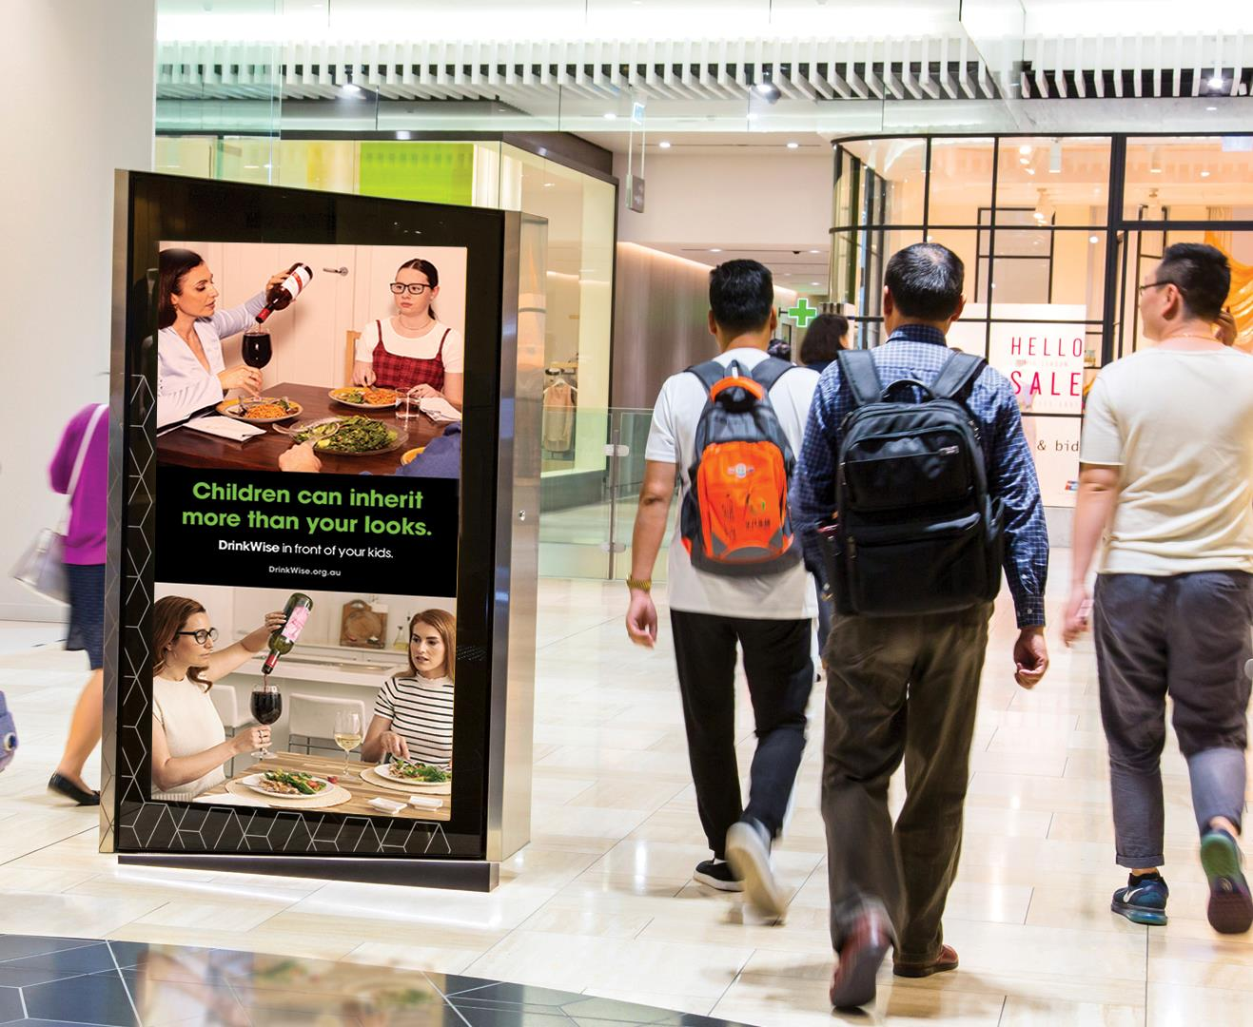
Out of Home influences behaviour
After the campaign ran in 2020
25%
of people who saw the campaign agreed they drink more moderately after seeing the ads, up from 24% in 2019
Source: Dynata ad hoc surveys, June 2019 and January 2020.

Slide 6
The DrinkWise campaign increased in effectiveness over time
Survey Results
July 2019 and January 2020
Survey responses show increased recall and action from 2019 to 2020
9 in 10
Australians leave home each day
Source: Dynata ad hoc surveys, June 2019 and January 2020.

Slide 7
Out of Home inspires positive campaign engagement
Of those who saw the DrinkWise campaign in 2020
Of those who saw the DrinkWise campaign in 2020
91%
57%
9 in 10
Australians leave home each day
said they liked it
said they think it is ‘good for society’
Source: Dynata ad hoc survey January 2020.

Slide 8
More research and insights may be found at Anatomy of Out of Home

