Slide 1
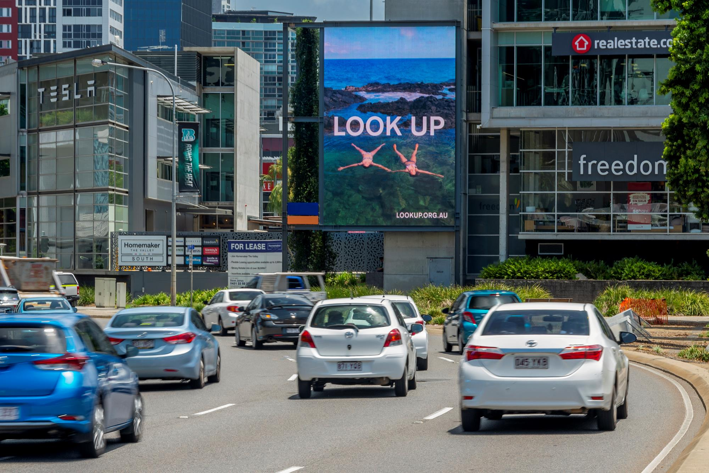
Survey results reveal people are Looking Up more
January 2020

Slide 2
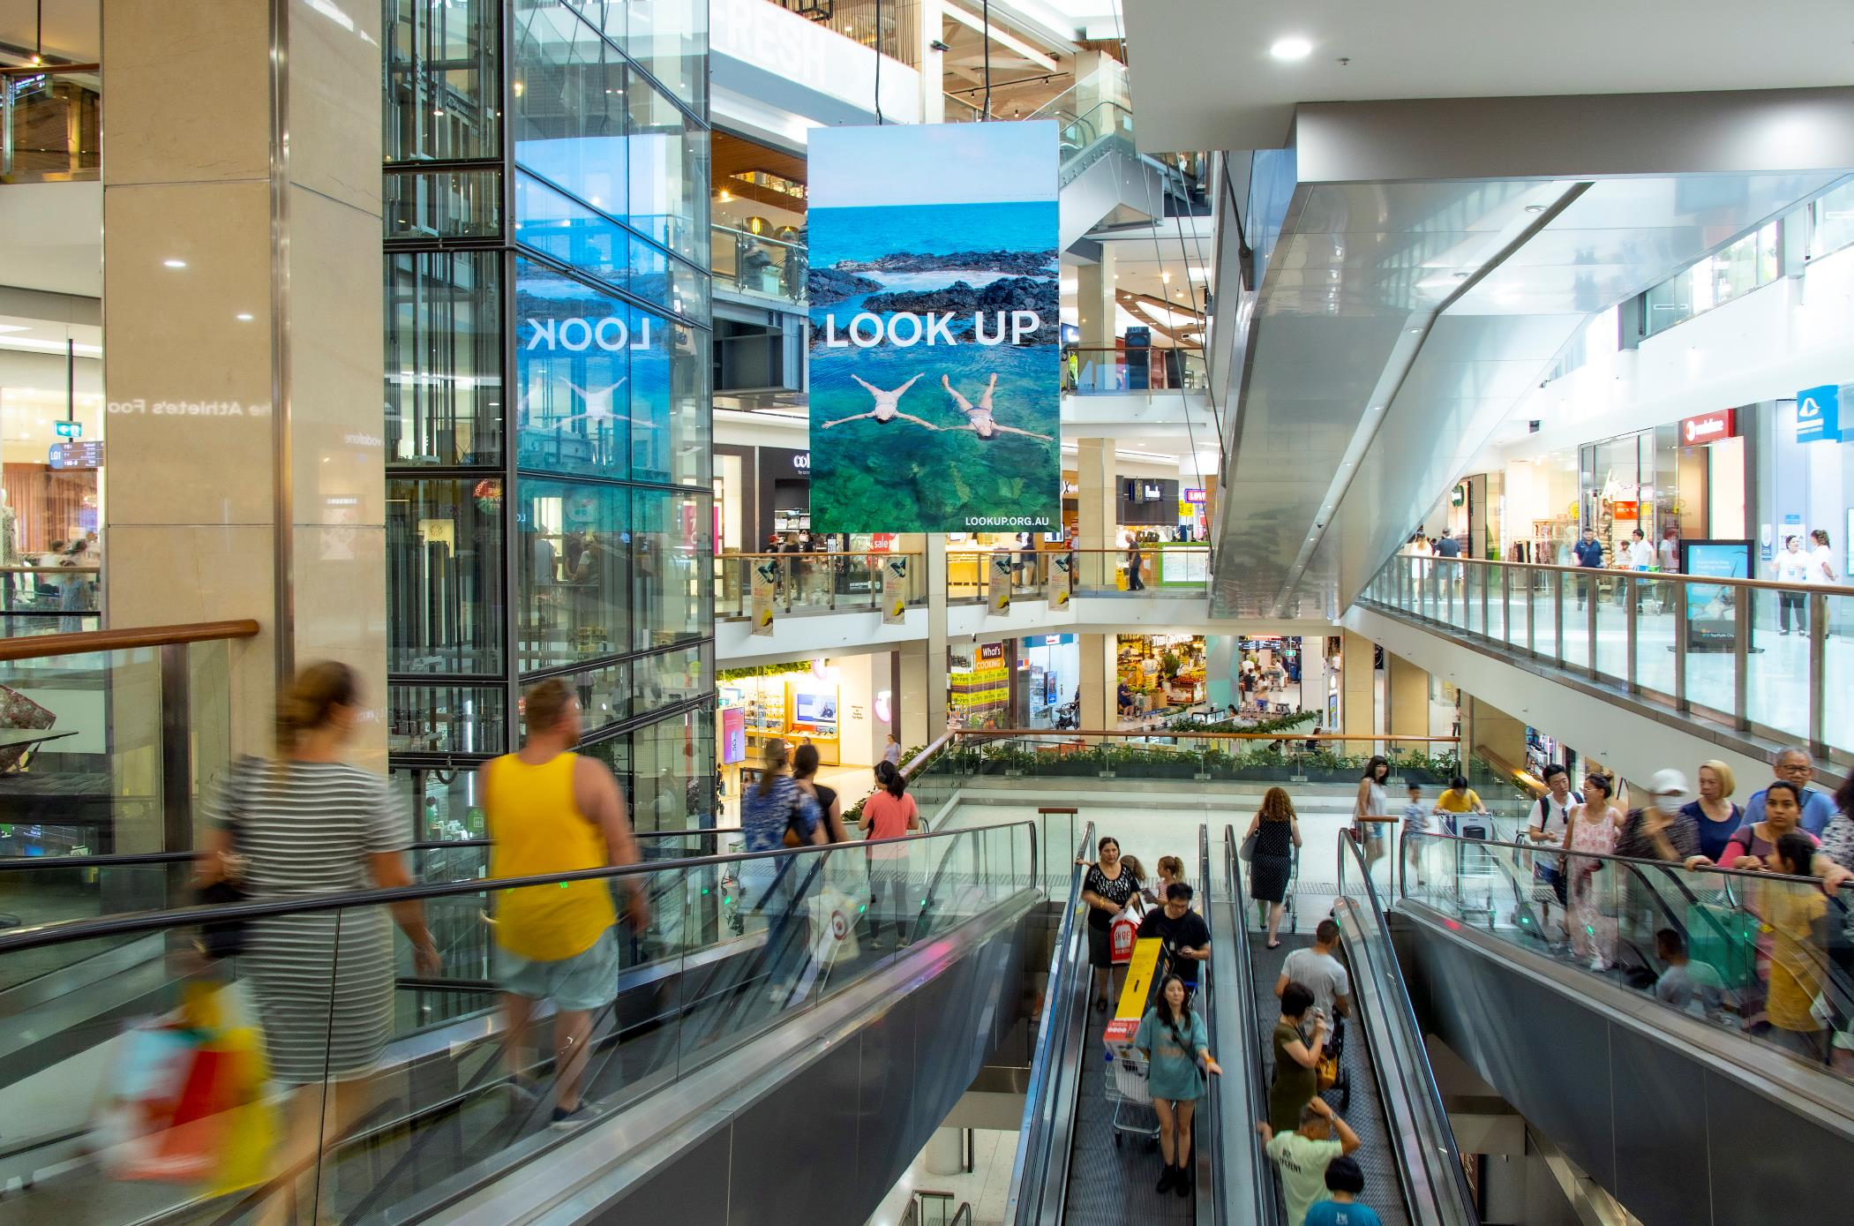
The ‘Look Up’ campaign achieved broadcast reach
Phase 1
4 weeks
Jan/Feb 2019
Phase 2
8 weeks
July/Aug 2019
Combined:
Phases 1 & 2
90%
87%
93%
Total reach of People 14+*
12.8M people
Total reach of People 14+*
12.3M people
Total reach of People 14+*
13.4M people
*Combined MOVE audience result across all five primary coverage areas: Sydney, Melbourne, Brisbane, Adelaide and Perth. Phase One was the launch and Phase Two consisted of fewer signs for a longer duration.

Slide 3
What does the campaign tell us?

Slide 4
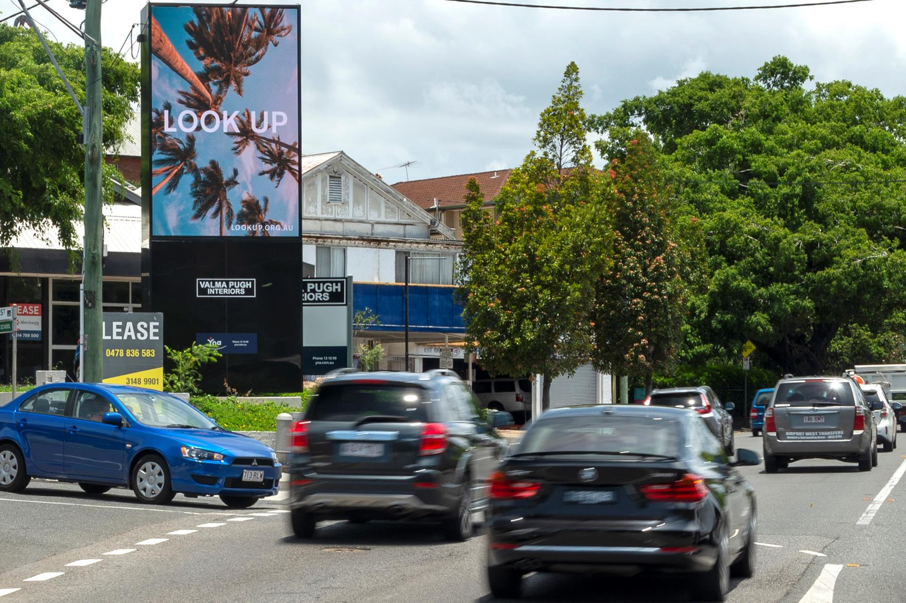
Out of Home drives recall
After Phase Two of the campaign
1
2
*
out of
people surveyed remembered seeing Look Up (*45%). An increase from 1 out of 3 after Phase One.
Source: Dynata Adhoc surveys: Phase One February 2019, n=2,003; Phase Two September 2019, n=1,199.

Slide 5
Out of Home influences behaviour
Of people who recalled Phase Two of the campaign
67%
said they’re trying to Look Up more; an increase from 50% after Phase One.
Source: Dynata Adhoc surveys: Phase One February 2019, n=2,003; Phase Two September 2019, n=1,199.

Slide 6
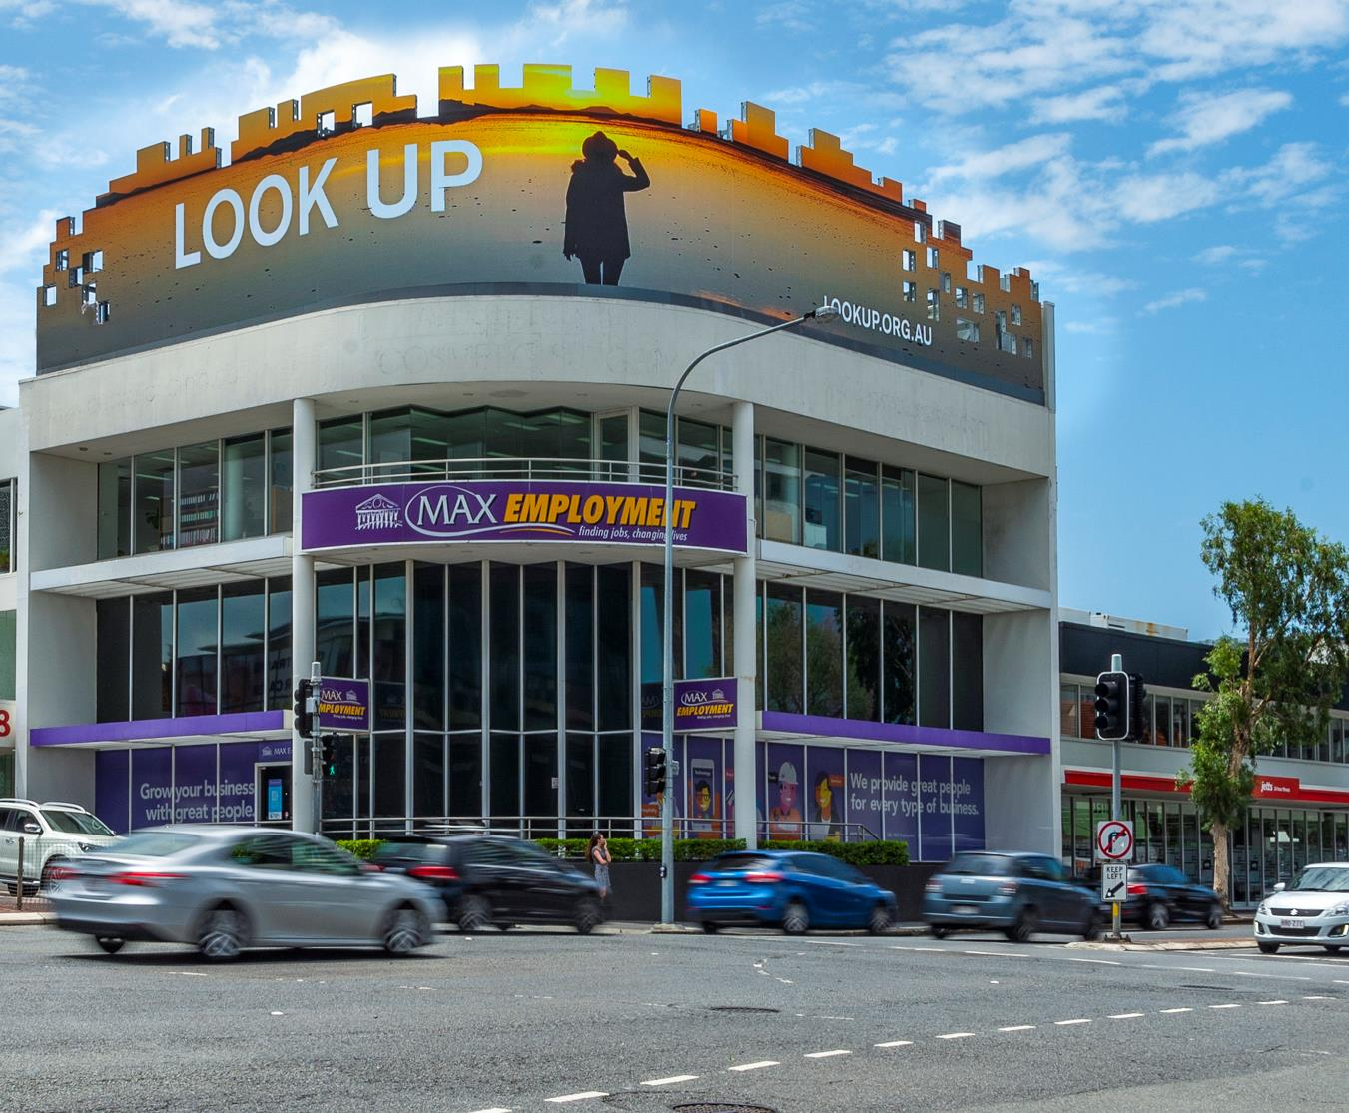
Out of Home sparks conversations
Of people who recalled seeing Look Up in Phase Two
48%
said they talked about it to friends or family, an increase from 30% after Phase One.
Source: Dynata Adhoc surveys: Phase One February 2019, n=2,003; Phase Two September 2019, n=1,199.

Slide 7
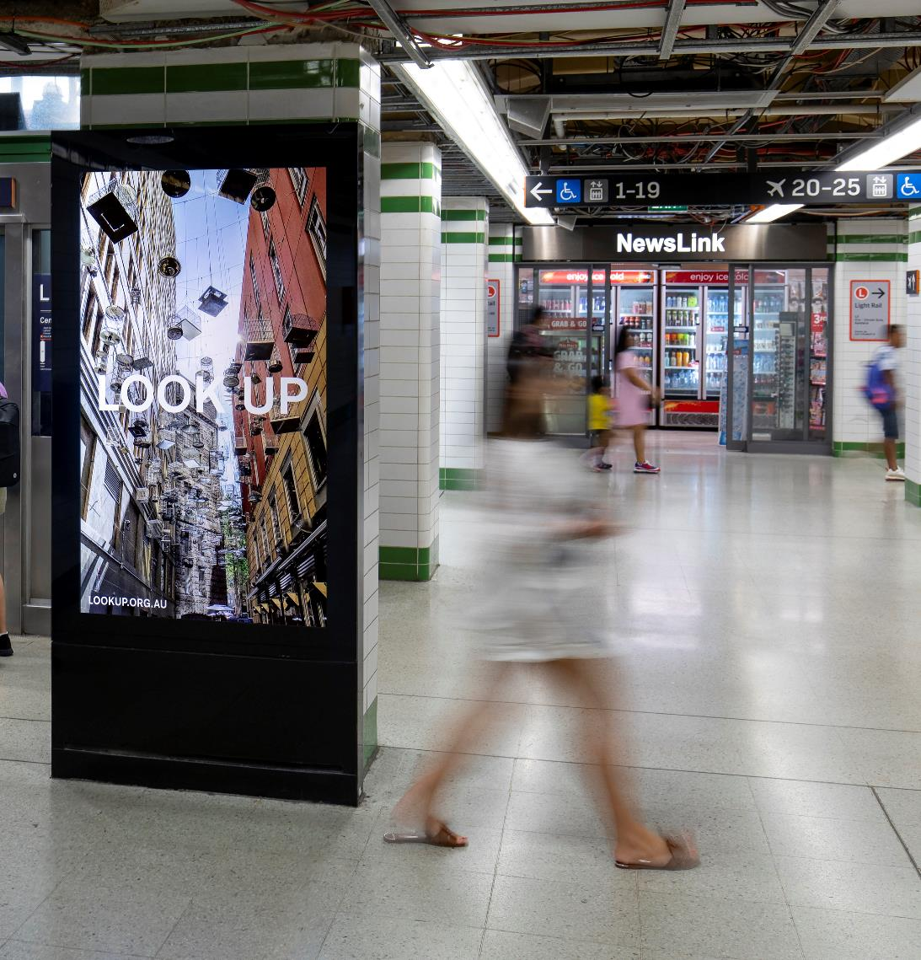
Out of Home inspires action
Paid and organic searches were
10^{x}
higher for ‘Look Up’ than average, showing that the campaign piqued curiosity at launch.
Source: Phase One launch, with Phase two seeing 3x higher online searches

Slide 8
Campaign effectiveness improved from Phase One to Phase Two
Awareness grew by
Behaviour changed with
There were more conversations with
34%
34%
60%
from 33% in Phase One to 45% in Phase Two*
more people saying they were trying to Look Up
more people saying they talked about Look Up with friends or family
*Phase Two was a smaller campaign, with approximately 85% less signs to Phase One (launch).
Source: Dynata Adhoc surveys: Phase One February 2019, n=2,003; Phase Two September 2019, n=1,199.

