Slide 1
LOOK UP: A CASE STUDY IN BRAND BUILDING
July 2020

Slide 2
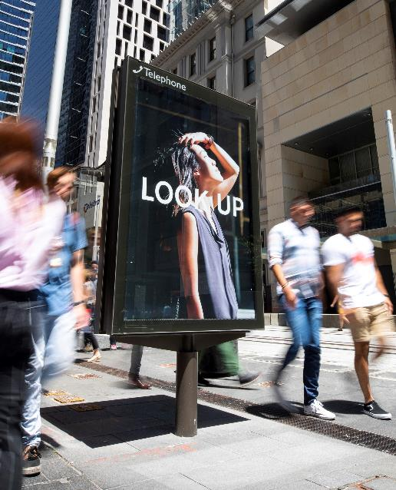
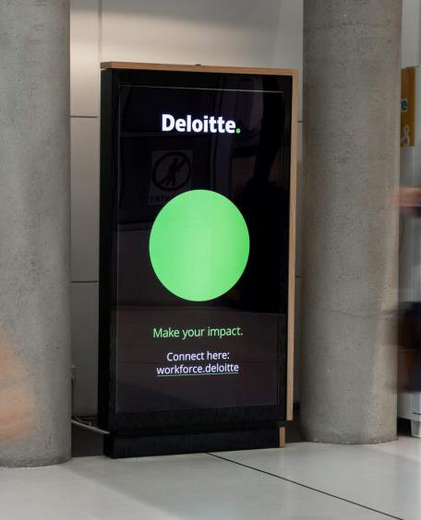
What is Look Up?
About the campaign
Look Up is a bid to engage people in an action that neuroscience research tell us has a significant positive impact on the way we think and interact with the world around us.
The campaign was run in three phases: Phases One and Two in January and September 2019, and Phase Three in January 2020.
Each phase was followed by a survey to assess RECALL, TALKABILITY and CHANGE OF BEHAVIOUR.
This is what we found.
For more information about the Look Up campaign, visit lookup.org.au.

Slide 3
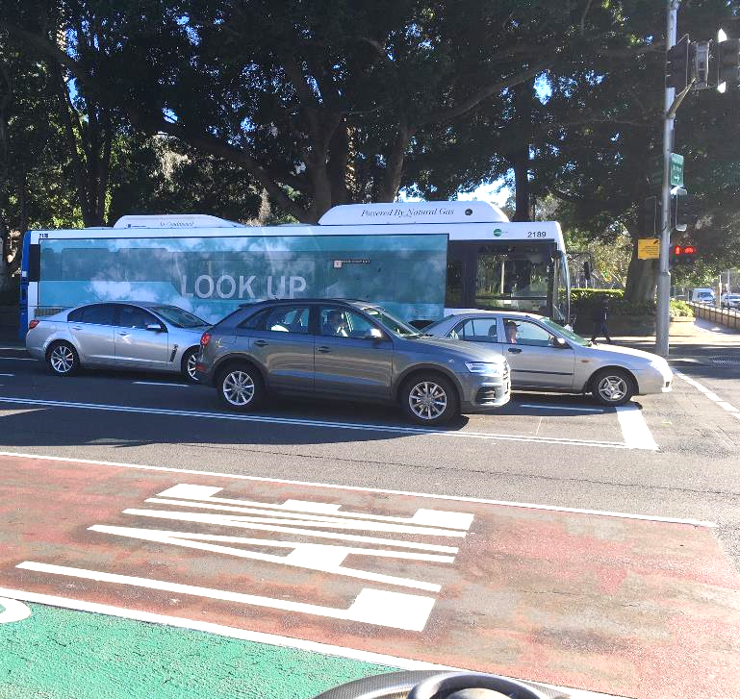
Out of Home builds
RECALL
52%
Uplift in the number of people who recalled Look Up from Phase One (33%*) to Phase Three (50%**).
Source: Dynata Adhoc surveys: Phase One February 2019, n=2,003*; Phase Three January 2020, n=1,247**.

Slide 4
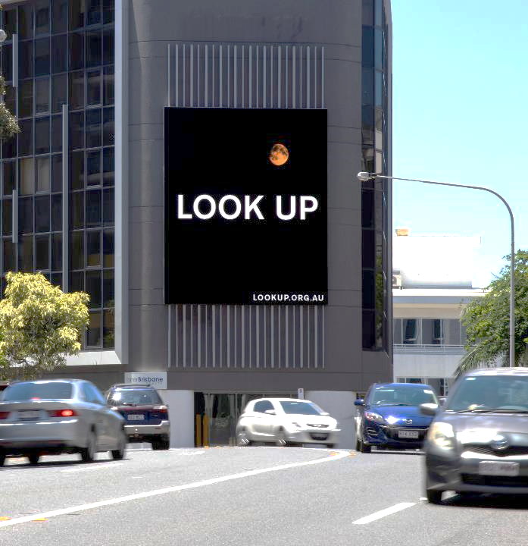
Out of Home increases TALKABILITY
63%
Uplift in the number of people who talked about Look Up with friends or family from Phase One (30%*) to Phase Three (49%**).^
Source: Dynata Adhoc surveys: Phase One February 2019, n=2,003*; Phase Three January 2020, n=1,247
^Note: Of those who recalled the campaign.

Slide 5
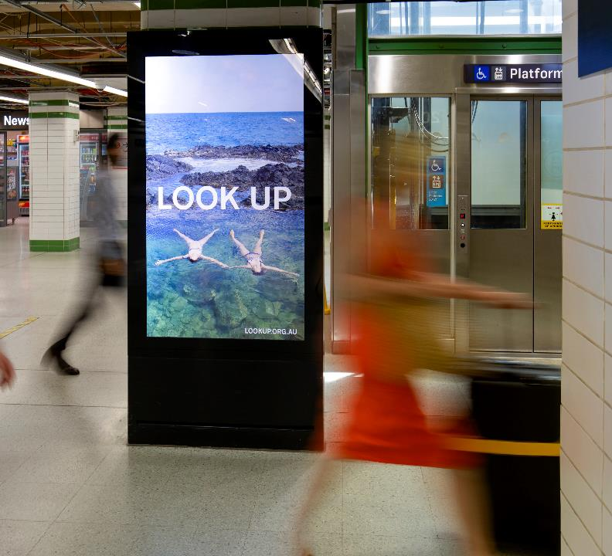
Out of Home CHANGES BEHAVIOUR over time
40%
Uplift in the number of people who said they’re trying to Look Up more from Phase One (50%*) to Phase Three (70%**).^
Source: Dynata Adhoc surveys: Phase One February 2019, n=2,003*; Phase Three January 2020, n=1,247**. ^Note: Of those who recalled the campaign.

Slide 6
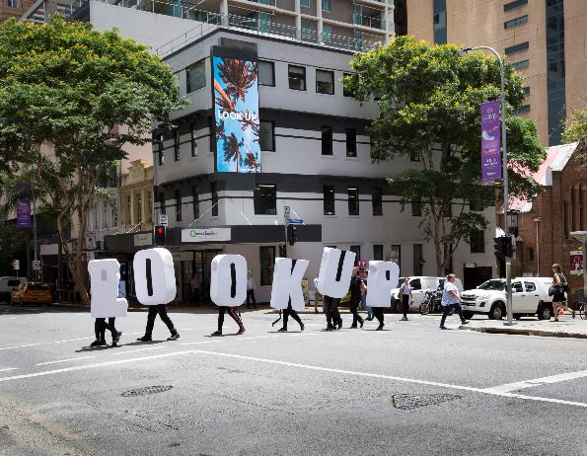
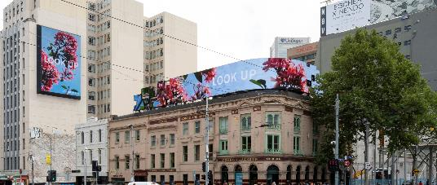
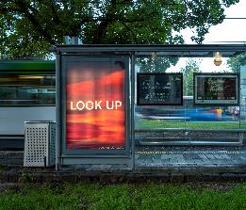
Out of Home, always on, excellent for long-term BRAND BUILDING
Time

Slide 7
More research and insights may be found at Anatomy of Out of Home

