Slide 1
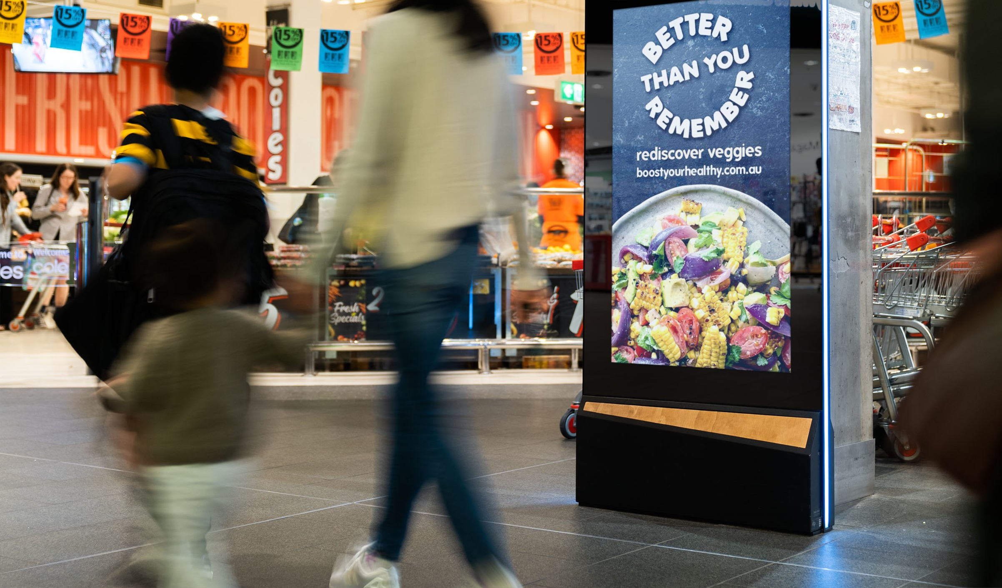
positive change
OOH influences
July 2022

Slide 2
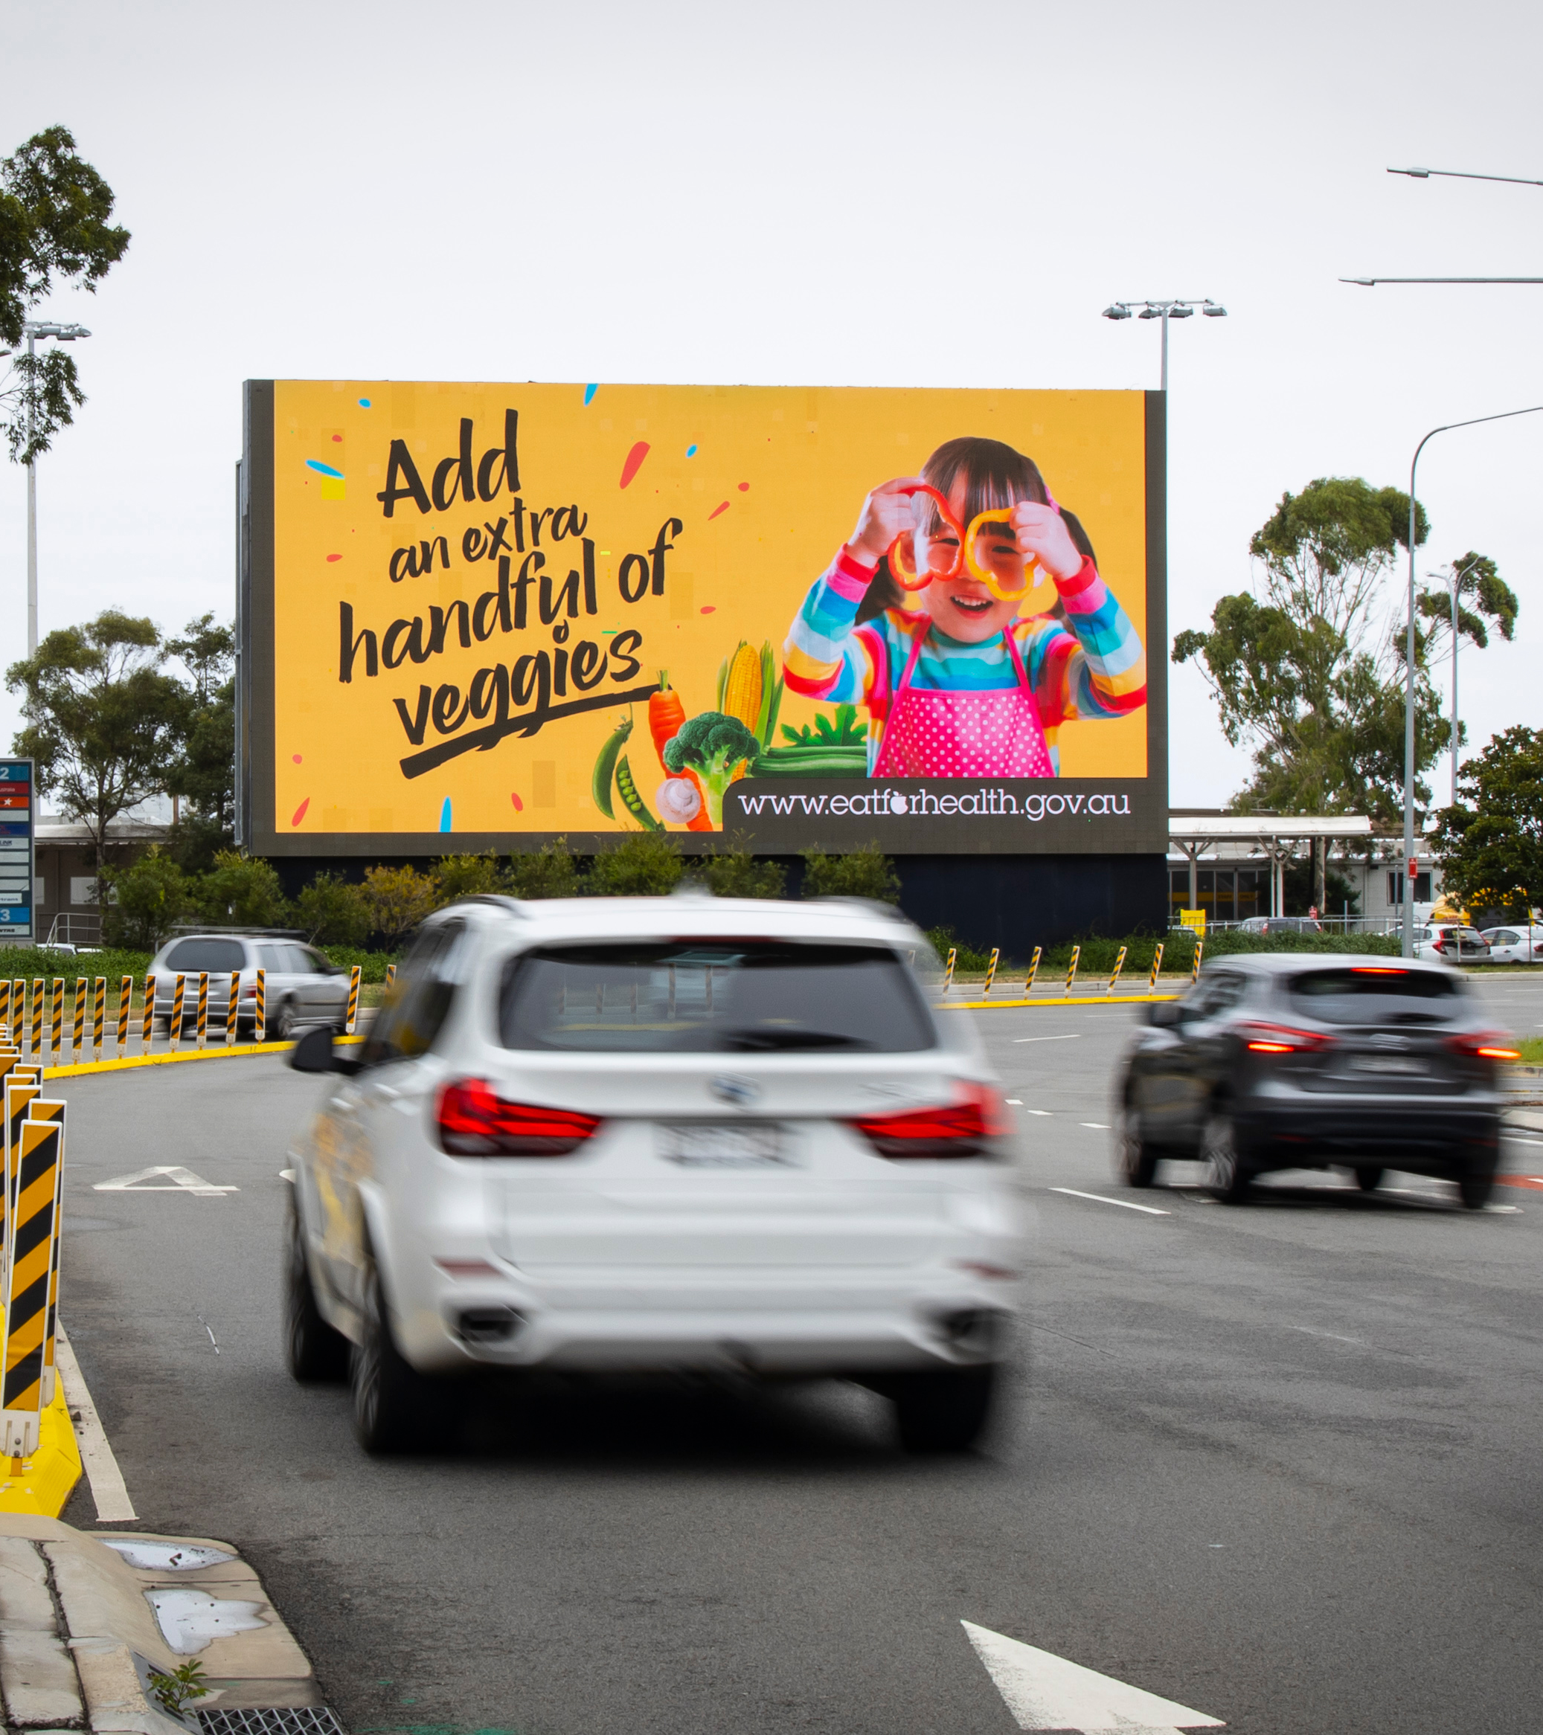
Influencing in public spaces
Reaching 93 per cent of the population, Out of Home (OOH) takes its role in the community seriously.
One way the industry gives back is to promote campaigns that make a difference to how we live our lives. An example
of this has been national campaigns to promote healthy eating. The industry has done this in partnership with government over the last two years.
What we see from our post campaign surveys is that people remember seeing healthy OOH campaigns. What they tell us is that it influenced and encouraged them to make positive changes.
These results are consistent with other OOH for good campaigns we have run over the years.
Source: post campaign survey March 2022, Outdoor Media Association with Dynata, N=1,217, 50 per cent parents and 50 per cent general population.

Slide 3
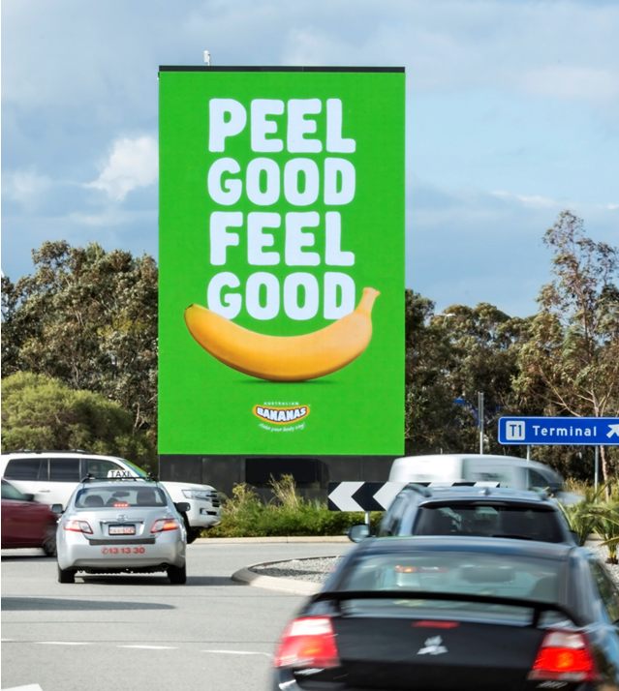
It’s memorable— people remember seeing OOH
75%
of those surveyed remembered seeing Outdoor advertising on trips made outside of the home.
Source: post campaign survey March 2022, Outdoor Media Association with Dynata, N=1,217, 50 per cent parents and 50 per cent general population.

Slide 4
People recall healthy eating campaigns
44%
Of those who recalled seeing OOH signs, also remember seeing advertisements that encourage healthy food choices.
Source: post campaign survey March 2022, Outdoor Media Association with Dynata, N=1,217, 50 per cent parents and 50 per cent general population.

Slide 5
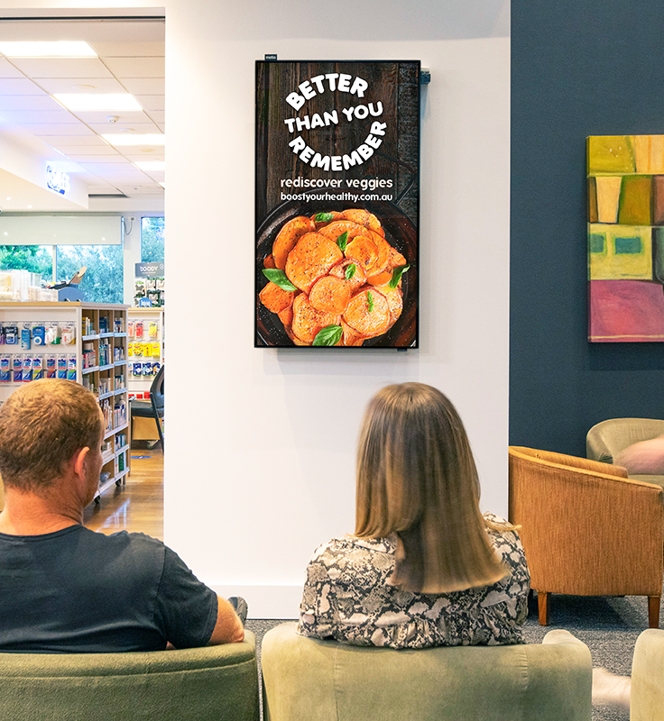
The Better than you remember campaign was effective
70%
Of those surveyed said the Better than you remember campaign encouraged them to think about healthy eating and cooking.
Source: The campaign was developed by Health and Wellbeing Queensland and Nutrition Australia, as part of a partnership with the Outdoor Media Association (OMA) from 30 January to 26 February 2022, nationwide. Results based on post campaign survey March 2022, with Dynata, N=1,217, 50 per cent parents and 50 per cent general population.

Slide 6
The Better than you remember campaign influenced positive change
76%
74%
77%
Of respondents said the campaign encourages them to make a conscious effort to incorporate vegies into their meals and snacks.
Of respondents said that the campaign encourages them to reconsider eating or cooking vegies for meals.
Of respondents said that the campaign encourages them to cook nutritious and tasty meals with vegies.
Source: The campaign was developed by Health and Wellbeing Queensland and Nutrition Australia, as part of a partnership with the Outdoor Media Association (OMA) from 30 January to 26 February, nationwide. Post campaign survey March 2022, with Dynata, N=1,217, 50 per cent parents and 50 per cent general population.

Slide 7
More research and insights may be found at Anatomy of Out of Home

