Slide 1
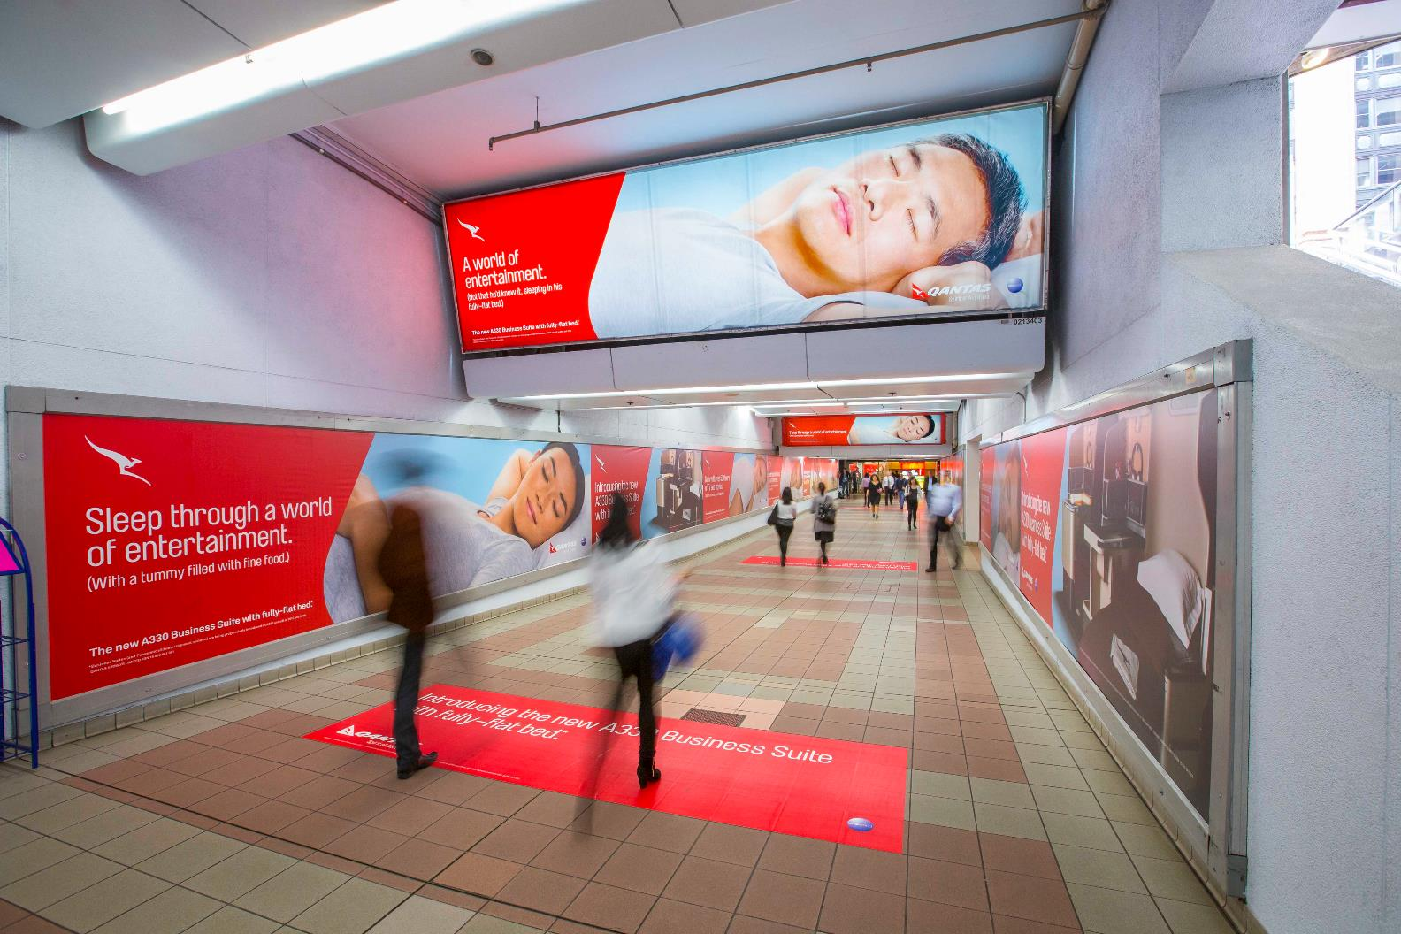
BRAND TRUST DRIVES CONSUMER ACTION
June 2020

Slide 2
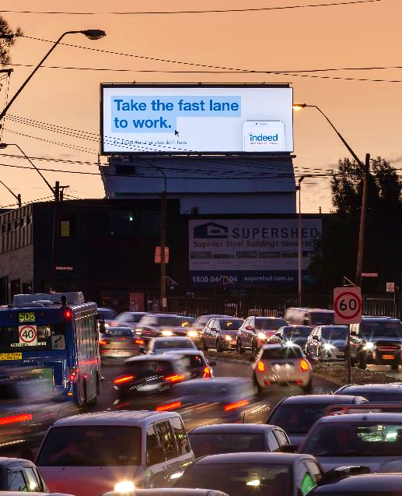
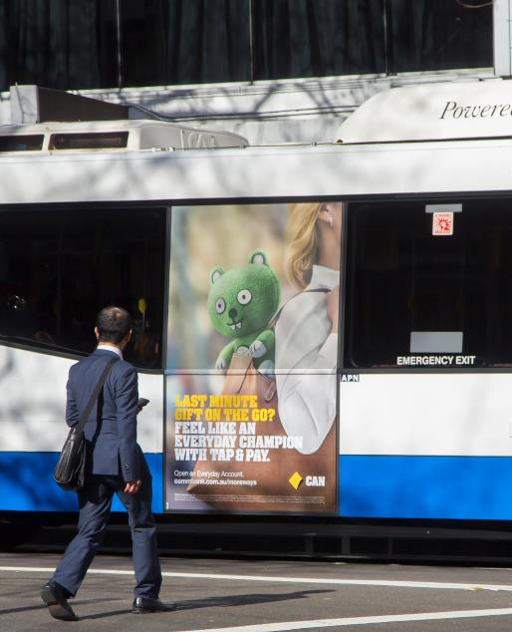
AUSTRALIA’S MOST TRUSTED BRANDS DURING COVID-19
The Roy Morgan Risk Report
Roy Morgan collected survey data about Australia's most trusted brands during the height of the COVID-19 pandemic in April 2020. The Roy Morgan Risk Report indicated that the brands which acted quickly and in ways that resonated with Australians were trusted the most. They are:
Bunnings
Woolworths
Qantas
ALDI
NRMA
ABC
Australia Post
Coles
Bendigo Bank
CBA
Source: The Roy Morgan Risk Report April 2020. N= 1,000

Slide 3
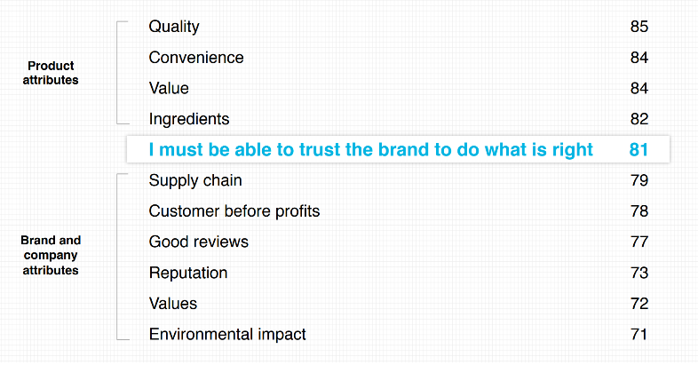
Brand trust is a top buying consideration
Of the people surveyed
81%
say that ‘I must be able to trust the brand to do what is right’ is a deal breaker or deciding factor in their brand buying decisions.
Source: Edelman Trust Barometer Special Report: In Brands We Trust? 2019. N= 16,000

Slide 4
Brand trust is becoming more important
62%
55%
69%
of people have growing concerns about product experience
of people have growing concerns about customer experience
of people have growing concerns about societal impact
Product-oriented concerns:
Pace of innovation
Increasing reliance on brands to automate my life
Can’t afford a bad purchase
Customer-oriented concerns:
Personal data
Brands can track and target me
Use of AI for customer service
Societal-oriented concerns:
‘Fake news’ and misinformation
Brands more involved in societal issues
I want brands to express my values
Source: Edelman Trust Barometer Special Report: In Brands We Trust? 2019. N= 16,000

Slide 5
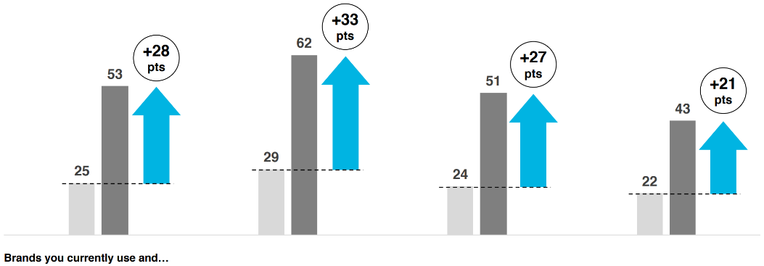
Trusted brands are rewarded more
More people will engage in positive behaviours on behalf of a trusted brand
Buy first
Stay loyal
Advocate
Defend
Source: Edelman Trust Barometer Special Report: In Brands We Trust? 2019. N= 16,000

Slide 6
Increase your brand’s trust through storytelling and emotive Out of Home
“You see, trust is an emotional thing…There is a physical, tactile, visceral and very human element to what makes these brands great. It’s the things these brands do that changes how we feel about them. They feel more human and that’s why we trust them, because we trust people more than we trust corporations.” Brent Smart, CMO of IAG.
Weather
Time
Source: Trust me, I’m an [established] brand…challengers now challenged, Mi3, June 2020.

Slide 7
More research and insights may be found at Anatomy of Out of Home

