Slide 1
CONTEXT INCREASES CAMPAIGN EFFECTIVENESS
May 2020

Slide 2
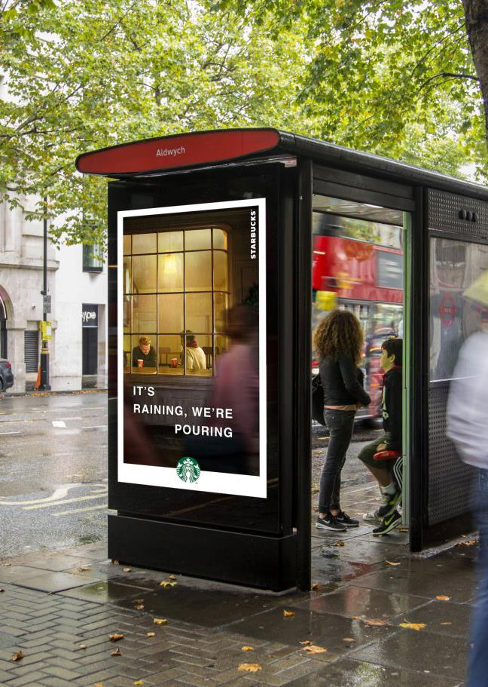
The Moments of Truth study
CONTEXTUAL MESSAGING INCREASES DOOH CAMPAIGN EFFECTIVENESS
‘The Moments of Truth’ study by JCDecaux, Clear Channel and Posterscope, in the UK, proves that dynamic creative increases the effectiveness of digital Out of Home (DOOH) campaigns. Key findings from this pioneering study reveal that consumer brain response is 18% higher when viewing relevant content in digital Out of Home campaigns, which in turn leads to a 17% increase in consumers’ spontaneous advertising recall, and ultimately proving that dynamic digital Out of Home campaigns can deliver a 16% sales uplift.
Source: The Moments of Truth research study released March 2020. N= 280

Slide 3
When you see DOOH with relevant content
your brain response increases by
+18%
Source: The Moments of Truth research study released March 2020. N= 280

Slide 4
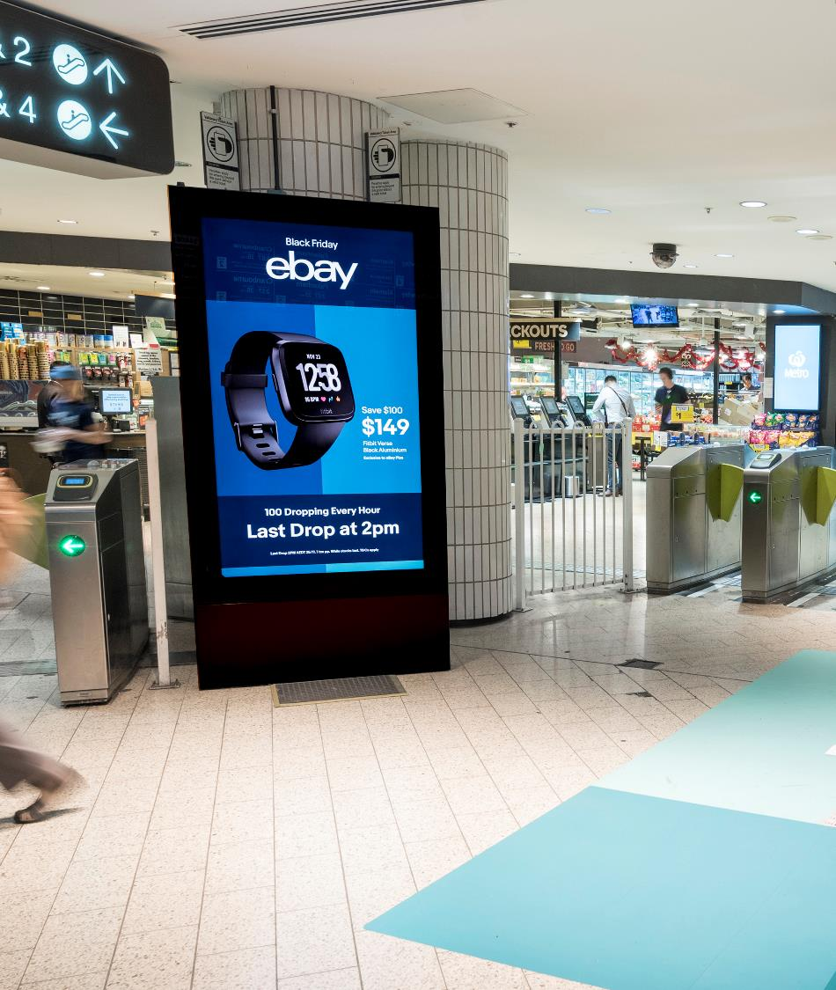
When you see DOOH at the right moment
your brain response increases by
+12%
Source: The Moments of Truth research study released March 2020. N= 280

Slide 5
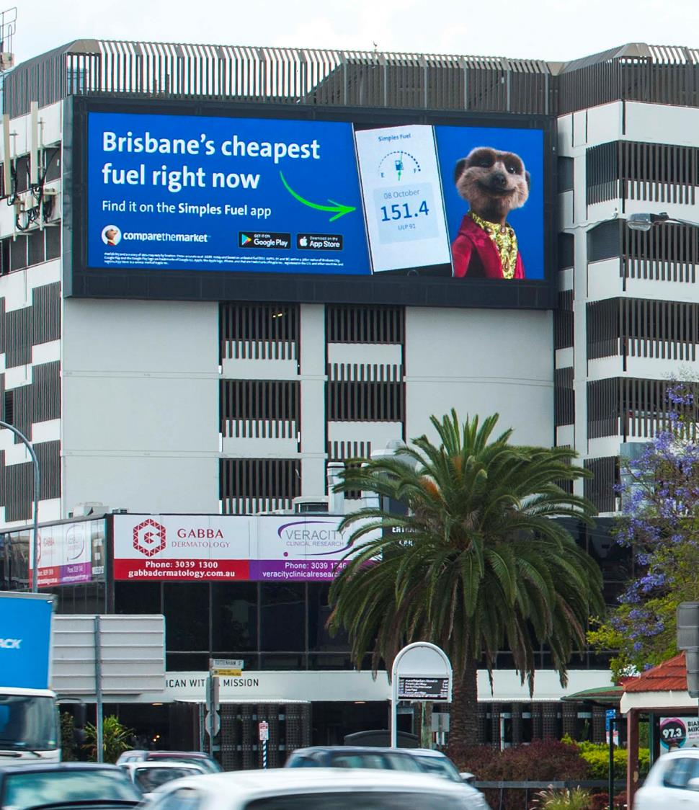
When you see DOOH with relevant content at the right moment
your brain response increases by
+32%
Source: The Moments of Truth research study released March 2020. N= 280

Slide 6
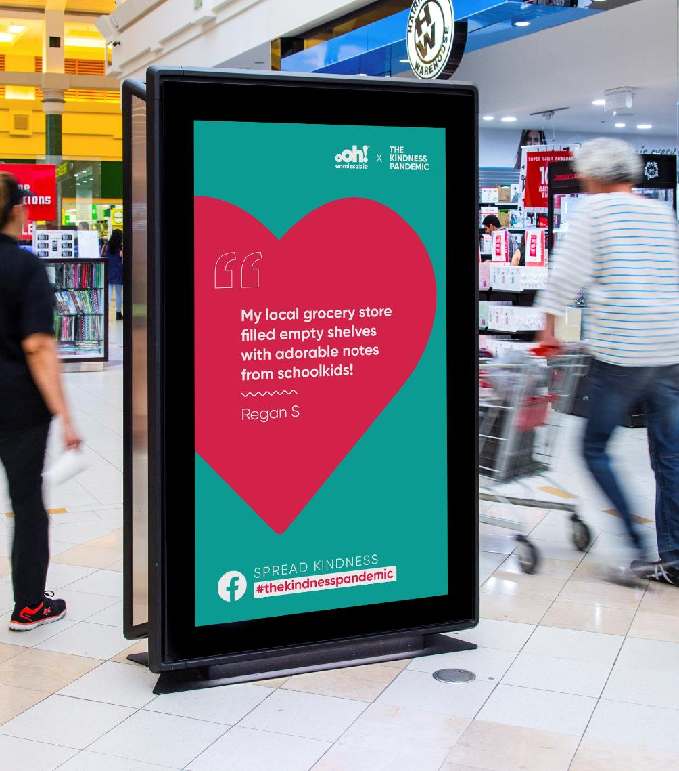
Relevant content makes DOOH more memorable
spontaneous ad awareness increased by
+17%
Source: The Moments of Truth research study released March 2020. N= 280

Slide 7
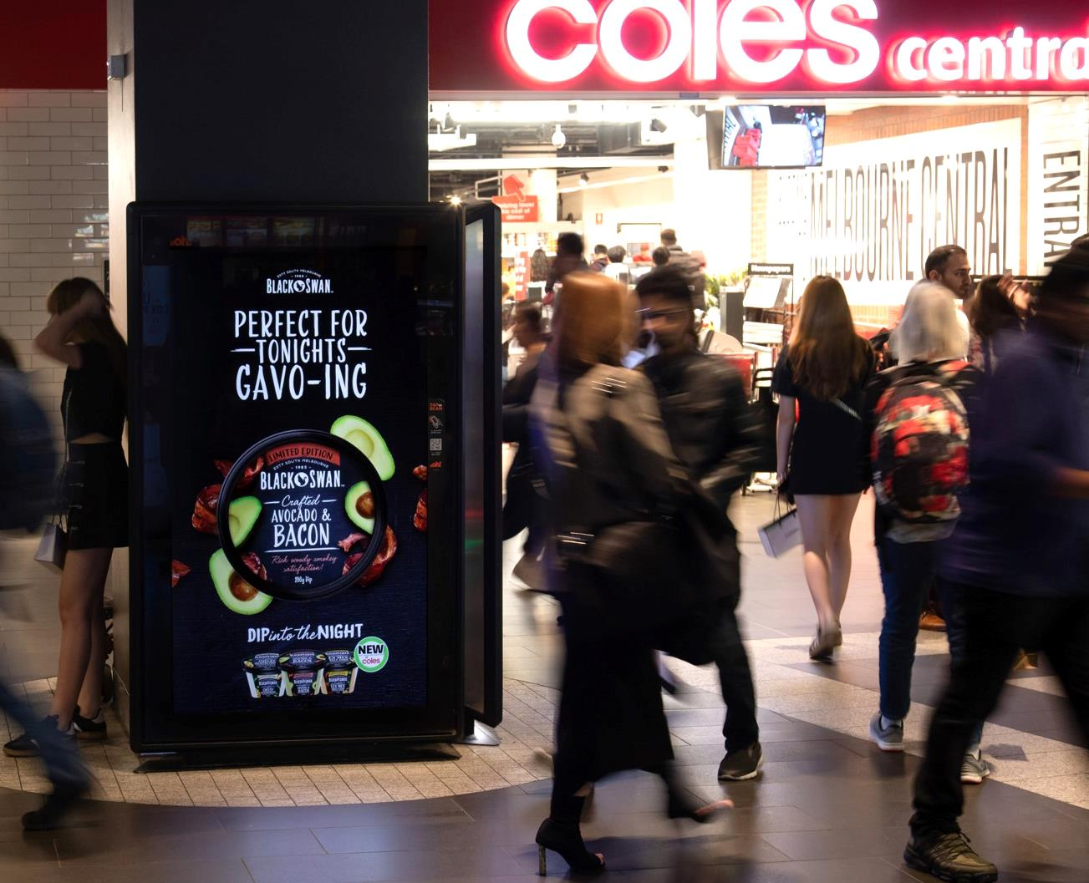
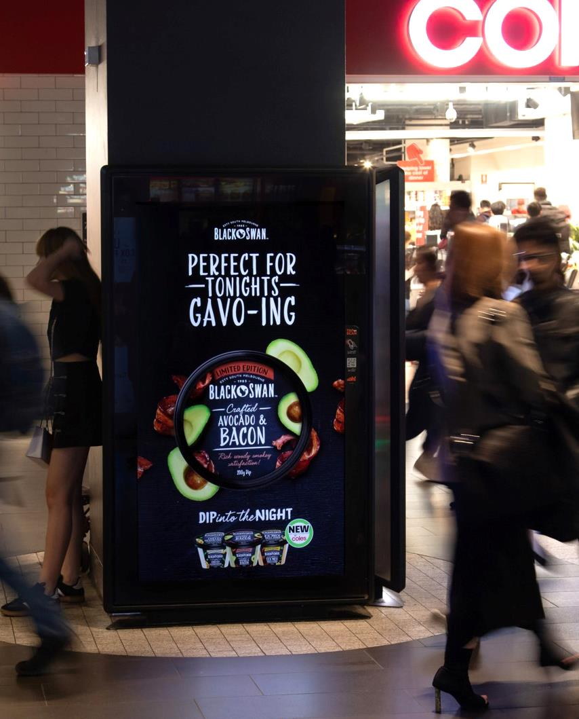
Relevant content on DOOH
drives consumer action
the study showed sales increased by
+16%
Source: The Moments of Truth research study released March 2020. N= 280

Slide 8
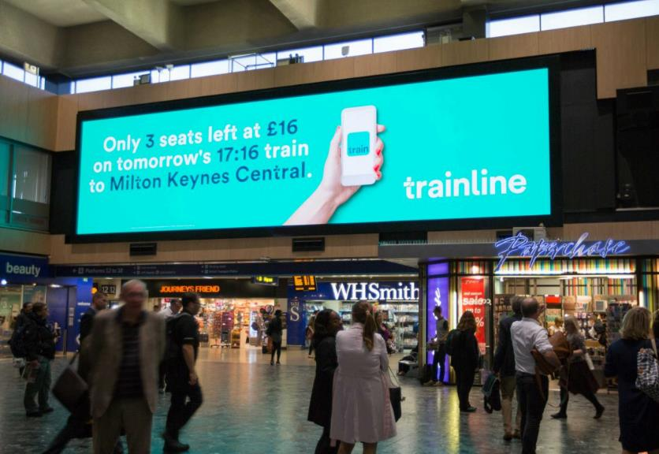
Increase the effectiveness of your DOOH campaign by showing relevant content at the right moment
Relevant content
based on the time, location, weather, or a real-time live update
Right moment
either by time, or the day of the week
Weather
Time
Source: The Moments of Truth research study released March 2020. N= 280

Slide 9
More research and insights may be found at Anatomy of Out of Home

