Slide 1
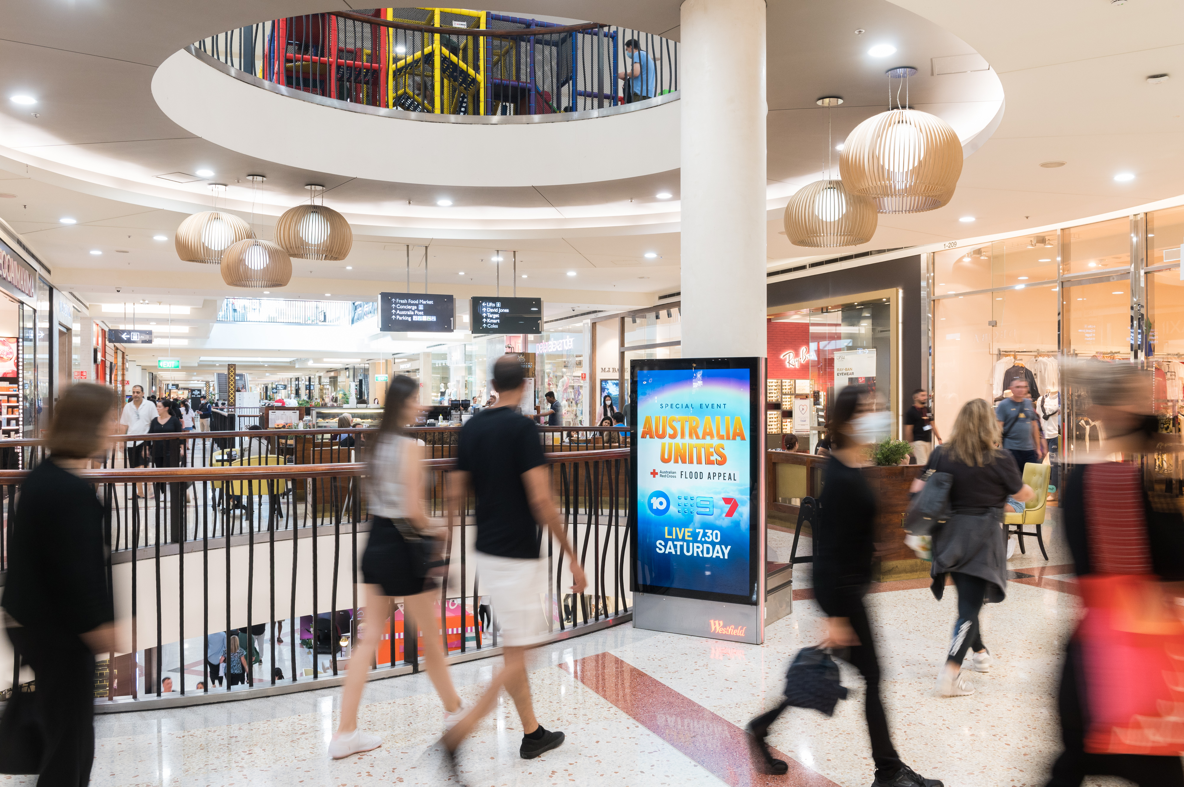
What DOOH adds to Out of Home experiences
May 2022

Slide 2
New study finds that consumers welcome DOOH
Kantar Group conducted a global study on behalf of Xaxis and Kinetic to understand the consumer perspective on Digital Out of Home (DOOH). The 15-minute survey was completed by 11,000 respondents from 11 countries.
Questions were posed to consumers aged 16+ to analyse the impact of DOOH by itself and compared to other advertising formats. The findings showed that consumers don’t just welcome DOOH in their environments, they also find it innovative and informative.
The full DOOH Difference Report 2022 may be found here.

Slide 3
Consumers believe DOOH “feels really current” and find it useful
Describe DOOH as “very” or “quite” informative
Say that DOOH gave them all the information they needed to make a purchase
Source: The DOOH Difference Report 2022. Kantar Group conducted the study on behalf of Xaxis and Kinetic, which have teamed to lead Sightline. A 15-minute survey was completed by 11,000 respondents across 11 countries around the world. All respondents were over the age of 16. Kantar set quotas to ensure that the demographic range of the respondents (age, gender, social grade) was in proportion with the respective national averages of each region.

Slide 4
DOOH inspires interaction and encourages purchase
Say DOOH encouraged them to make a purchase there and then
Find QR codes to be useful
Source: The DOOH Difference Report 2022. Kantar Group conducted the study on behalf of Xaxis and Kinetic, which have teamed to lead Sightline. A 15-minute survey was completed by 11,000 respondents across 11 countries around the world. All respondents were over the age of 16. Kantar set quotas to ensure that the demographic range of the respondents (age, gender, social grade) was in proportion with the respective national averages of each region.

Slide 5
DOOH is more MEMORABLE, ENTERTAINING and ACTIONABLE than other media channels
50% more memorable than social media
Consumers who said DOOH is entertaining
Consumers who said DOOH gives them all the info needed to purchase
Source: The DOOH Difference Report 2022. Kantar Group conducted the study on behalf of Xaxis and Kinetic, which have teamed to lead Sightline. A 15-minute survey was completed by 11,000 respondents across 11 countries around the world. All respondents were over the age of 16. Kantar set quotas to ensure that the demographic range of the respondents (age, gender, social grade) was in proportion with the respective national averages of each region.

Slide 6
DOOH was ranked as the #1 most innovative ad format in 7 of 11 countries surveyed

Slide 7
More research and insights may be found at Anatomy of Out of Home

