Slide 1
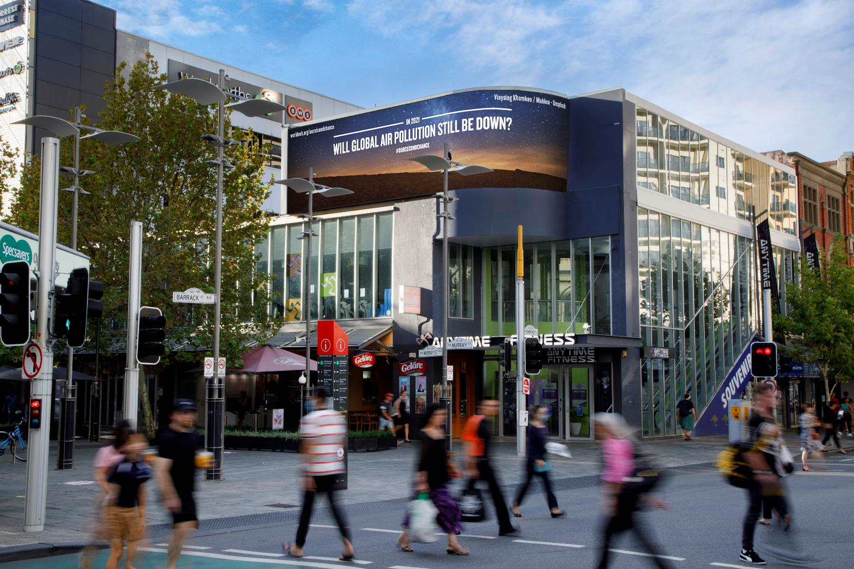
#OurSecondChance Out of Home advertising can engender empathy and fire emotion
October 2020

Slide 2
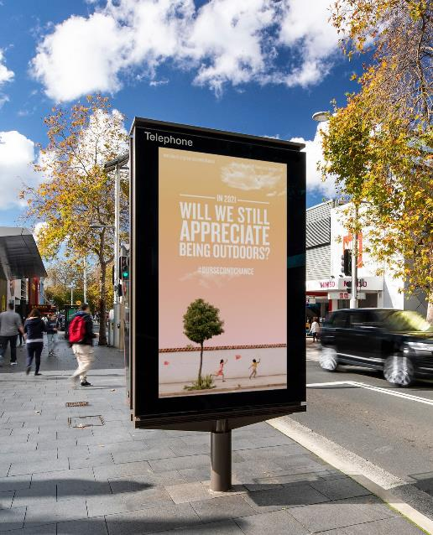
About the campaign
Research results from #OurSecondChance
#OurSecondChance ran on digital Out of Home (OOH) signs around the world August–September 2020. In Australia, a post-campaign nationwide survey measured the impact of the campaign as well as the recall of all OOH advertising during lockdown.
Developed by the global OOH community, the #OurSecondChance campaign looked to 2021 as the world’s ‘second chance’, asking simple questions about how we can make the most of the opportunities that have arisen from the pandemic.
For more information about the campaign, click here.

Slide 3
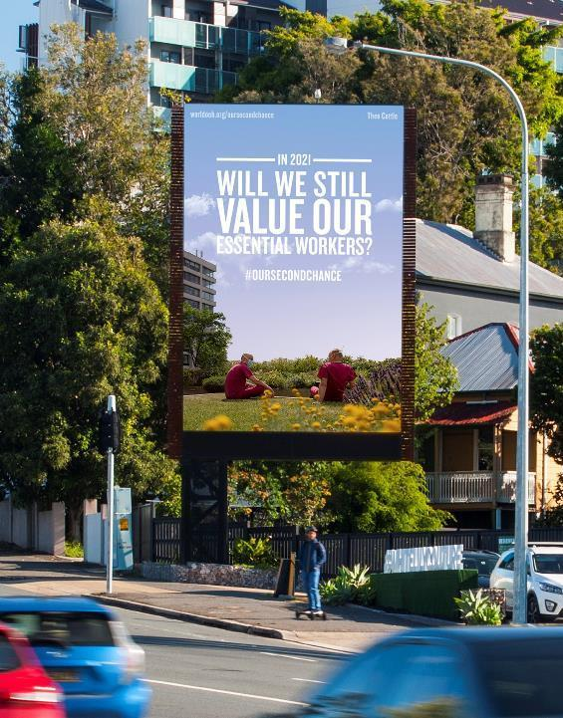
People noticed OOH during lockdown
Of the people surveyed
68%
Recalled seeing OOH advertising during the lockdown period.
OMA survey, conducted by Dynata, Metro Australians aged 18+ n=1238, Sydney, Melbourne, Brisbane, Adelaide and Perth. Excluding Melbourne; 73%.

Slide 4
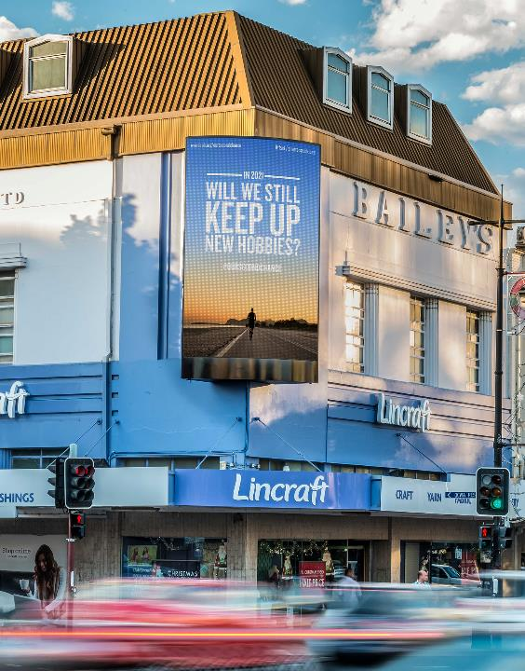
People remembered #OurSecondChance
Of the people who recalled seeing OOH advertising during the lockdown period
35%
Recalled seeing the #OurSecondChance campaign.
Source: OMA survey, conducted by Dynata, September 2020, Metro Australians aged 18+ n= 846, Sydney, Melbourne, Brisbane, Adelaide and Perth. Excluding Melbourne; 35%.

Slide 5
OOH informs and builds trust
Of the people who recalled seeing OOH advertising during the lockdown period:
51%
29%
47%
Remembered OOH advertisements that provided advice on health restrictions at that time.
Remembered messages on OOH that increased their trust in restrictions at that time.
Remembered OOH that advertised a product or service.
Source: OMA survey, conducted by Dynata, September 2020, Metro Australians aged 18+ recalled seeing Outdoor advertising during lockdown n= 846, Sydney, Melbourne, Brisbane, Adelaide and Perth.

Slide 6
OOH can inspire positive emotions and drives action
Of the people who recalled seeing the #OurSecondChance campaign on OOH and social media:
90%
87%
77%
Thought more about the positive aspects of their lives as a result of the pandemic.
Made a conscious effort to think more positively.
Spoke to family and friends about the future.
Source: OMA survey conduced by Dynata, September 2020, Metro Australians aged 18+ n= 238, Sydney, Melbourne, Brisbane, Adelaide and Perth.

Slide 7
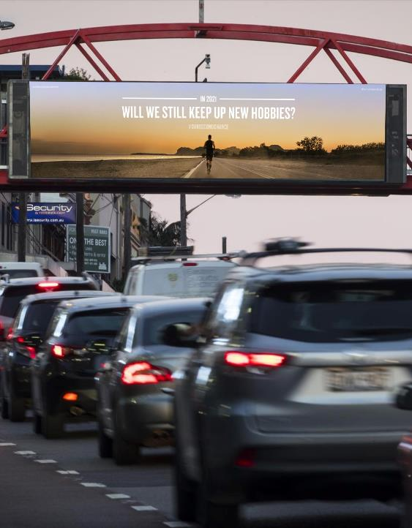
OOH prompts people to find out more
Of those people who recalled seeing #OurSecondChance on OOH and social media:
79%
Sought more information about the campaign.
Source: OMA survey, conducted by Dynata, September 2020, Metro Australians aged 18+ n= 238, Sydney, Melbourne, Brisbane, Adelaide and Perth.

Slide 8
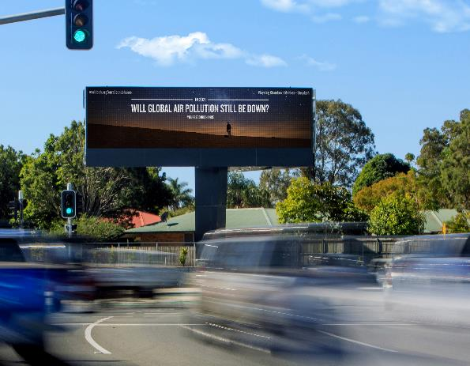
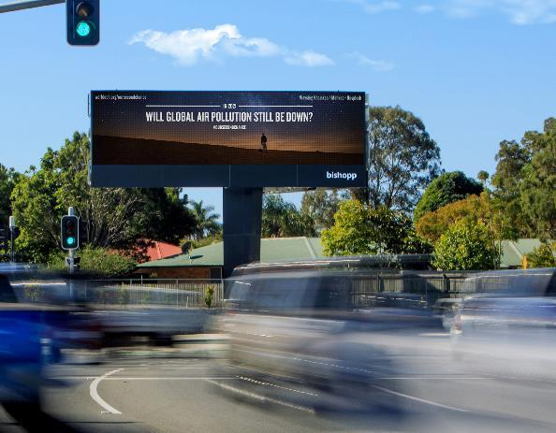
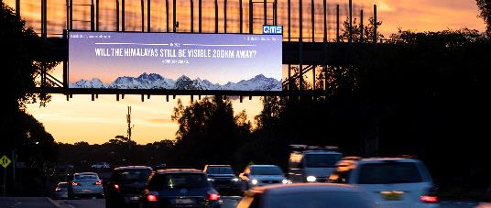
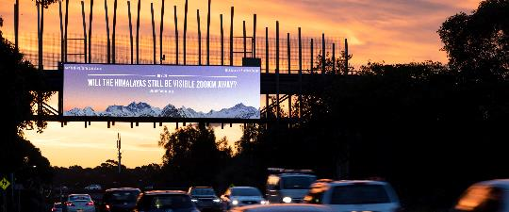
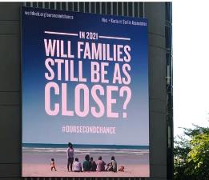
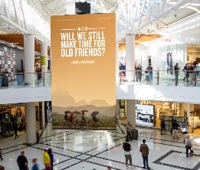
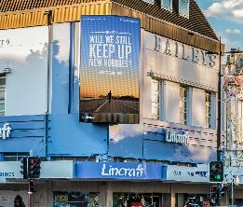
Use OOH advertising to connect with empathy and emotion.

Slide 9
More research and insights may be found at Anatomy of Out of Home
In partnership with Dynata - one of the world’s largest first-party data and insights platforms, the survey fielding partner of Outdoor Media Association (OMA).
Dynata is one of the world’s largest first-party data and insights platforms. With a reach that encompasses more than 62 million consumers and business professionals globally, and an extensive library of individual profile attributes collected through surveys, Dynata provides precise, trustworthy, quality data. The company has built innovative services and solutions around its robust first-party data offering to bring the voice of the customer to the entire marketing continuum―from strategy, innovation and branding to advertising, measurement and optimisation. Dynata serves nearly 6,000 market research, media and advertising agencies, publishers, consulting and investment firms, and corporate customers in North America, South America, Europe and Asia-Pacific.
For more information, go to www.dynata.com.

