Slide 1
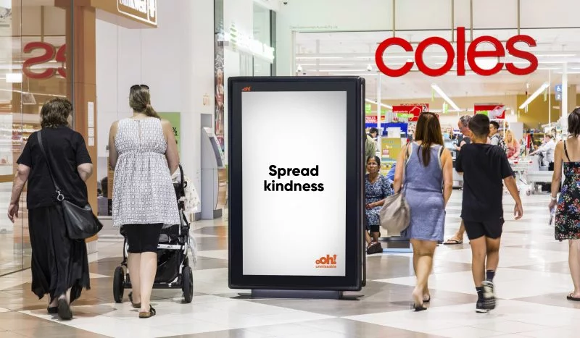
Advertising now will result in future growth
Special report

Slide 2
History shows that advertising now will position brands 20% ahead
History Part A
1920s
Advertising executive Roland S. Vaile tracked
200 companies through the recession of 1923. He reported in the April 1927 issue of the Harvard Business Review that companies that had continued to advertise during the economic downturn were 20% ahead of where they had been before the recession, while companies that reduced advertising were still in the recession, 7% below their 1920 levels.
1960s
Buchen Advertising tracked advertising dollars vs. sales trends for the recessions of 1949, 1954, 1958 and 1961. They found that sales and profits dropped at companies that cut back on advertising and, that after the recession had ended, those same companies lagged behind the ones that maintained their ad budgets.
Source: https://www.asicentral.com/ Advertising in a recession

Slide 3
The best strategy for growth is long-term branding
History Part B
1980s
McGraw-Hill Research analyzed 600 B2B companies
and found that those who maintained or increased advertising grew significantly … both during the recession and the following three years. In fact, by 1985, sales of companies that advertised aggressively had grown 275% over those that didn’t.
1990s
A MarketSense study concluded the best strategy for coping with a recession is balanced long-term branding with promotion for short term sales. The study shows brands like Jif and Kraft Salad Dressing experienced sales growth of 57% and 70% respectively after increasing their advertising during the recession.
Source: https://www.asicentral.com/ Advertising in a recession

Slide 4
In-home brands may be among those that benefit
History Part C
2000s
Euromonitor International reported on the global trends for 2009 and 2010 after the global financial crisis of 2008. Their reporting indicates “as consumers spent more time at home, this benefited sectors such as in-home electronics, cooking appliances, video games, basic food ingredients and snack foods, restaurant/coffee shop-style foods and drinks, alcohol, home care, and at-home beauty treatments while adversely impacting consumer foodservice and tourism.”
Source: Euromonitor International Global trends in 2009 and 2010 reports from WARC

Slide 5
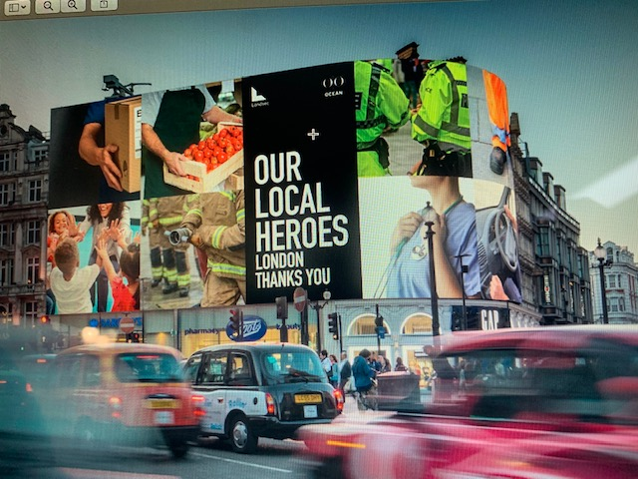
Advertising now has a positive impact on customers
86%
of B2B customers agree, when they see a company advertise in a down economy
these brands are top of mind when it comes time to make purchase decisions.
they feel better about their commitment to those products and services.
Source: Harris Interactive/ Yankelovich survey of 505 B2B executives regarding companies that advertise during a recession

Slide 6
More research and insights may be found at Anatomy of Out of Home

