Slide 1
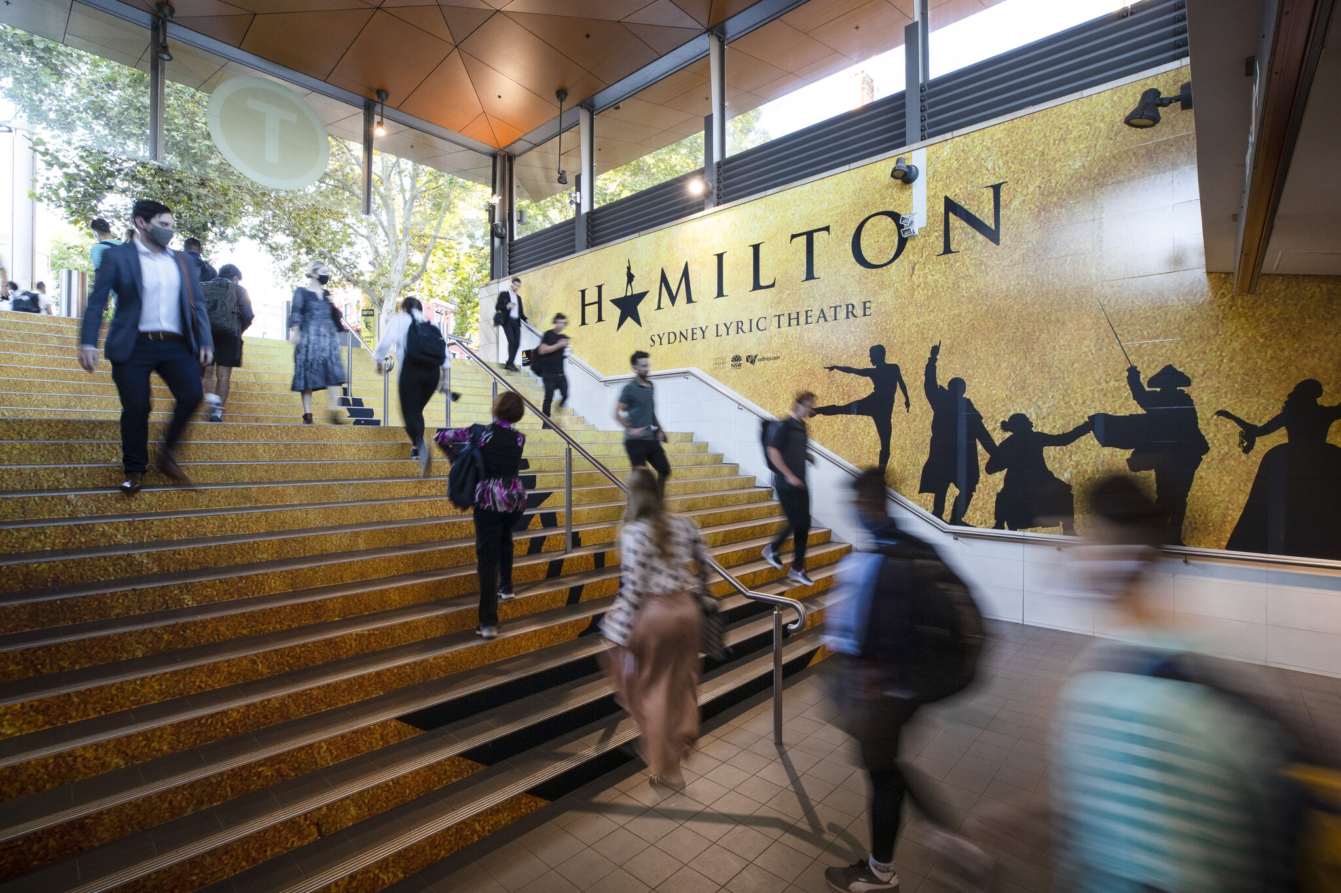
Australians return to metro areas and CBDs in Q1
April 2021

Slide 2
Roadside audiences are surging beyond pre-pandemic levels
Mobile data shows that metropolitan and suburban roadside audience volumes in March 2021 were higher than in March 2019.
102%
101%
96%
of March 2019 levels in suburban areas.
of March 2019 levels in metro areas.
of March 2019 levels in CBDs.
Source: oOh! Pulse Report April 2021 derived using DSpark data. Report available for download from oOh!media’s Audience Intelligence Hub.

Slide 3
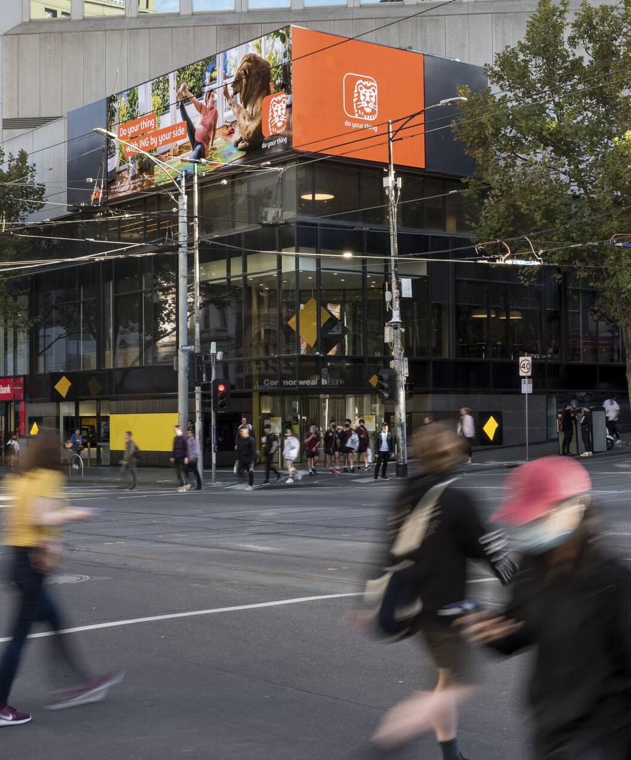
Office workers are embracing CBDs again
Australians continue to return to their workplaces at a greater frequency.
+13%
77%
jump in office and cafe audience volumes since February 2021.
of March 2019 levels in offices and cafes during March 2021.
Source: oOh! Pulse Report April 2021 derived using DSpark data. Report available for download from oOh!media’s Audience Intelligence Hub.

Slide 4
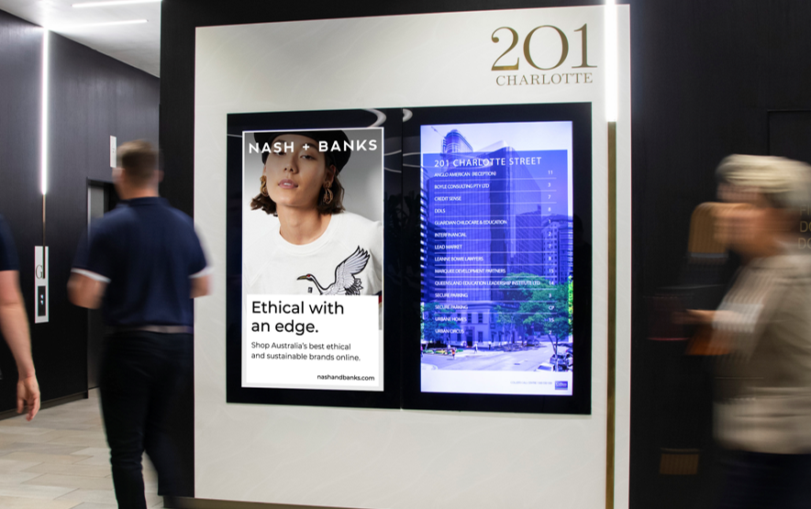
Office workers are excited to go back to the workplace
During the height of lockdowns, Australians still believed that offices would continue to play a strong role in their working lives.
77%
57%
of workers agree that they missed some elements of being in an office.
of workers were excited to go back to their workplace when restrictions eased.
Source: oOh! Pulse Report April 2021 referencing BCG Workforce Sentiment Survey, 2020 (n=1002, Australia only). Report available for download from oOh!media’s Audience Intelligence Hub.

Slide 5
More research and insights may be found at Anatomy of Out of Home

