Slide 1
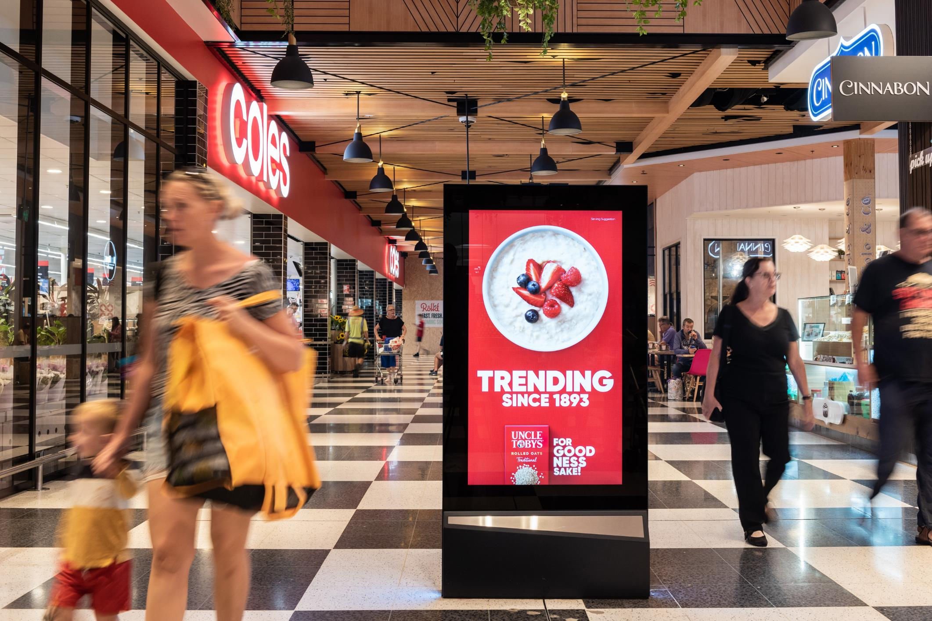
Think big, think hyperlocal Out of Home
August 2021

Slide 2
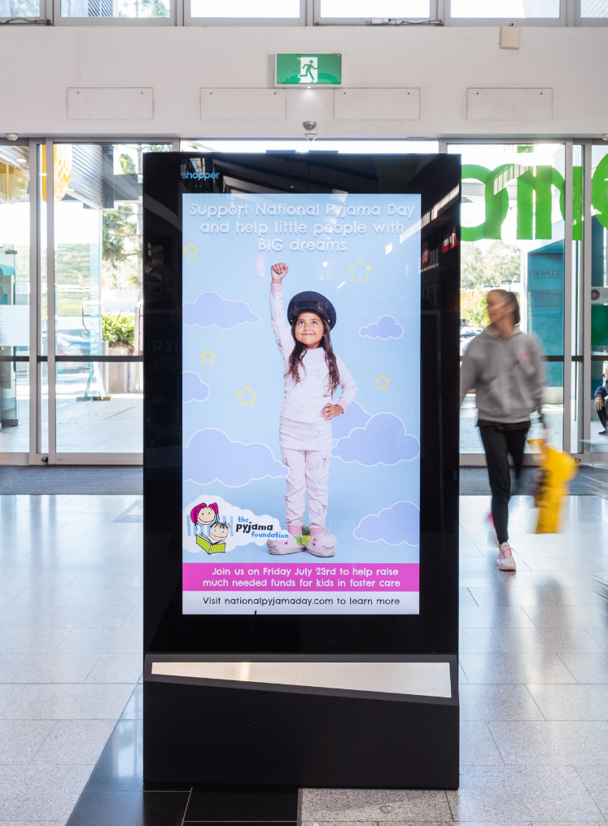
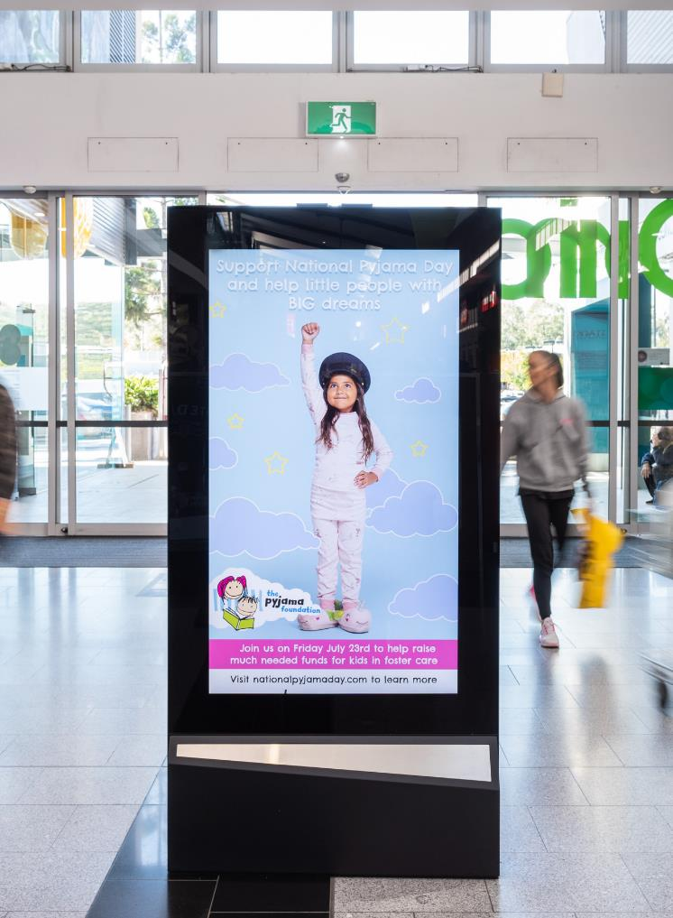
Australians feel closer to home than ever before
Many of us—15 million of us—find ourselves at home as lockdowns once again change the way we live, work and play. What we are doing is spending more time in our community and spending our money locally.
An opportunity for marketers is to think big and reach us in our locale. This is backed by research conducted by OMA member Shopper’s Closer to Home study.
Because we all need to feel optimistic, we have folded in oOh!media’s Pulse Reports insights representing how we feel during a lockdown. That regardless of our age we are positive about the future and are looking for opportunities to spend and support businesses around us.
Source: Shopper, Closer To Home study, June 2021 & ABS Supermarket Spending, May 2021.
Source: oOh!media Pulse Reports, May 2020.

Slide 3
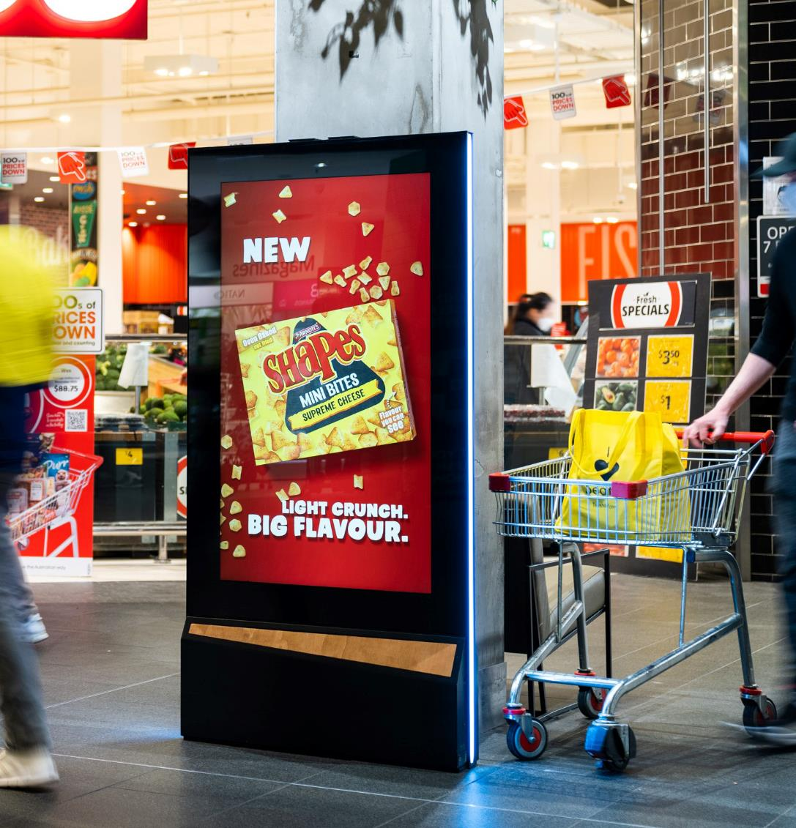
We feel more connected to our community
More than ever, we are feeling a greater sense of belonging to our community and we are supportive of local businesses.
1in3
62%
Feel more connected to our community than ever before.
Will support local businesses where we can.
Source: Shopper, Closer To Home study, June 2021 & ABS Supermarket Spending, May 2021

Slide 4
We are more open to trying new brands
Small to medium brands have new opportunities for growth as we shift our buying attitudes and mindsets.
2in3
1in3
54%
Have tried new brands in the last 12 months.
We are more open to switching brands than we have been in the past.
We made purchases from brands that are new to us in the pandemic’s first wave.*
Source: Shopper, Closer To Home study, June 2021 & ABS Supermarket Spending, May 2021
*Source: MIT Sloan Management Review research highlight Growth Opportunities for Brands during the COVID-19 Crisis, March 2020.

Slide 5
We can see the silver linings during a lockdown
Our attitudes during a lockdown provides a snapshot of things to come; we feel optimistic that opportunities to shop and spend will rise as restrictions ease.
91%
81%
77%
Gen X
Intend to maintain or increase time spent outdoors once restrictions are lifted.
Baby Boomers
Believe their ability to purchase products and services in the future will be unimpacted.
Gen Y
Expect their ability to buy products and services will be maintained or increased in the future.
Source: 1 oOh!media Pulse Report | Timing Wave 1: 1st- 4th May, 2020 Wave 2: 18th- 19th May, 2020 Wave 3: 1st -3rd June 2020| Research Panel: Dynata| Australians aged 16+, Total n=2,953 | Gen Z (16-24) n=267, Gen Y (25-39) n=777, Gen X (40-55) n=769, Baby Boomers (56-74) n=970, Pre Baby Boomers (75+) n=170.

Slide 6
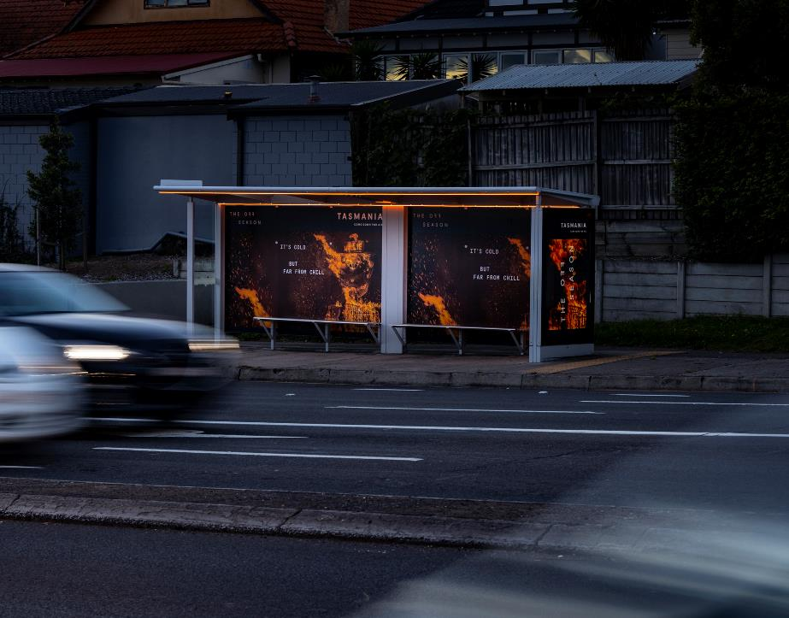
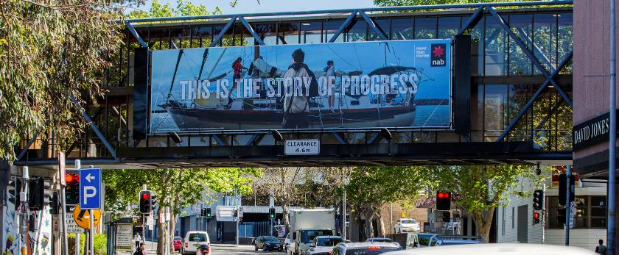
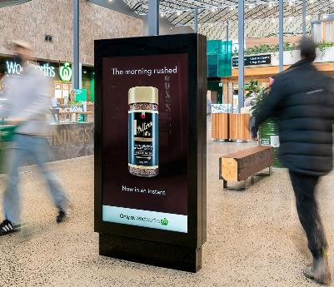
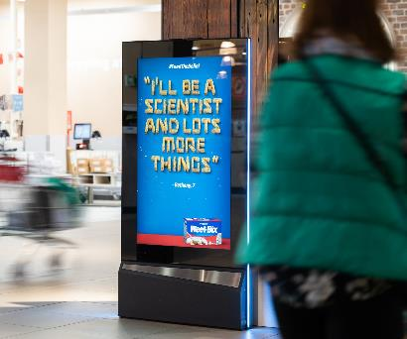
Use Out of Home to impact a local, relevant audience

Slide 7
More research and insights may be found at Anatomy of Out of Home

