Slide 1
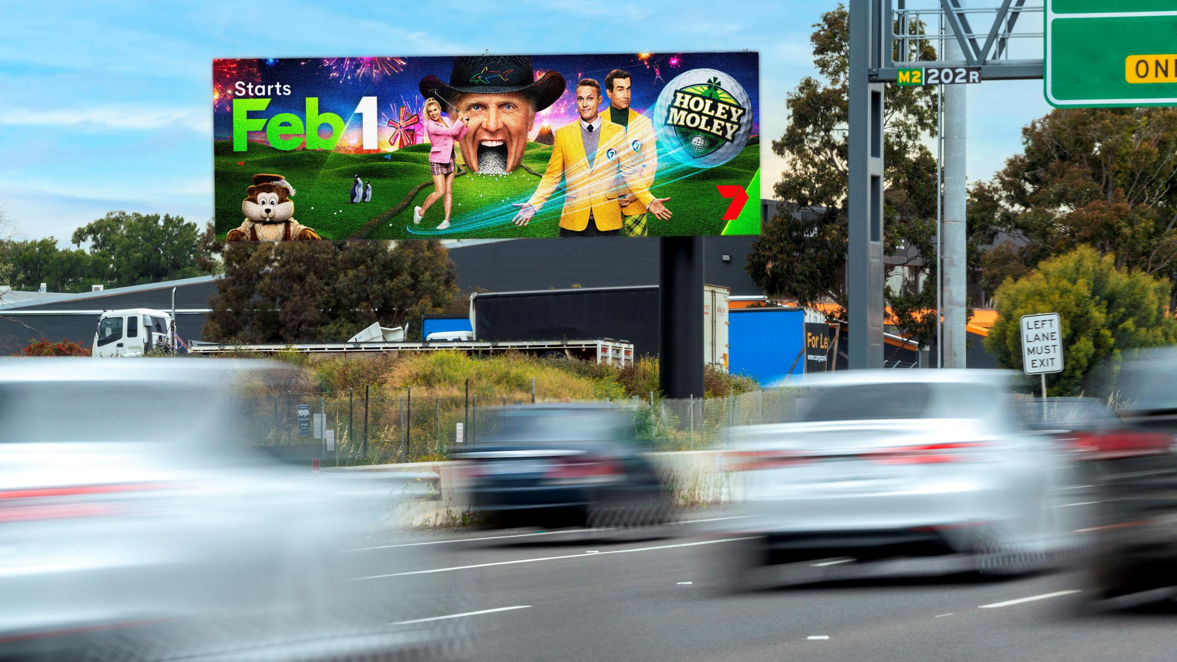
Research reveals new opportunities for Out of Home
February 2021

Slide 2
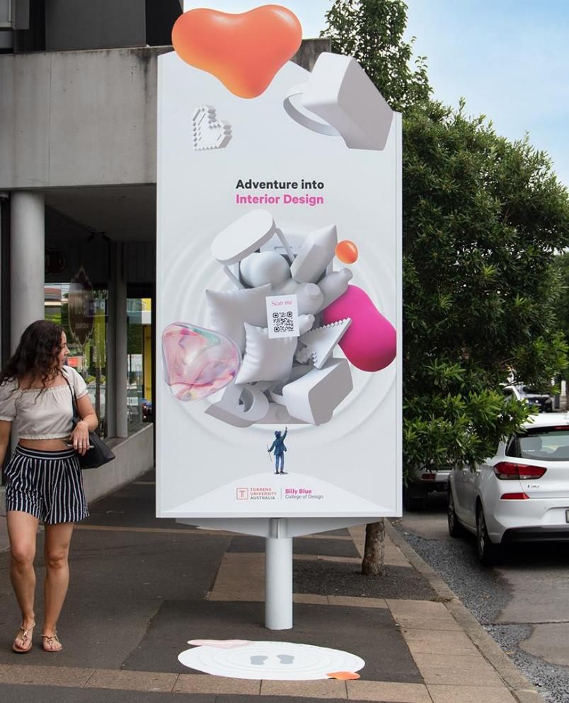
Background
Results of new OOH
consumer research
The Consumer Insights and Intent – Q1 OOH Opportunities study aimed to find the opportunities unique to Out of Home (OOH) advertising out of the pandemic. The research looked at three key areas: mobility trends, the impact and influence of OOH during the pandemic, and the implications of digital transformation.
The results of the survey, commissioned by the Out of Home Advertising Association of America (OAAA) and The Harris Poll, confirmed that consumers are still noticing OOH, engage with OOH messages, and are influenced by OOH on the path to purchase.
For more information about the study, click here.

Slide 3
OOH is driving awareness and influence in larger urban areas
OOH is leading people to discover new brands and influencing their path to purchase, especially urbanites in population centers of 1M+.
26%
33%
34%
Said that OOH informed them of a new business in their area.
Said that OOH helped them discover a new brand.
Said OOH influenced their decision to buy a product or service.
Source: Consumer Insights and Intents – Q1 OOH Opportunities study by OAAA and The Harris Poll, 2021. More info.

Slide 4
OOH works for both emotional and rational messaging
Consumers say that they notice, have an emotional response to, and learn new things from OOH advertising.
51%
70%
29%
Noticed public health information on OOH advertising.
Felt informed and safe by public health and safety messaging on OOH.
Learned new public health and safety information from OOH advertising.
Source: Consumer Insights and Intents – Q1 OOH Opportunities study by OAAA and The Harris Poll, 2021. More info.

Slide 5
OOH is gaining traction among younger consumers
60%
58%
42%
of Gen Z respondents said they are noticing OOH more.
of Millennial respondents said they are noticing OOH more.
of Gen X respondents said they are noticing OOH more.
Source: Consumer Insights and Intents – Q1 OOH Opportunities study by OAAA and The Harris Poll, 2021. More info.

Slide 6
Tuning out digital devices = tuning in Outdoors
As burnout from digital devices rises, consumers are increasingly seeking to spend more time out and about.
75%
72%
71%
Said they are tuning out ads on digital devices due to burnout.
Said they try to get out of the house as often as they can, even if it’s just for a drive or a walk.
Said they have been trying to find outdoor activities to spend their time.
Source: Consumer Insights and Intents – Q1 OOH Opportunities study by OAAA and The Harris Poll, 2021. More info.

Slide 7
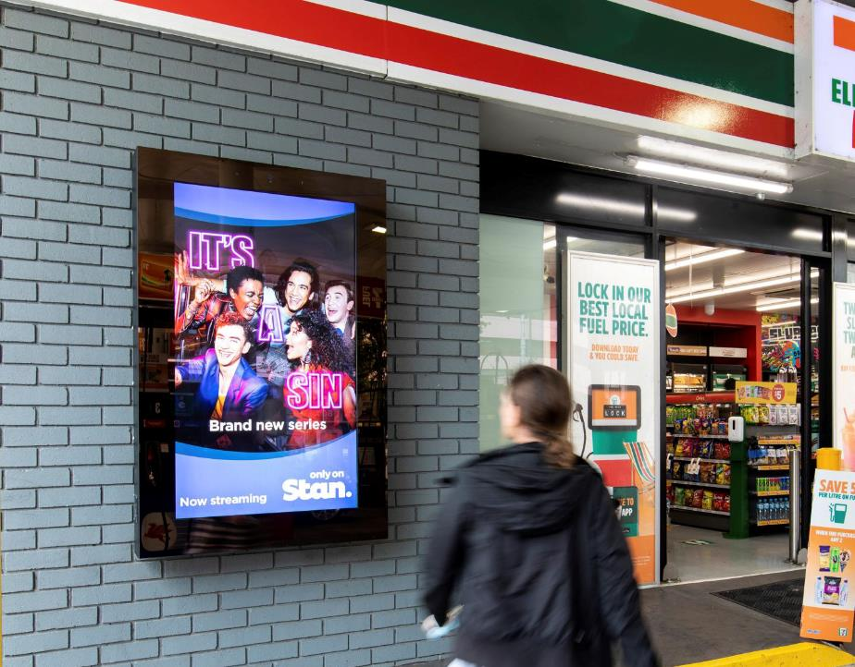
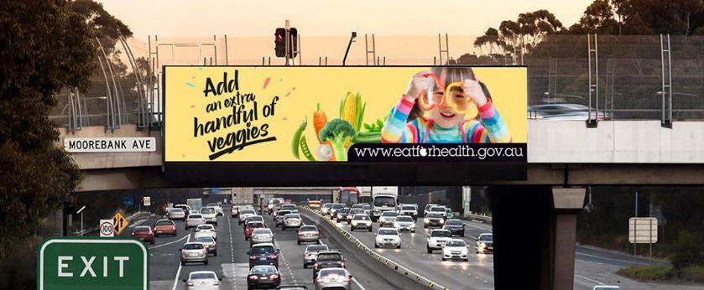
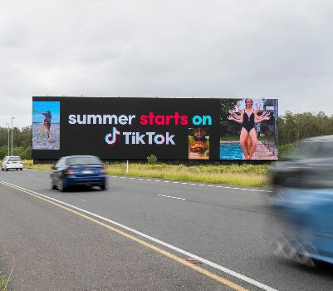
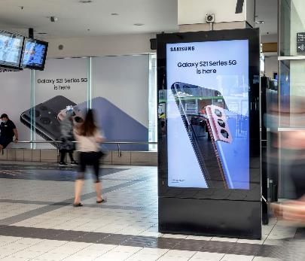
Use OOH to reach and impact a young, receptive audience

Slide 8
More research and insights may be found at Anatomy of Out of Home

