Slide 1
Special edition: MOVE 1.5 and the Neuro Impact Factor
February 2022

Slide 2
OOH reaches the nine of 10 people who leave home each day
Now in market, MOVE 1.5— the latest evolution in audience measurement— gives you more information about your audience and their engagement with Out of Home (OOH) media.

Slide 3
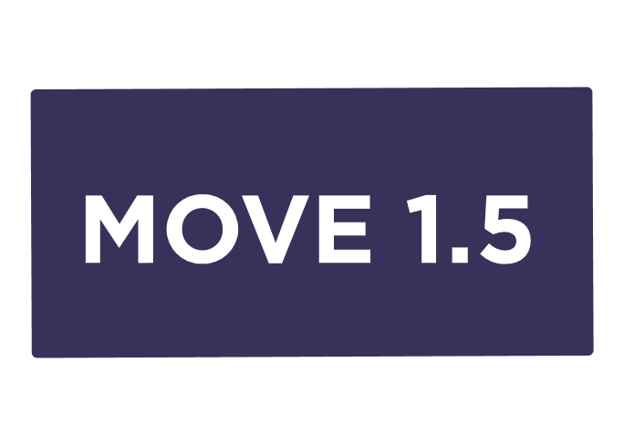
OOH now in the palm of your hand
MOVE 1.5 measures the audience of digital campaigns. It also includes The Neuro Impact Factor, the new value-based currency which goes beyond attention to measure impact.
Now you can choose what you buy from across the network of classic and digital signs, based on the formats that deliver the right audience and impact that delivers on your campaign strategy.

Slide 4
What’s new in MOVE 1.5
1
2
3
Accurate audience for digital campaigns reported as LTS impressions measuring attention
Introducing a new metric, Neuro Impact Factor (NIF) measuring impact
New report with OTS + LTS + reach and frequency + impact score

Slide 5
MOVE 1.5 gives you more accurate data
Allowing you to choose the signs that deliver the right audience and impact for your campaigns.

Slide 6
Watch this short 3 minute video for more information
Watch online

Slide 7
More research and insights may be found at Anatomy of Out of Home

