Slide 1
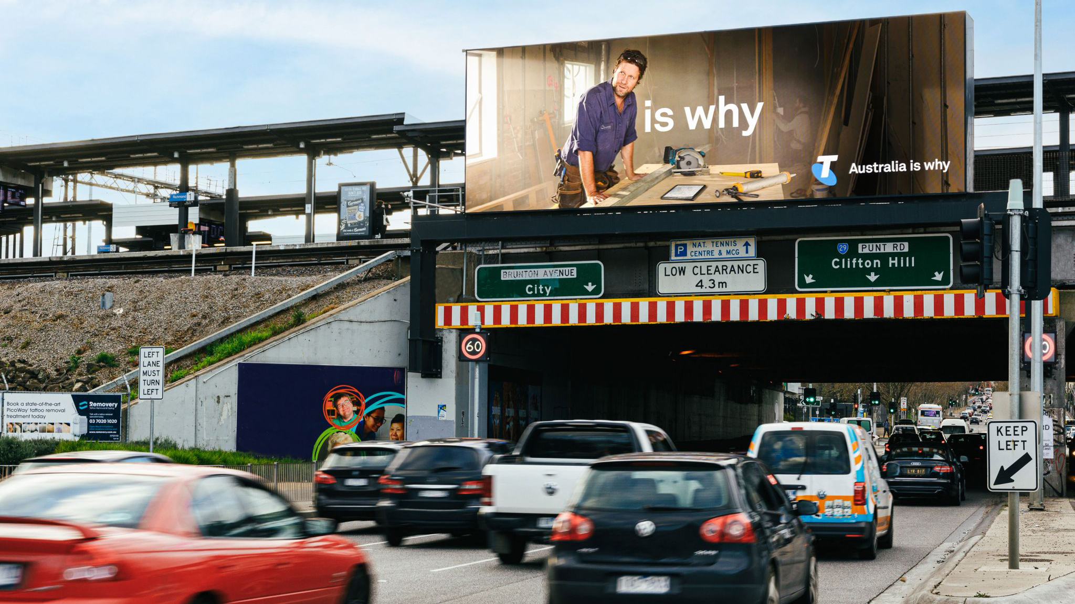
Out of Home builds brand trust and consideration
July 2021

Slide 2
Out of Home influences purchase consideration through trust
Trust that a brand or product will deliver on its promises is fundamental to decision-making. Now more than ever, there are big wins to be had by brands who prioritise and explore opportunities for enhancing trust.
Results of a new study by JCDecaux UK and Clear Channel UK reveals that Out of Home (OOH) is the most successful media channel for promoting brand trust and delivering consideration.
The study is based on the responses of 1,500 participants who were exposed to in-situ advertisements on OOH, TV, social and news media.
Source: Source: A Moment for Trust study by JCDecaux UK and Clear Channel UK, n=1,500. Read more.

Slide 3
Trust increases action among both current and potential customers
Percentage of people likely to engage in consumer action by product category.
Source: Toluna Clear Channel Trust Research 2020 Q: And, of these [category] brands, how likely are you to do any of these actions? N=1013

Slide 4
The three measures of trust
Perceptions of trust in the brand.
Trust in claims made by the brand.
Consideration of the brand.
Source: A Moment for Trust study by JCDecaux UK and Clear Channel UK, n=1,500. Read more.

Slide 5
OOH delivers +7% more positive perceptions of trust
Percentage of people who used positive terms associated with trust to describe a brand, having been exposed to an advertisement, by media channel.^
Source: A Moment for Trust study by JCDecaux UK and Clear Channel UK, n=1,500. Read more. ^Positive words included ‘honest’, ‘reliable’, ‘safe’, ‘secure’, ‘believable’.

Slide 6
OOH delivers +5% more brand consideration than other channels
Percentage of people who would consider a brand, following exposure to advertising, by media channel.
Source: A Moment for Trust study by JCDecaux UK and Clear Channel UK, n=1,500. Read more.

Slide 7
OOH is best at delivering trust and consideration
Trust in brand claims vs consideration across the average of all media channels.
CONSIDERATION
TRUST IN BRAND CLAIMS
Source: A Moment for Trust study by JCDecaux UK and Clear Channel UK, n=1,500. Read more.

Slide 8
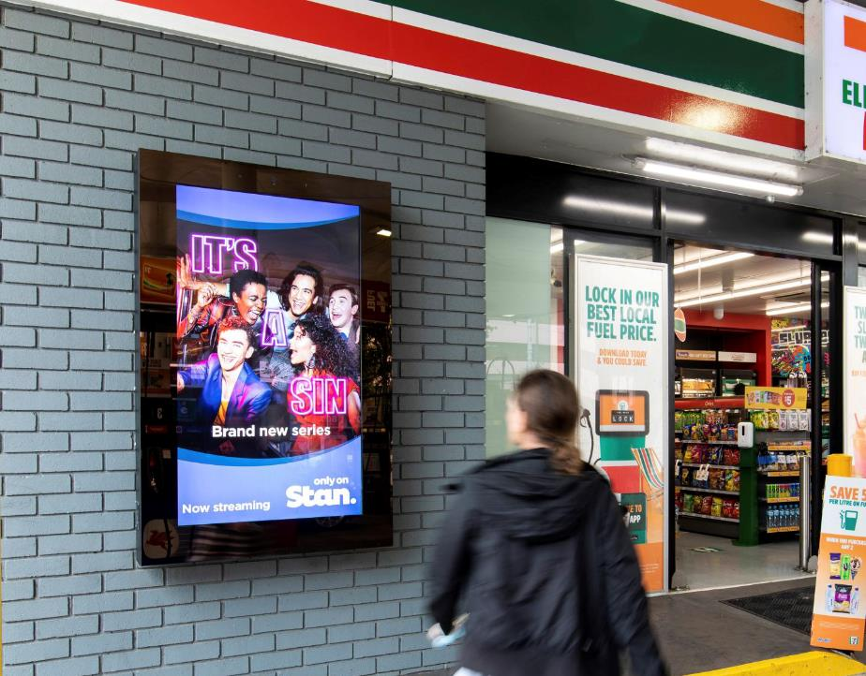
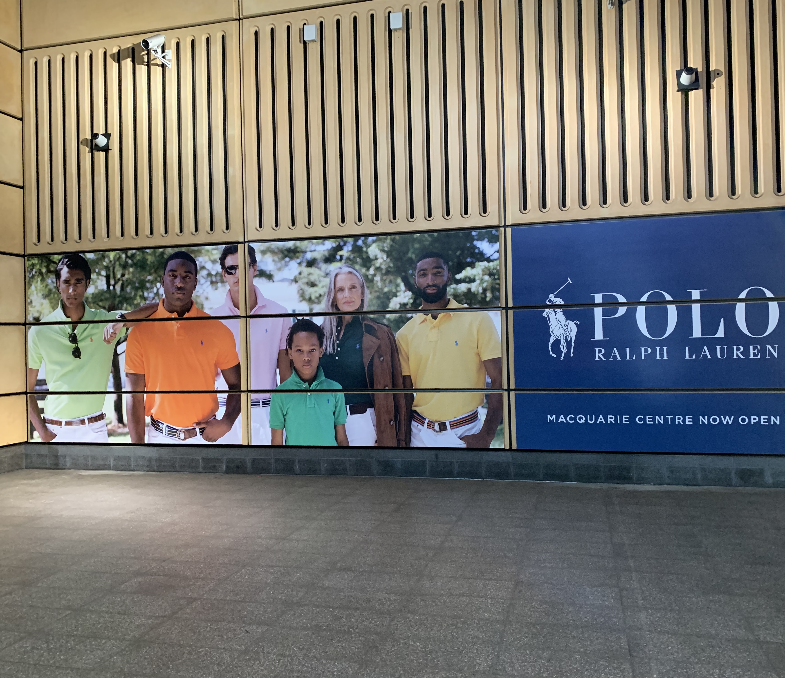
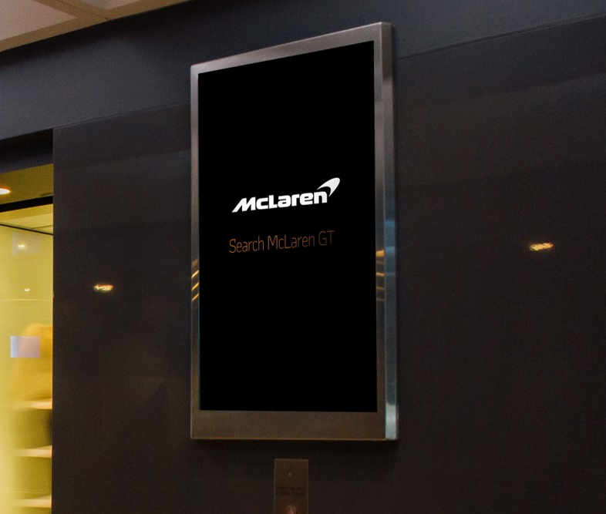
Use OOH to promote trust and influence consideration

Slide 9
More research and insights may be found at Anatomy of Out of Home

