Slide 1
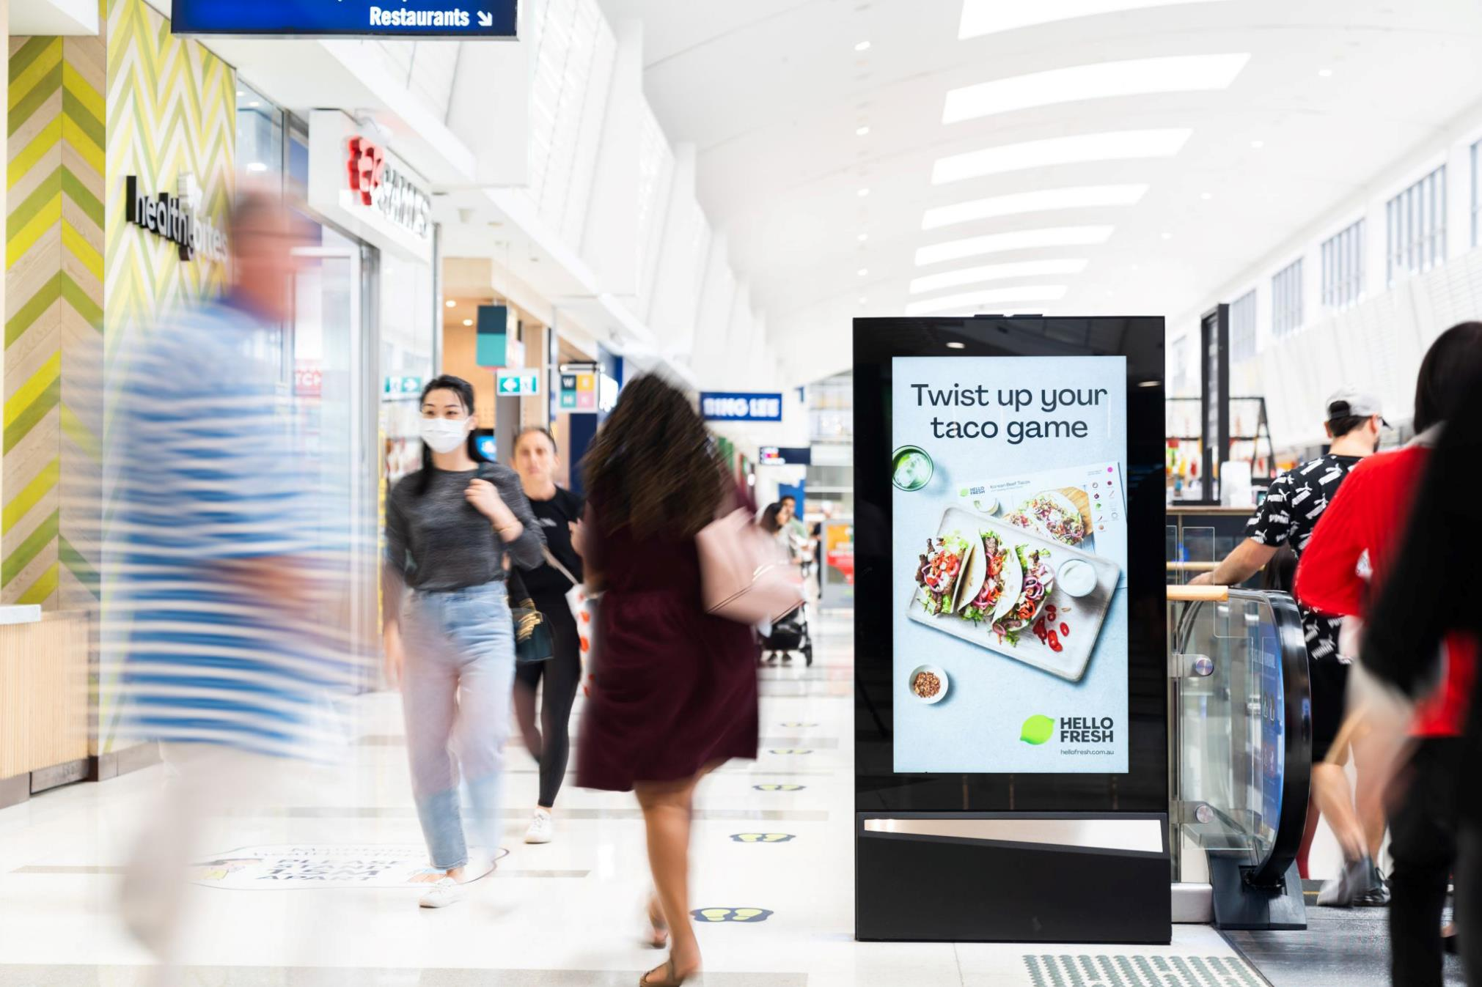
Out of Home drives online and offline brand actions
June 2021

Slide 2
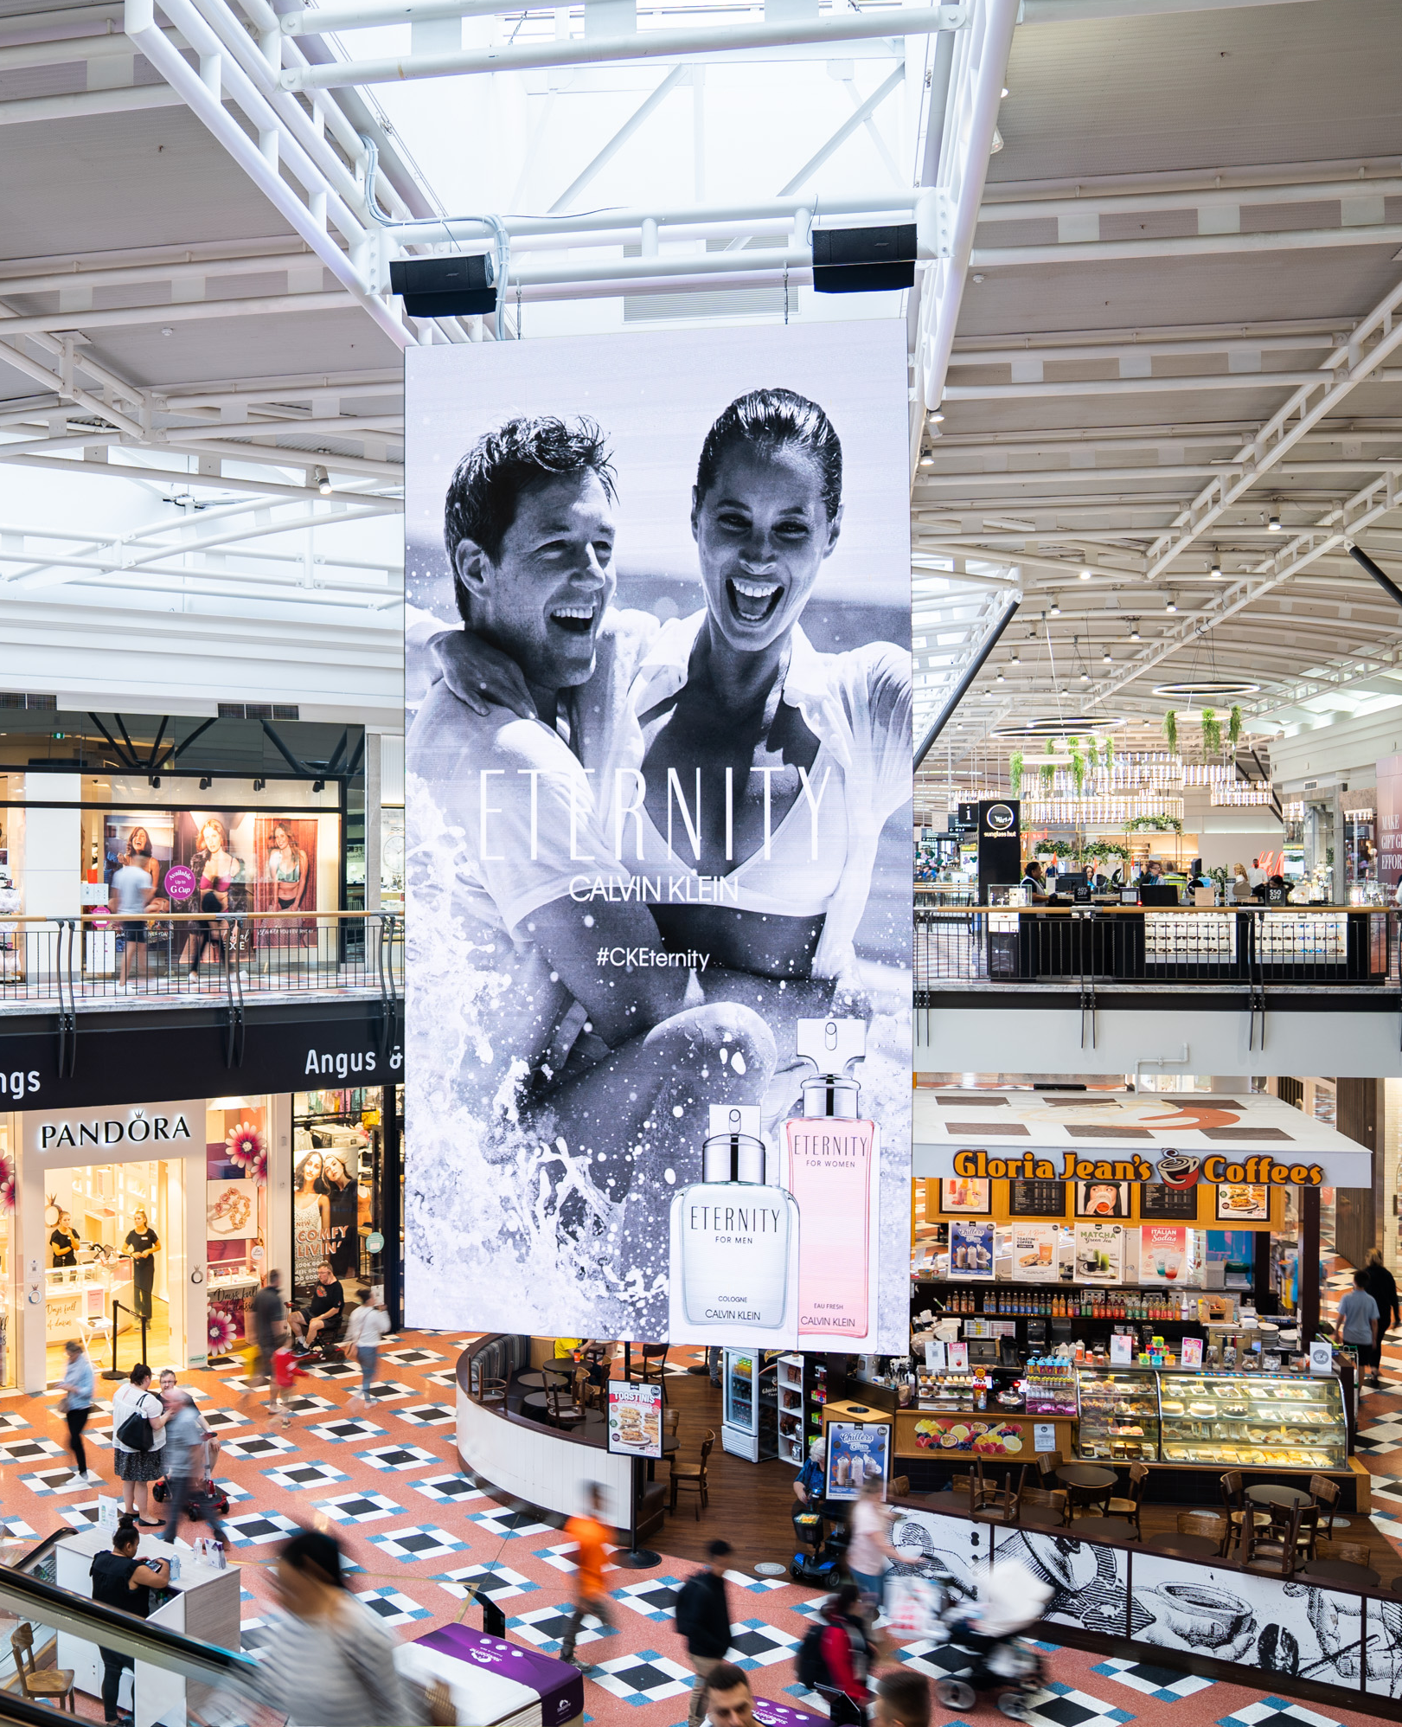
Background
Outdoor influences consumers to act
With an infinite number of distractions vying for our attention each day, advertising needs to be short, sharp and memorable to cut through and influence purchasing behaviour.
New research by Posterscope proves that Out of Home (OOH) has a clear impact on actions people take, driving traffic and sales both online and in-store. What’s more, the results show that OOH has a positive effect on brand equity.
The study is based on an analysis of more than 33,000 survey responses to 52 campaigns which ran in the UK between 2015–2020.
Source: Posterscope study based on an analysis of consumers recalling/exposed to OOH versus all respondents from 52 campaigns (n=33,668 respondents), 2015-2020. Not all campaigns tracked all metrics. Read more.

Slide 3
OOH drives online traffic and sales
People who see OOH are more likely to make an online brand action.
+63%
+56%
+53%
More online actions taken (eg, web visits, searches , app downloads)
More online searches
More online purchases
Source: Posterscope study based on an analysis of consumers recalling/exposed to OOH versus all respondents from 52 campaigns (n=33,668 respondents), 2015-2020. Not all campaigns tracked all metrics. Read more.

Slide 4
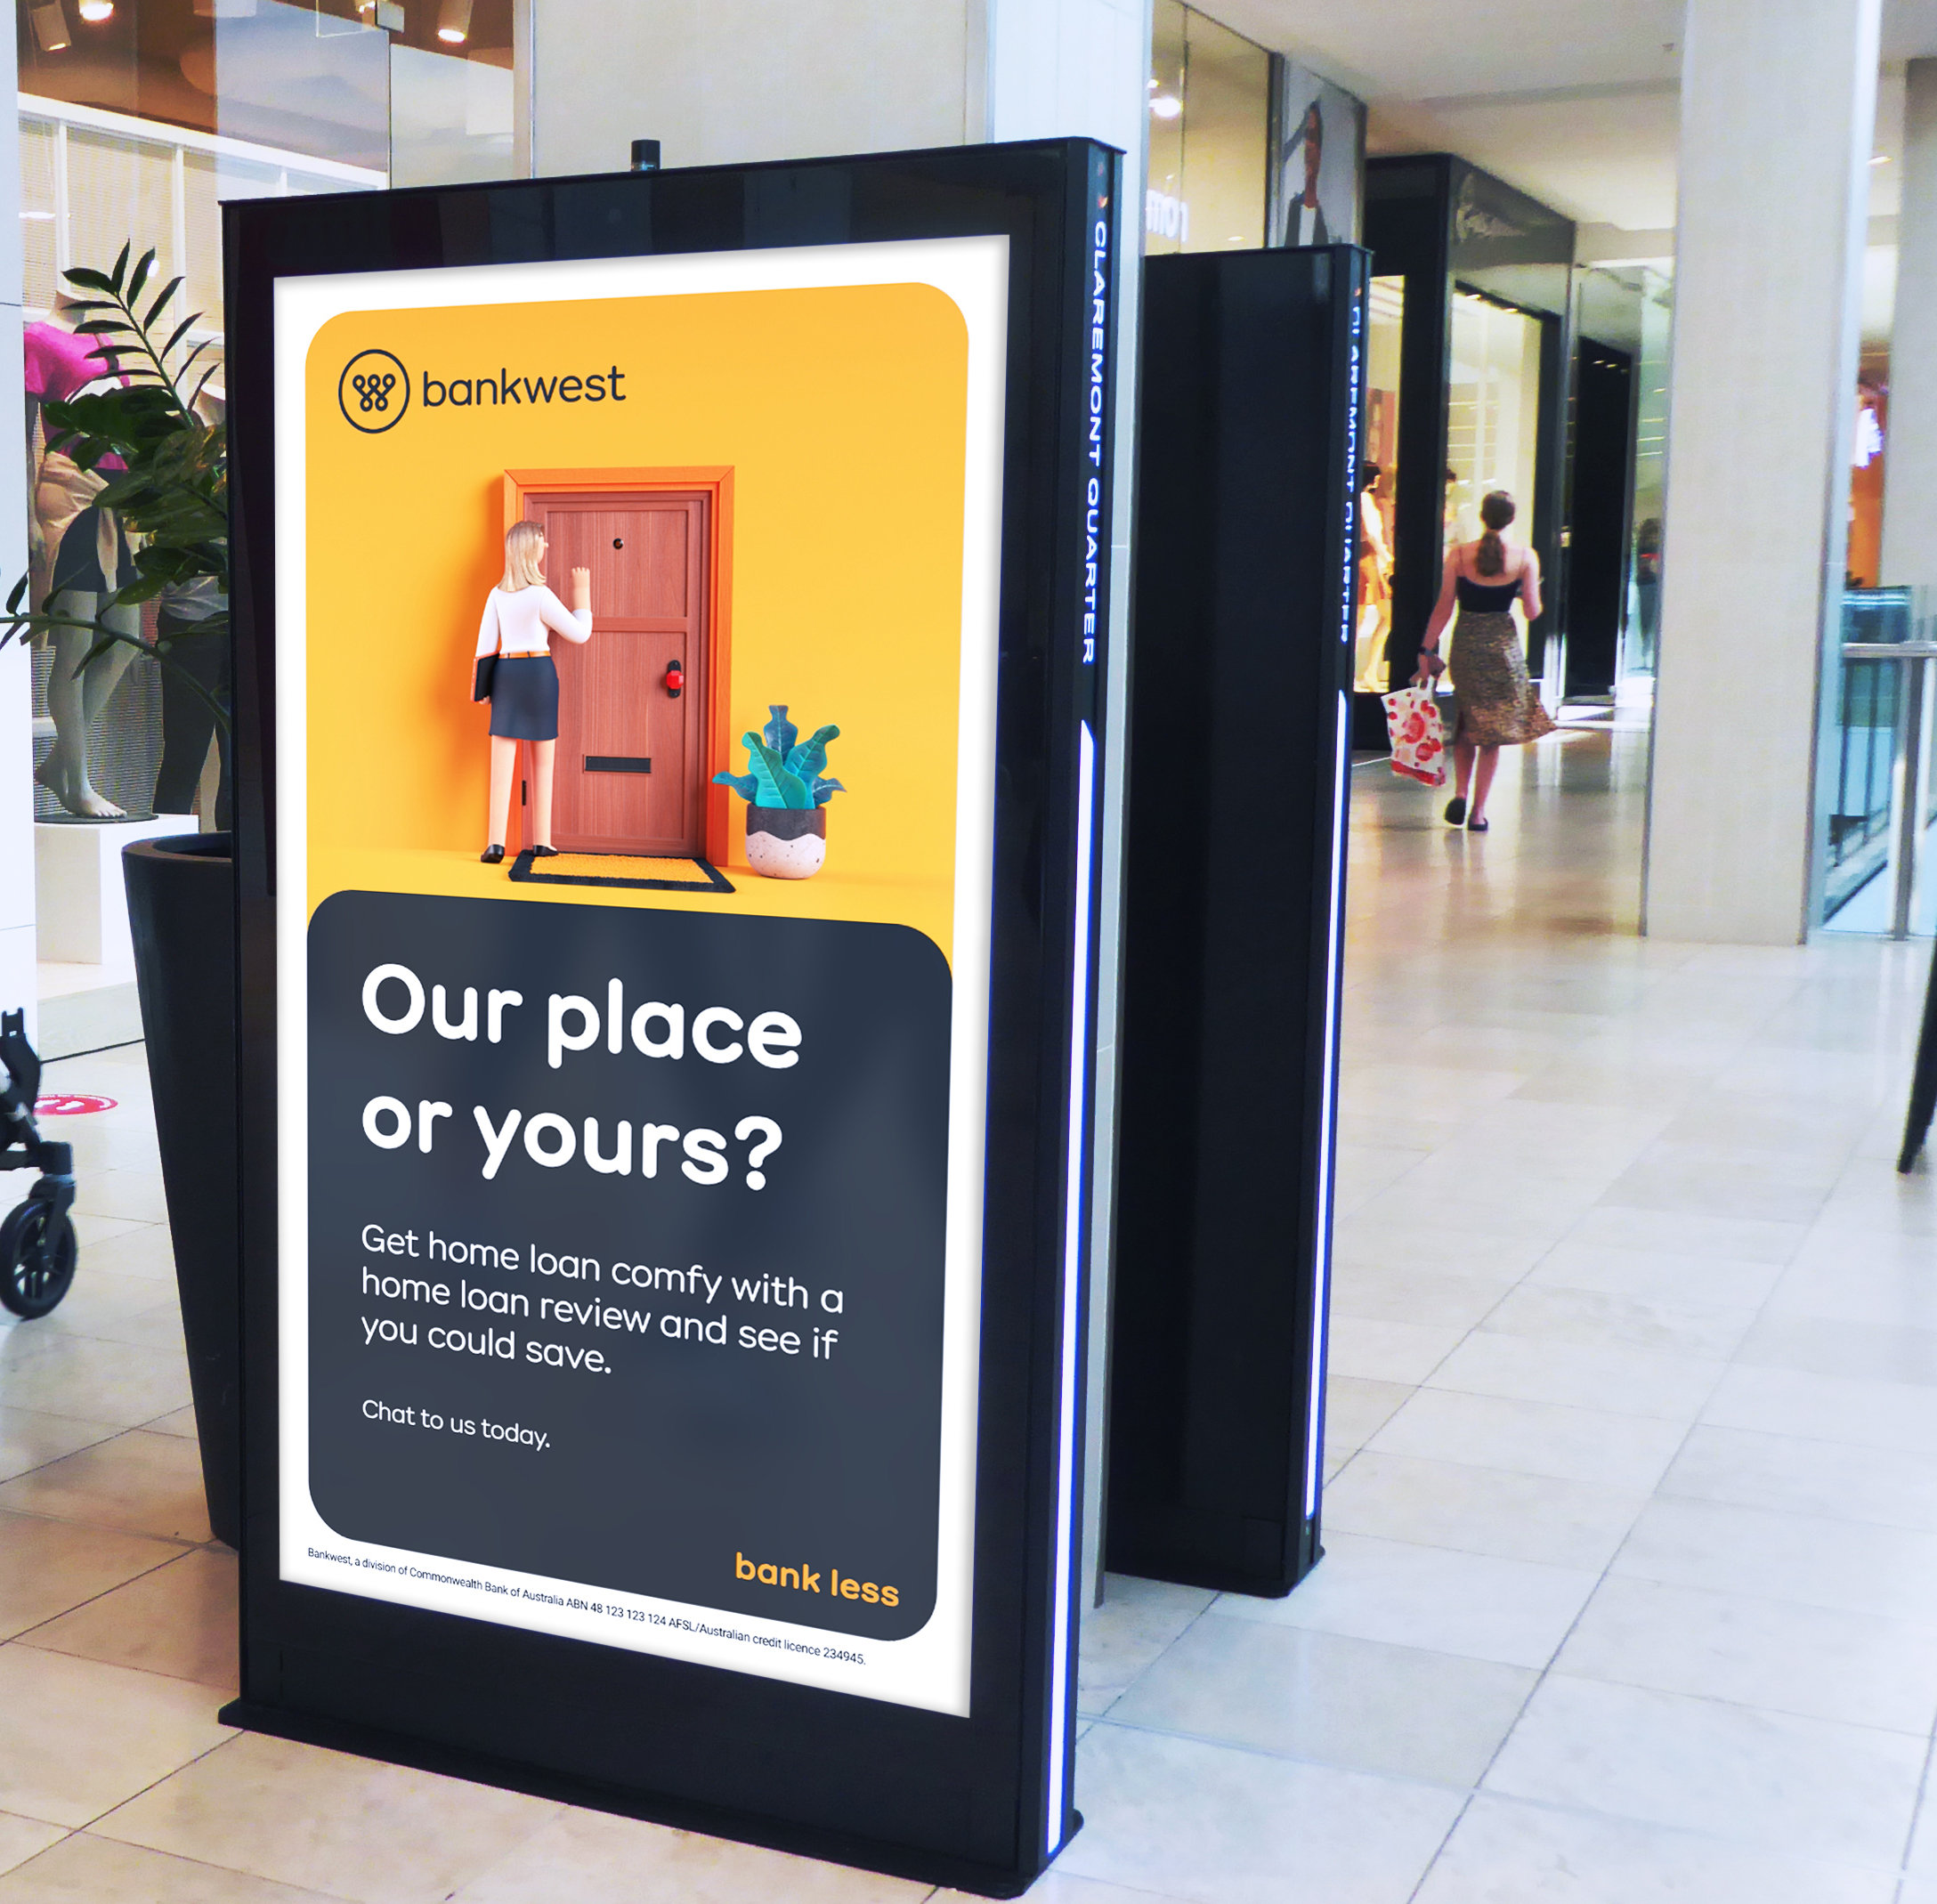
OOH increases foot traffic
People who see OOH are more likely to make a store visit.
+46%
+28%
More in-store visits
More in-store purchases
Source: Posterscope study based on an analysis of consumers recalling/exposed to OOH versus all respondents from 52 campaigns (n=33,668 respondents), 2015-2020. Not all campaigns tracked all metrics. Read more.

Slide 5
OOH lifts added brand value
Brand metrics increase among people who have seen OOH, compared to all people surveyed.
+23%
+22%
+7%
Increase in brand consideration
Increase in brand equity
Increase in brand familiarity
Source: Posterscope study based on an analysis of consumers recalling/exposed to OOH versus all respondents from 52 campaigns (n=33,668 respondents), 2015-2020. Not all campaigns tracked all metrics. Read more.

Slide 6
More research and insights may be found at Anatomy of Out of Home

