Slide 1
Public attitudes reveal Out of Home’s broad appeal
May 2021

Slide 2
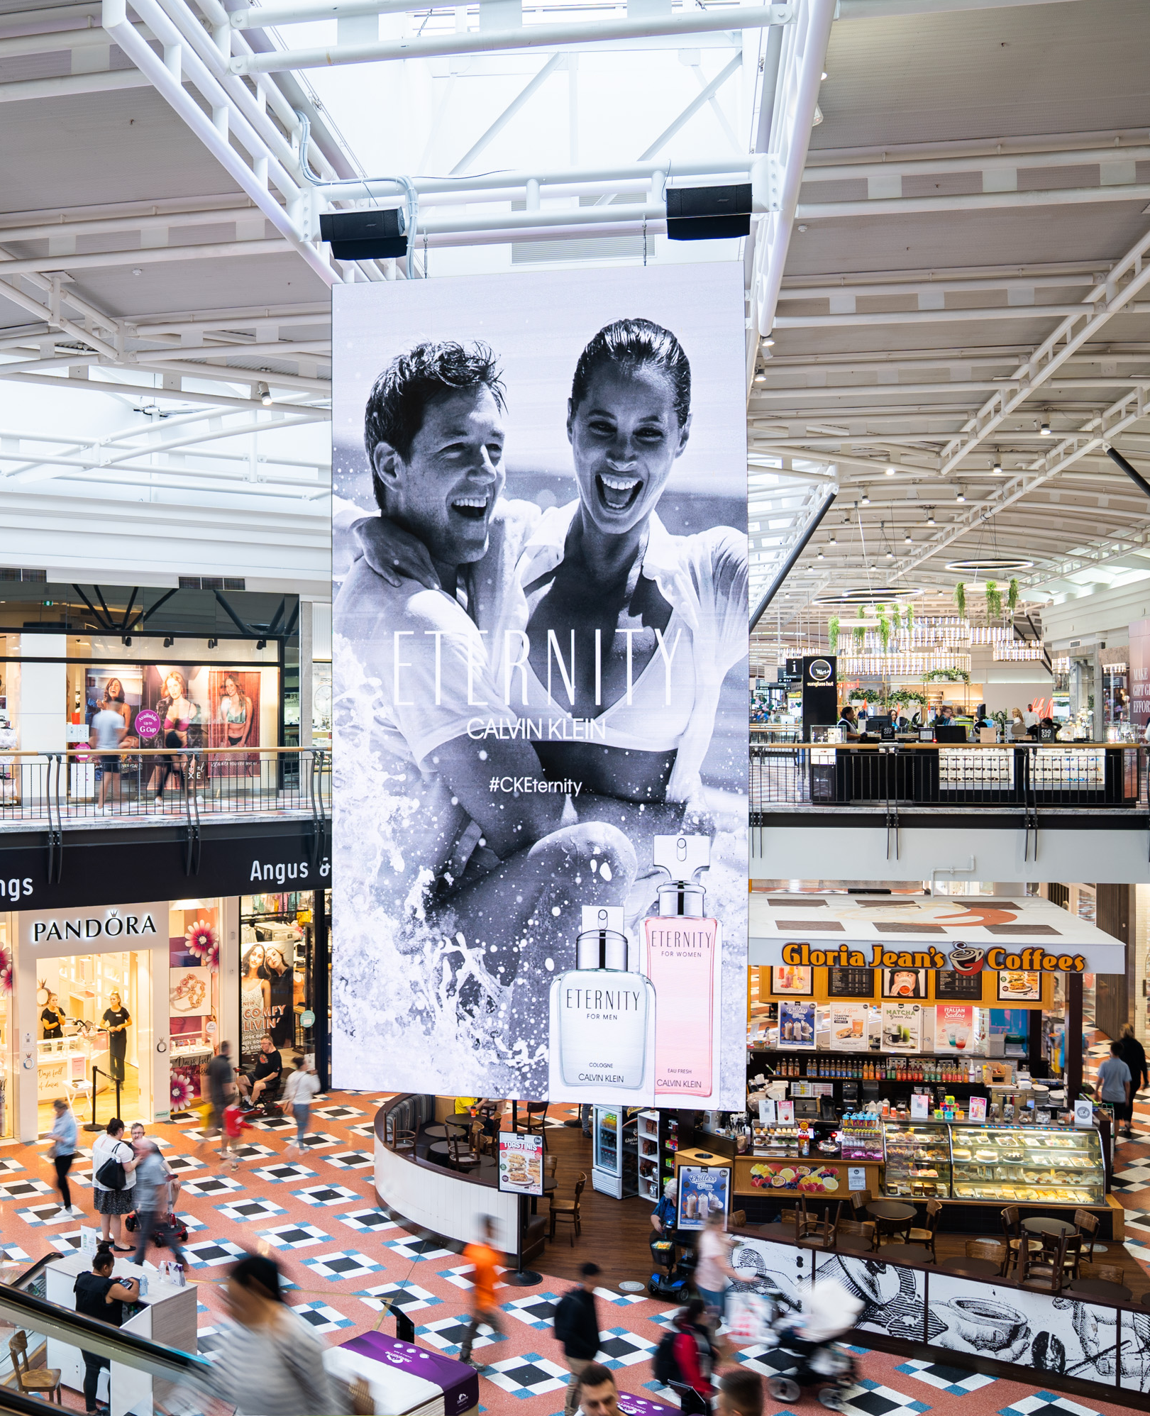
Background
Consumer research shows people like OOH
We know that Out of Home (OOH) is an effective reach medium, broadcasting to people when they are out and about. But what do our audiences think of the big, bold, and bright canvas that is Outdoor advertising?
Our research found that everyday Aussies like OOH when it’s at its best: simple, creative and informative. Reach was seen as a key strength, with OOH serving as an ‘always on’ touchpoint for people outside the home.
The survey, conducted by Dynata, ran during January in CBD and metropolitan areas across Sydney, Melbourne and Brisbane.
Source: Dynata survey commissioned by the OMA, January 2021, n=1,241, Sydney, Parramatta, Northern Beaches, Melbourne, Brisbane, Gold Coast.

Slide 3
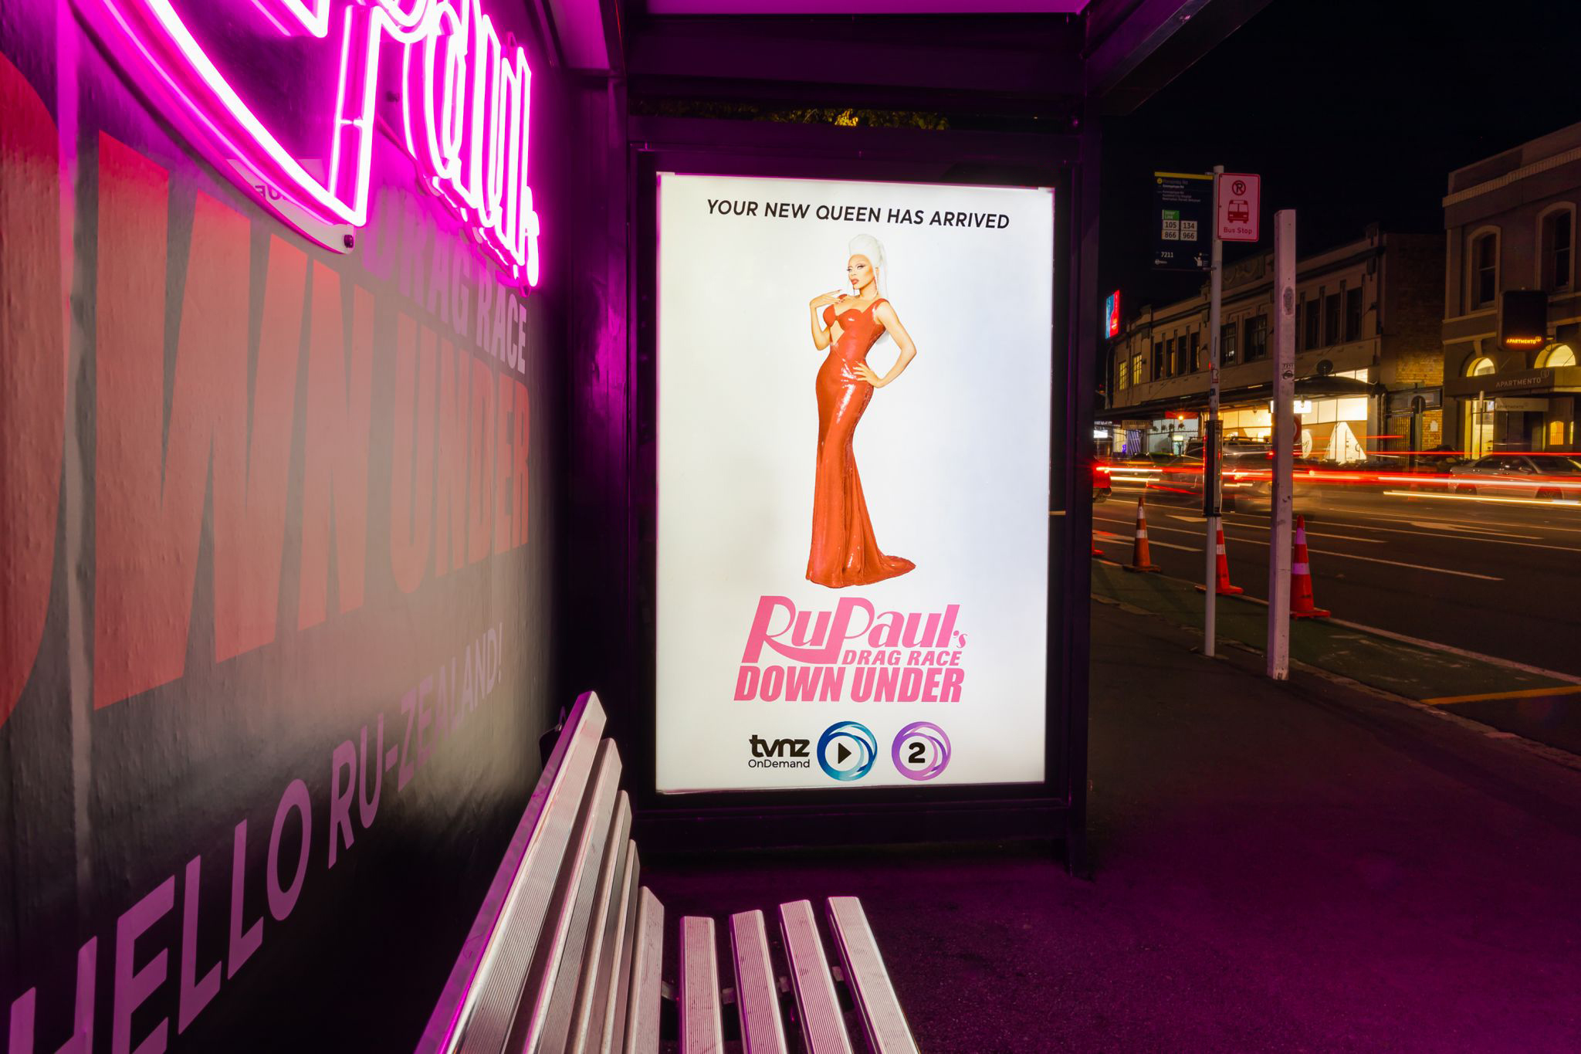
People either like or don’t mind OOH
We asked Australians how they feel about OOH advertising:
74%
Feel positive and/or neutral toward OOH
Source: Dynata survey commissioned by the OMA, January 2021, n=1,241, Sydney, Parramatta, Northern Beaches, Melbourne, Brisbane, Gold Coast.

Slide 4
Eye catching images, originality, and clarity valued most
Australians like OOH advertising that is:
67%
66%
61%
Big, bright and colourful
Simple and concise in the messages
Eye-catching and/or has beautiful images
Source: Dynata survey commissioned by the OMA, January 2021, n=1,241, Sydney, Parramatta, Northern Beaches, Melbourne, Brisbane, Gold Coast.

Slide 5
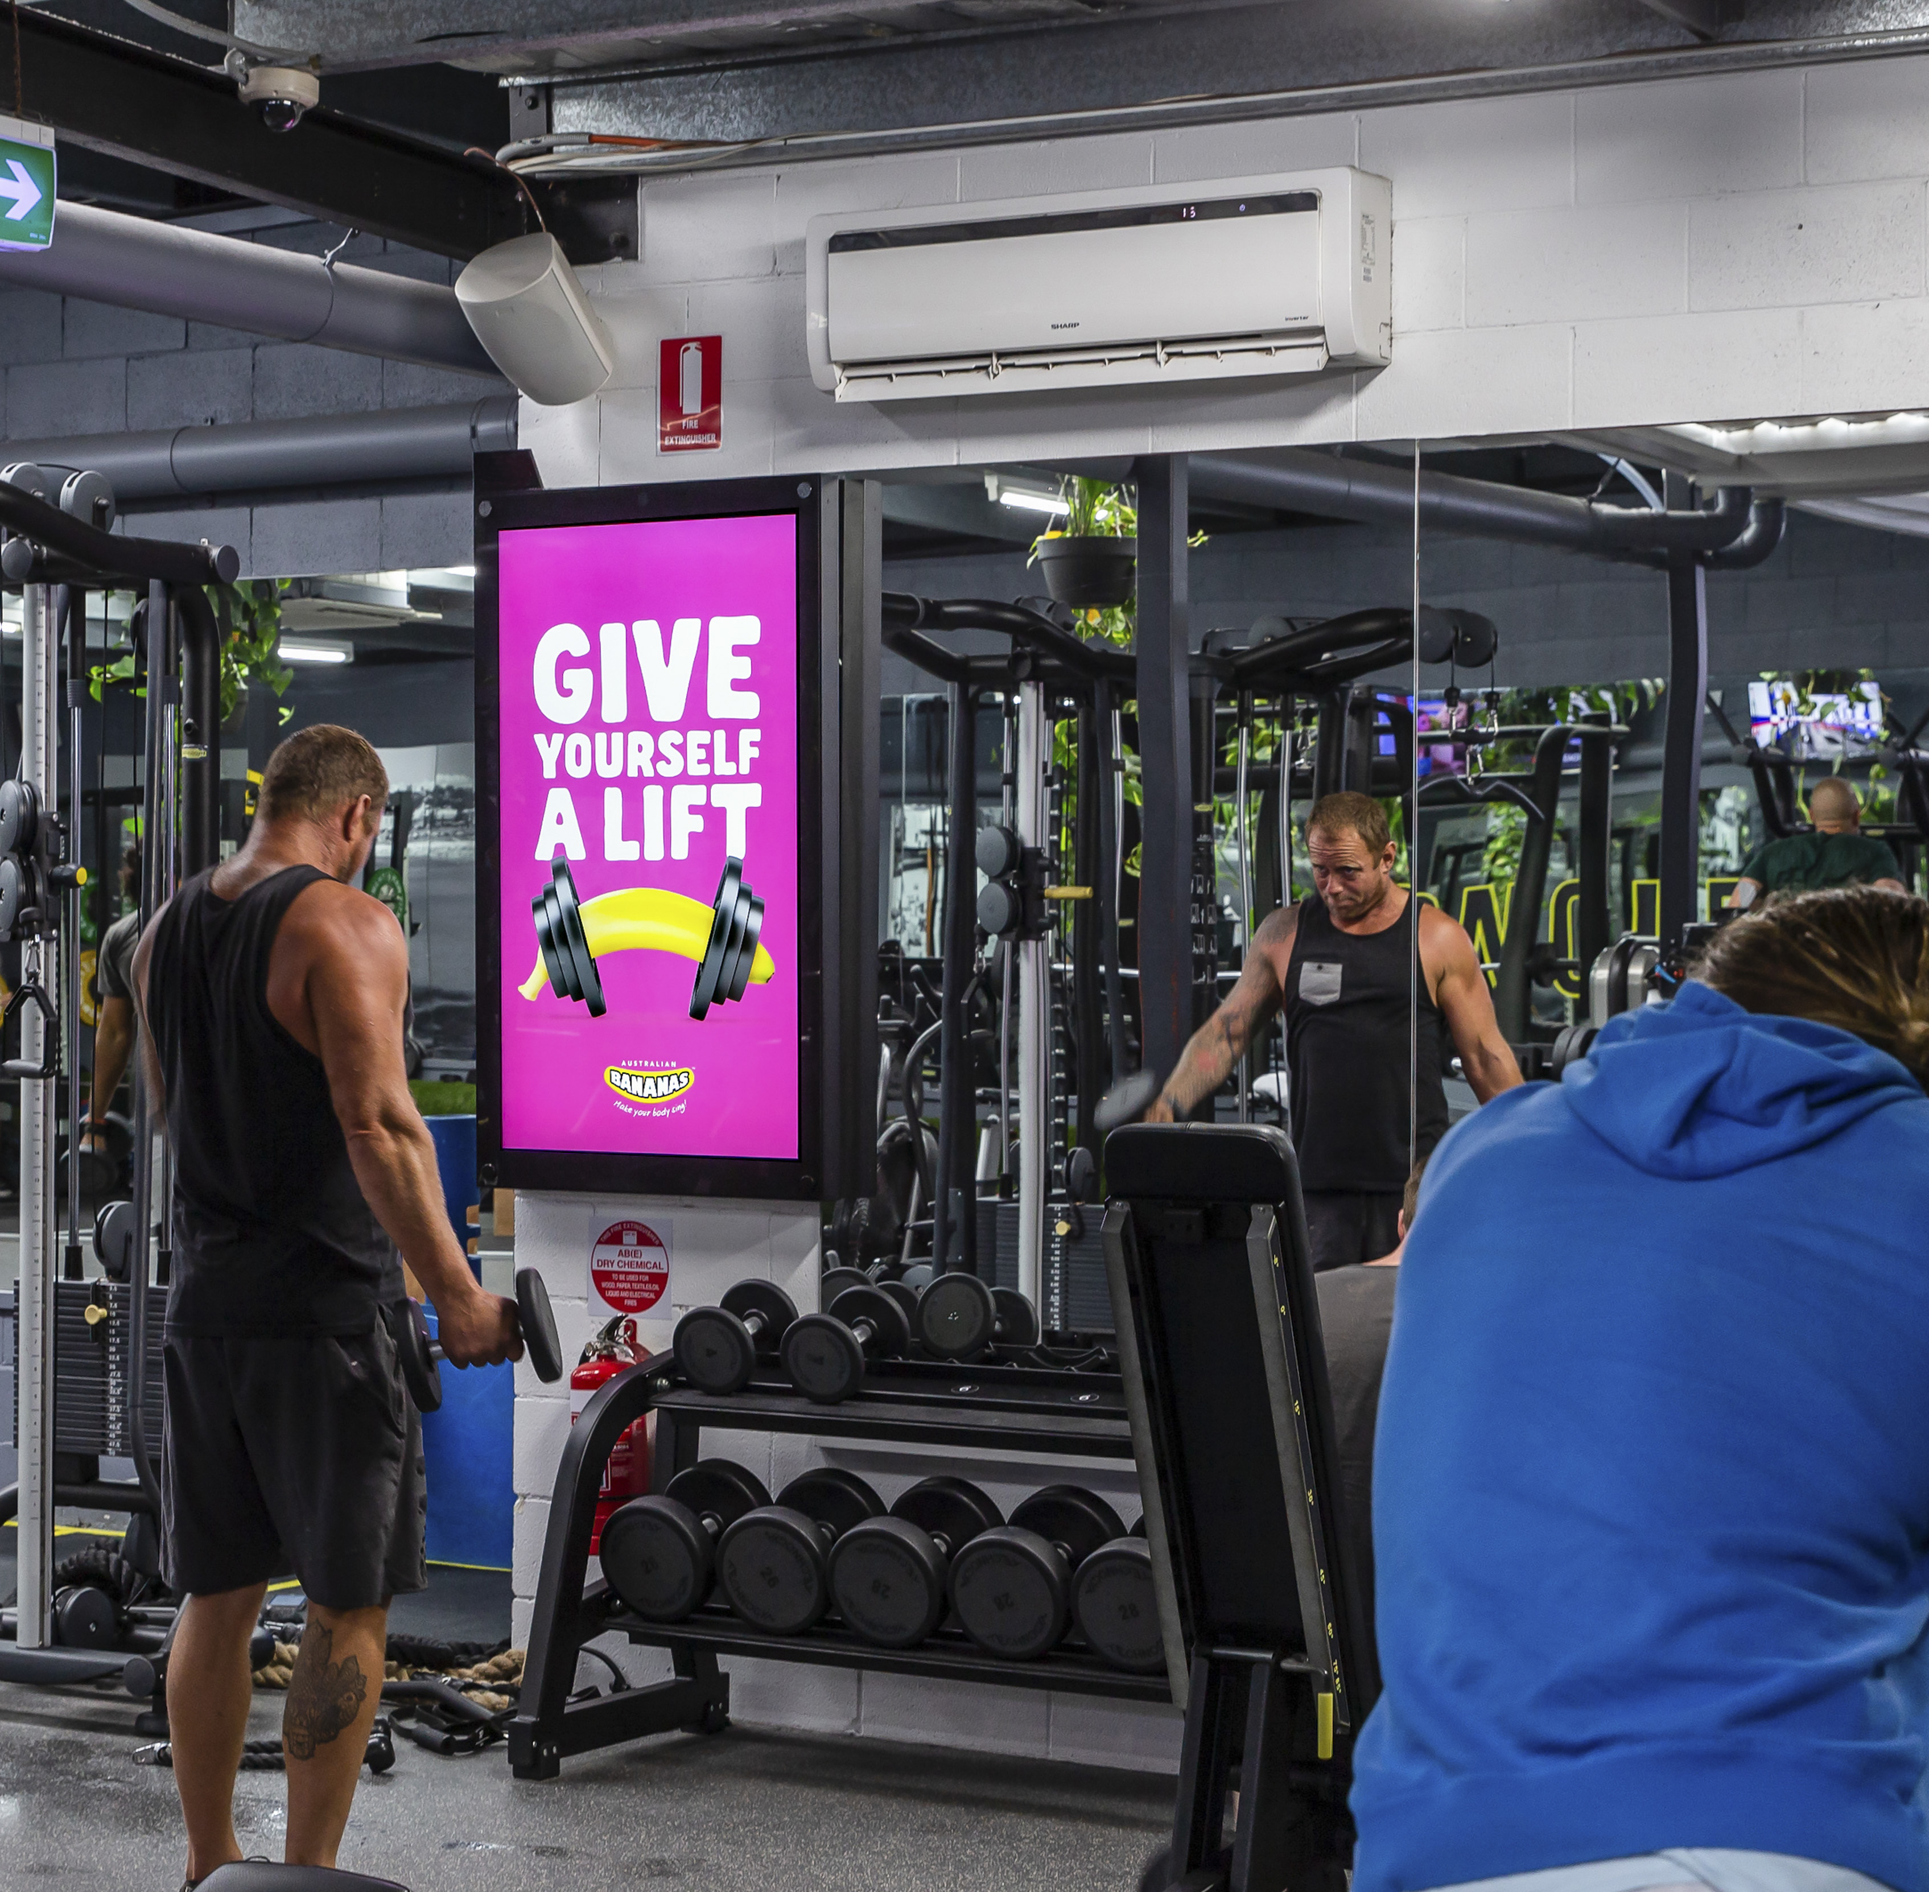
It reaches and informs them outside the home
What Australians think are the key strengths and/or benefits of OOH advertising:
71%
70%
Reaches a mass audience
Reaches people who may not see other media
Source: Dynata survey commissioned by the OMA, January 2021, n=1,241, Sydney, Parramatta, Northern Beaches, Melbourne, Brisbane, Gold Coast.

Slide 6
More research and insights may be found at Anatomy of Out of Home

