Slide 1
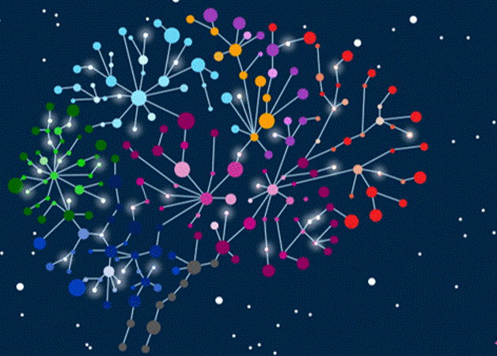
Special edition: The Neuro Impact of Out of Home
September 2021

Slide 2
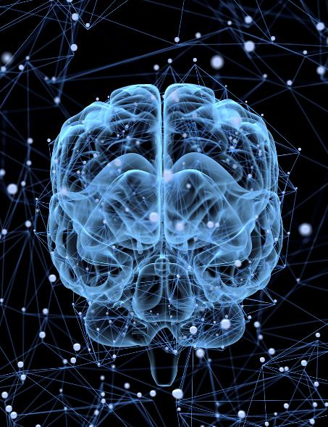
All it takes is a glance
How does Out of Home (OOH) advertising work in the brain? Do digital signs really have an ‘X-factor’? How do classic and digital signs compare?
Using neuroscience, we can answer these questions and show how advertising, seen in a quick glance, can be effective. What’s more, the impact of both classic and digital signs is within the range of a 15 second television commercial or 30 second radio spot; with digital signs averaging 63 per cent higher impact.
The Neuro Impact of Out of Home study was conducted by Neuro-Insight for the OMA. At over one million data points, it is the world’s largest media neuroscience study.
Source: OMA study conducted by Neuro-Insight, Neuro Impact of Out of Home, September 2021.

Slide 3
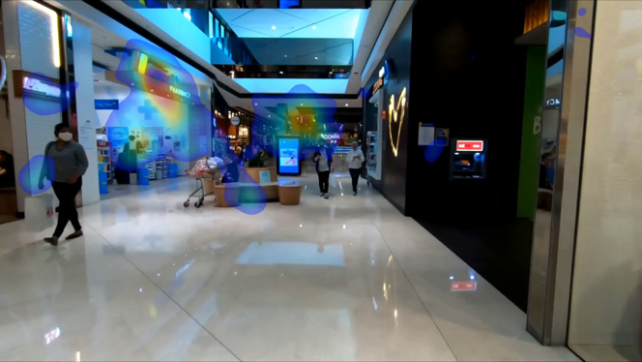
About the study
In conducting the research for the OMA, Neuro-Insight used eye-tracking and brain-imaging technology to analyse the brain’s neural responses to seeing advertising on classic and digital signs.
More than 2,000 people participated in the study and their interactions with over 800 classic and digital signs recorded. By measuring peaks in long-term memory encoding and emotional intensity in the brain, cornerstones of the Neuro Impact Factor formula, Neuro-Insight could provide scientific proof of the impact of OOH advertising on the subconscious.
The research accounted for variables that drive different levels of impact including environment, size, transitions, location and audience mode.
Source: OMA study conducted by Neuro-Insight, Neuro Impact of Out of Home, September 2021

Slide 4
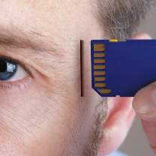
The Neuro Impact Factor formula
High levels of long-term memory encoding and emotional intensity at peak branding moments are highly correlated to advertising effectiveness.
Long term memory encoding
Emotional Intensity
Peaks
Source: OMA study conducted by Neuro-Insight, Neuro Impact of Out of Home, September 2021

Slide 5
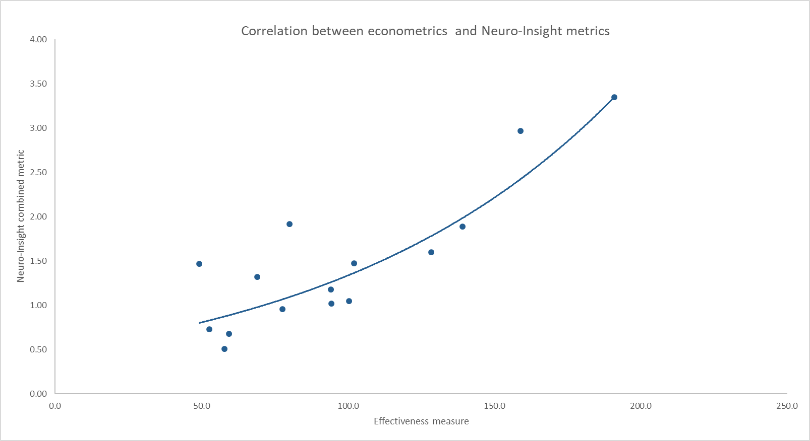
Neuro Impact Factor correlates 86 per cent to sales
CORRELATION BETWEEN ECONOMETRICS AND NEURO-INSIGHT METRICS
HIGH
THE RELATIONSHIP
NEURO IMPACT FACTOR
LOW
ADVERTISING SALES EFFECTIVENESS SCORE
Source: OMA study conducted by Neuro-Insight, Neuro Impact of Out of Home, September 2021

Slide 6
Best performing ads score higher for memory and emotion
Ebiquity Modelled Sales Data on 3000+ Campaigns
9 pairs of representative ads chosen in different categories
Media investment was equal on all pairs … but performance was not
Ads with higher memory and emotional intensity had a better sales performance
Figures for each brand based on target audience for that category. These responses are for the key branding moment of each ad
Source: OMA study conducted by Neuro-Insight, Neuro Impact of Out of Home, September 2021

Slide 7
Classic signs peak brain responses four times*
The green line is set at 0.7, an important threshold classified by neuroscientists as the point where strong or ‘peak’ memory encoding occurs.
MEMORY & EMOTION
CLASSIC SIGN-TYPICAL RESPONSE
ACTIVITY
1.0
0.8
0.6
0.4
0.2
0.0
Source: OMA study conducted by Neuro-Insight, Neuro Impact of Out of Home, September 2021. *During a typical exposure.

Slide 8
Digital signs peak brain responses five times
On average, digital signs peak memory and emotion more times during a typical exposure than classic signs.
MEMORY & EMOTION
DIGITAL SIGN-TYPICAL RESPONSE
ACTIVITY
1.0
0.8
0.6
0.4
0.2
10
Time (Sec)
0.0
Source: OMA study conducted by Neuro-Insight, Neuro Impact of Out of Home, September 2021

Slide 9
Digital has 63 per cent higher average impact
Digital compared to classic at an index of 100 showing the range of impact for both formats.
254
172
163
100
98
72
INDEX
CLASSIC – ALL
DIGITAL – ALL
Source: OMA study conducted by Neuro-Insight, Neuro Impact of Out of Home, September 2021

Slide 10
Classic and digital side-by-side comparison
The average of all responses to advertising on classic and digital signs. Warmer colours indicate areas of higher Neuro Impact.
Source: OMA study conducted by Neuro-Insight, Neuro Impact of Out of Home, September 2021

Slide 11
Use classic and digital Out of Home together
Classic offers a consistent message for an established duration, ultimately leading to greater share of voice. Digital offers tactical opportunities to use context, relevancy, immediacy.
Both offer opportunities to build a brand and increase the impact and effectiveness of your whole campaign.
Share of Voice
Tactical opportunities
Creative impact
Source: OMA study conducted by Neuro-Insight, Neuro Impact of Out of Home, September 2021

Slide 12
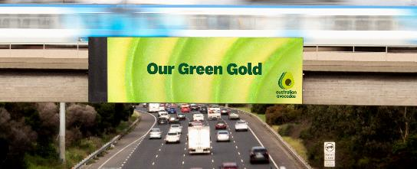
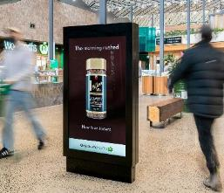
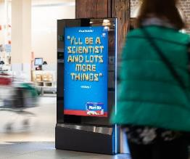
A glance at Out of Home is all it takes to deliver impact

Slide 13
Watch the webcast on demand.
For more information on the Neuro Impact of Out of Home, or to book a presentation for your team, contact emma.ward@oma.org.au
More research and insights may be found at
Anatomy of Out of Home

