Slide 1
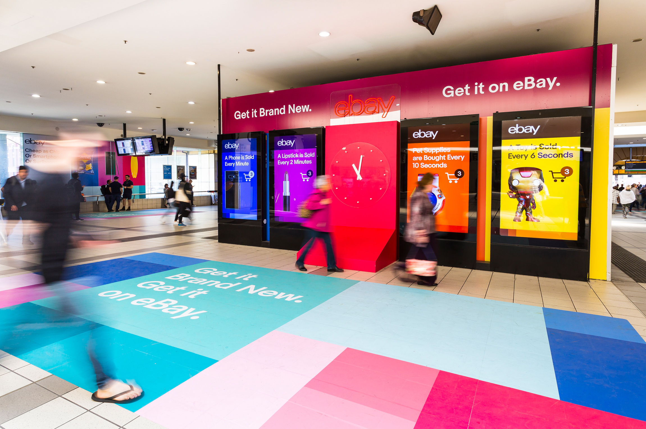
Out of Home AUDIENCE GROWTH IN 2019
October 2019

Slide 2
Out of Home (OOH) audiences are growing
In 2019 OOH audiences grew
2.4%
vs population growth of 1.5%.
Source: MOVE October 2019 data release, comparing change in audience of the same signs year on year

Slide 3
OOH audiences are growing faster than the population
Since 2010 audiences have grown
28.7%
vs 18.8% for the population.
Source: MOVE October 2019 data release, comparing change in audience of the same signs year on year since move launched

Slide 4
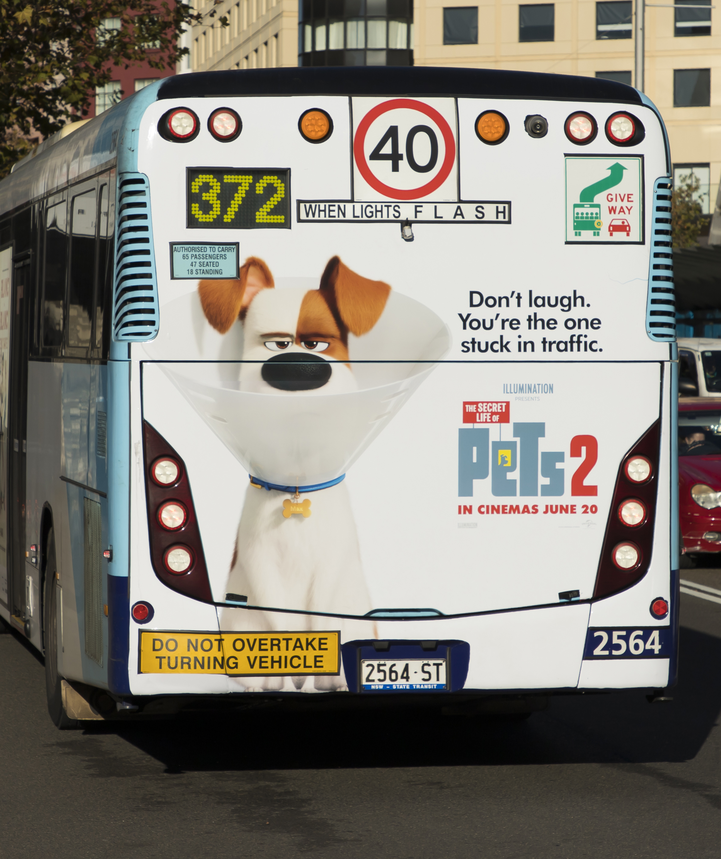
Increasing reach
In 2019 there are
217K
MORE people* in OOH environments each day.
*on average
Source: MOVE October 2019 data release,

Slide 5
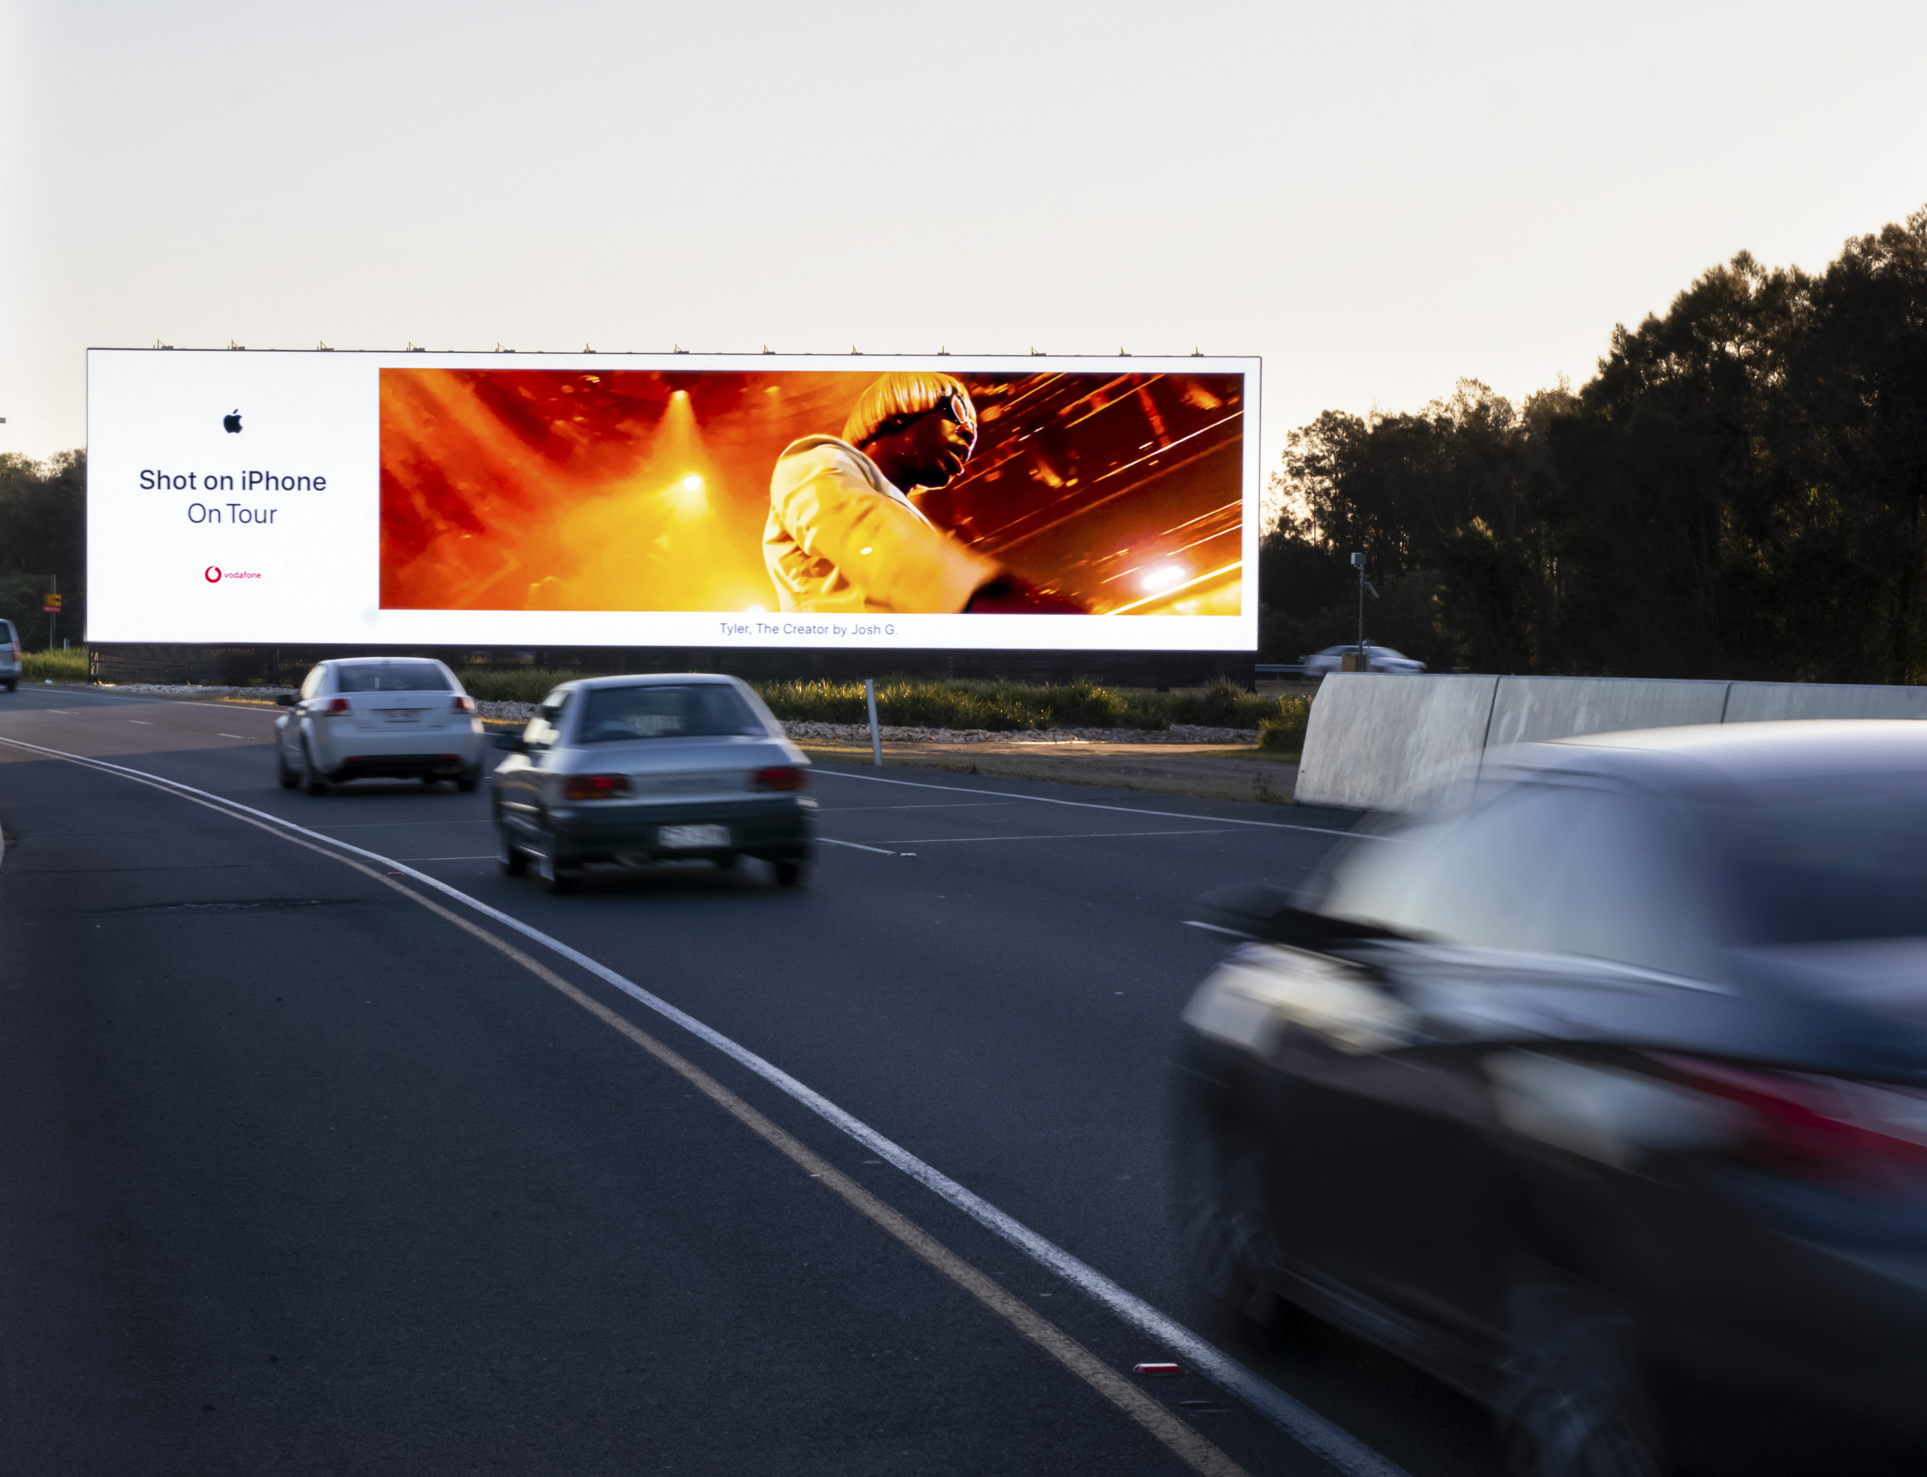
Broadcast delivery
OOH advertising reaches
13M
Australians in capital cities where they live, work, shop, and socialise. Resulting in increased exposure for the 77,500 advertising faces measured by MOVE.
Source: MOVE October 2019 data release,

